Slide 1



MODUL LSC200
ADVANCED
LITERATURE
SEARCH I:
SCOPUS

Slide 2
MODUL OVERVIEW / INTRO
What is LSC200 Module?
This module help postgraduate students and researchers in completing their research work. The aim of this module is to introduce peer-reviewed and citation database that produce high quality articles for their research.
.
Module highlight :
1.Scopus Source List
2.Basic Search
3.Authors Search
4.Affiliations Search
5.Advanced Search in Scopus
6.Analyze Search Results
7.Article Metrics in Scopus
8.Personalization
1
2
Teaching Medium
  Online via Webex, Google Meet, Google Classroom
2. Face to Face : Computer Lab (After MCO period)
3
Duration
2 Hour(s)
4

Slide 3

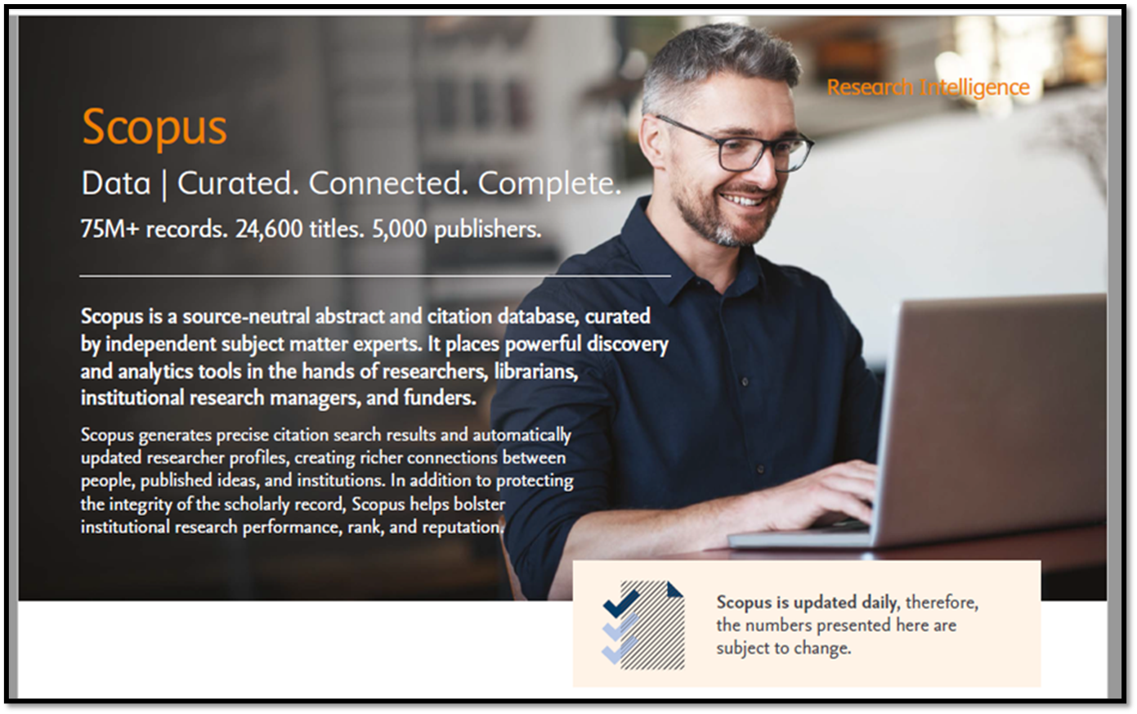
Scopus Fact Sheet : https://www-elsevier-com.ezaccess.library.uitm.edu.my/__data/assets/pdf_file/0017/114533/Scopus_GlobalResearch_Factsheet2019_FINAL_WEB.pdf

Slide 4
TIPS > NAVIGATION BAR
SOURCES:
Click Sources to browse an alphabetical listing or search for available Scopus sources and titles
SEARCH:
Click Search to open the Scopus search forms: Document, Author, Affiliation and Advanced
ANALYTICS:
Click Analytics to open the Journal Analyzer. Compare up to 10 Scopus sources on the number of citations, documents and percentage not cited
ALERTS:
Click Alerts to view a list of a previously saved search, document citation, or author citation alerts
MY LIST:
Click My list to view temporary lists of documents. You can Also choose to save documents in a basket permanently
MY SETTINGS:
Click My setting to view or modify your account or profile information and to set up preferences

Slide 5
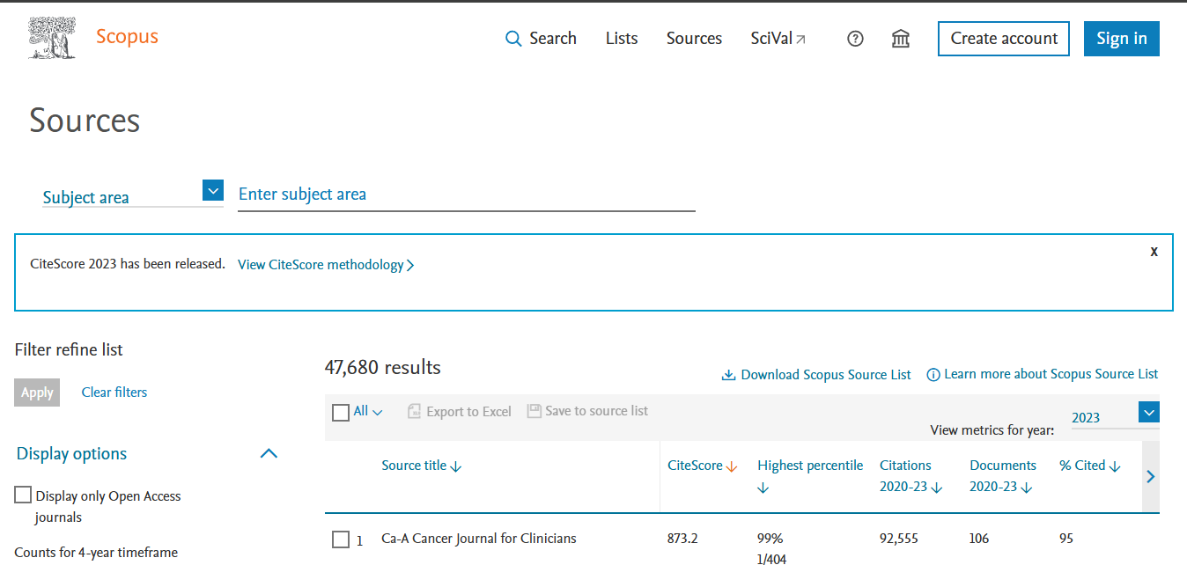

SCOPUS SOURCES LIST
  The Scopus list of journals consists of indexed publications that area either serial or non-serial
  Examples of serial publications are journals, annuals (such as reports, yearbook and directories), and book these are assigned on ISSN (International Standard Serial Number).
  Non-serials include one-off books, monographs, reports, etc, and these are assigned an ISBN (International Book Number).
  From the browse sources tab, you have the option to download a complete source title list to Microsoft Excel.

Slide 6
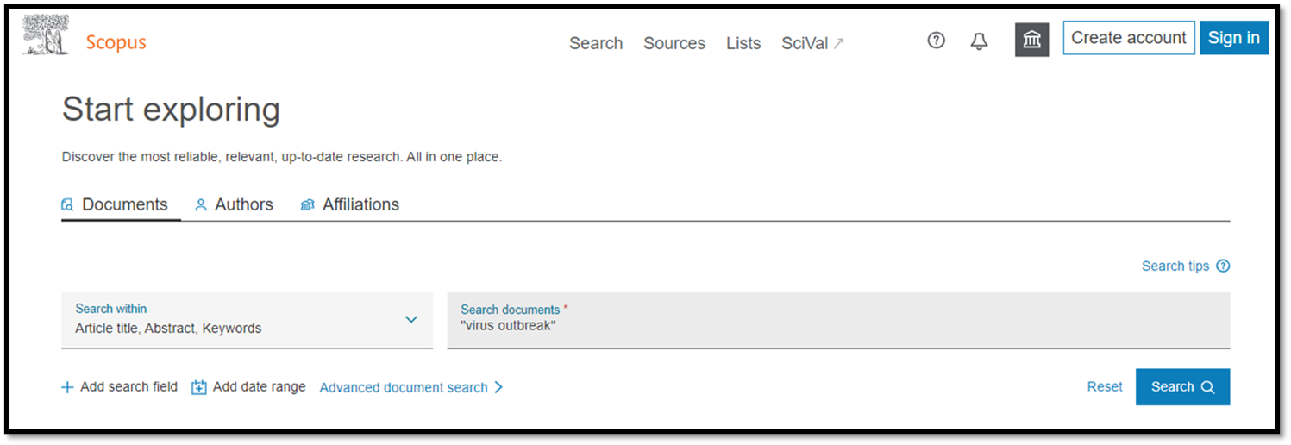
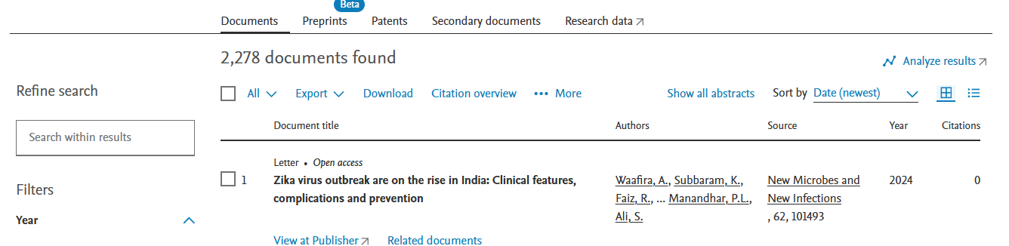
BASIC SEACRH > DOCUMENTS SEARCH
Document search > Type keyword and filter your search

Slide 7
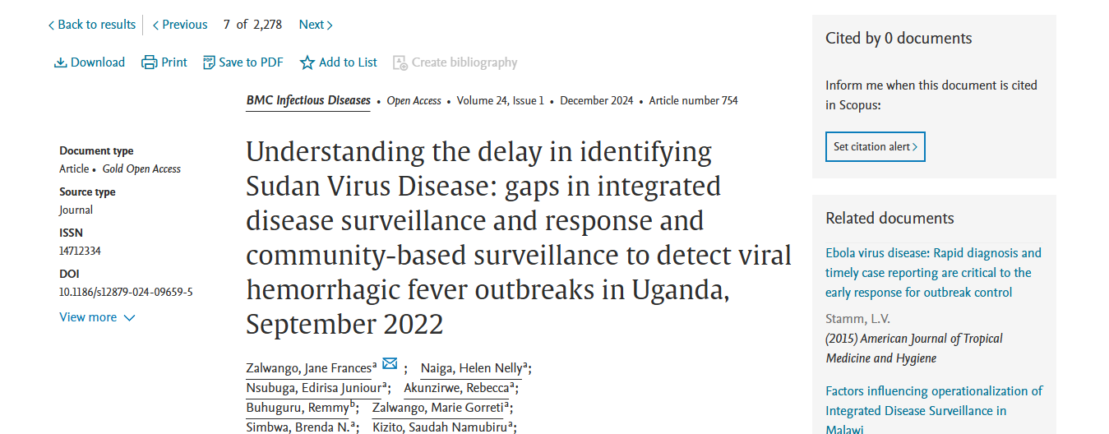
DOCUMENTS DETAILS - SAVE TO PDF

Slide 8
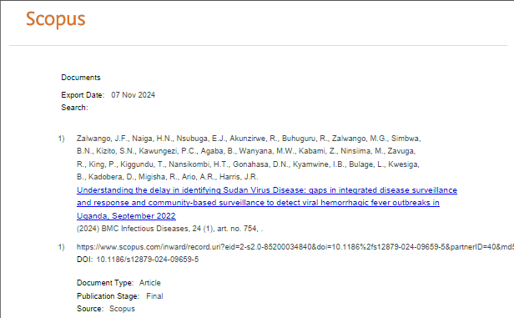
DOCUMENTS DETAILS - SAVE TO PDF
PDF output only supports the following
citation information:
✔Author(s)
✔Document title
✔Year
✔Source Title
✔Volume, issue, pages
✔Citation count
✔Source & document type
✔Publication Stage
✔Access Type

Slide 9
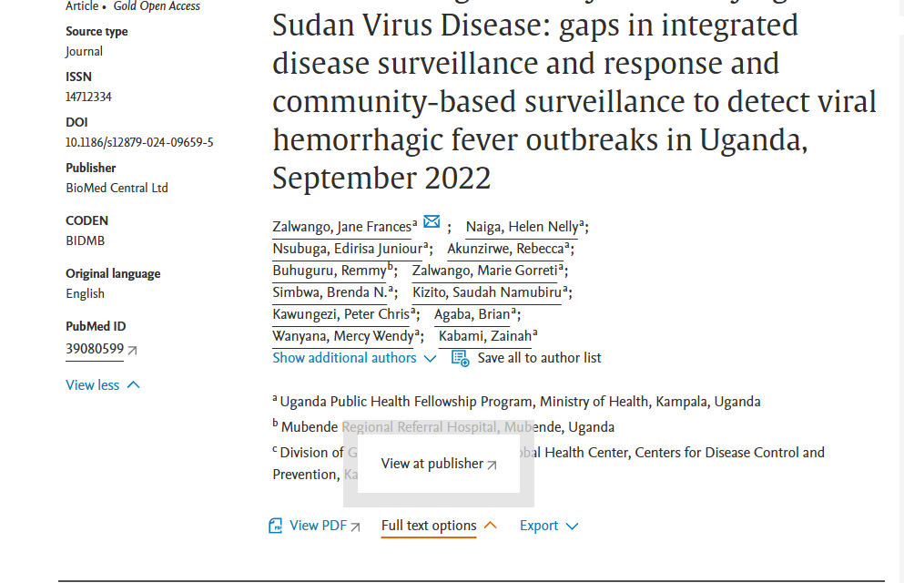
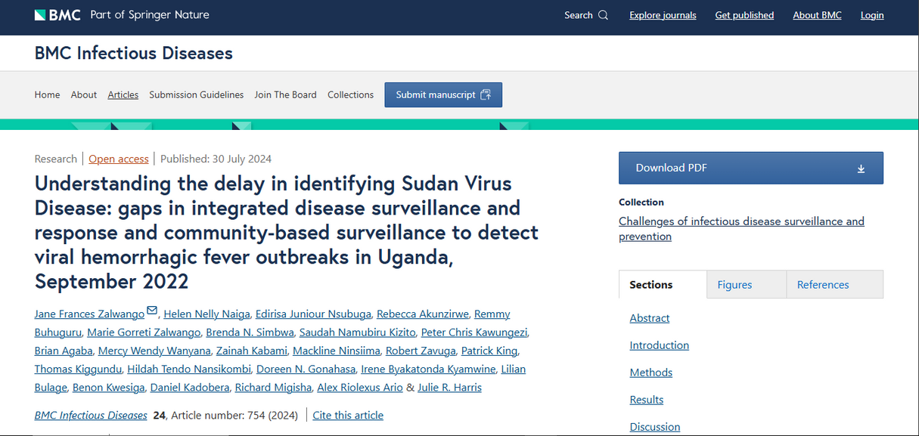
DOCUMENTS DETAILS - VIEW AT PUBLISHER
✔ By clicking View at Publisher, user can link to the full text on each publisher’s website if authorized.
✔ If UiTM Subscribed to selected Journal / Online databases , user can view/download full text @PDF.

Slide 10
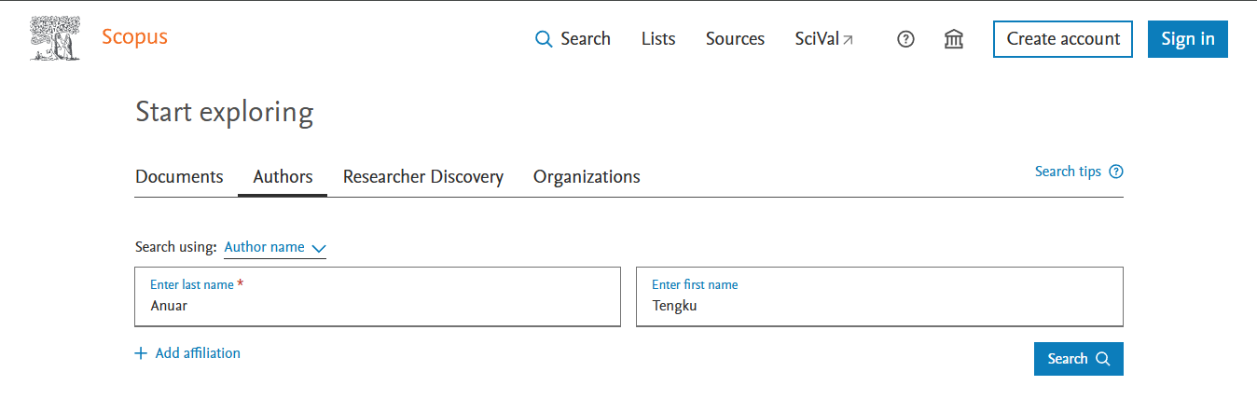
AUTHOR SEARCH
Enter Author last name & Enter Author first name

Slide 11
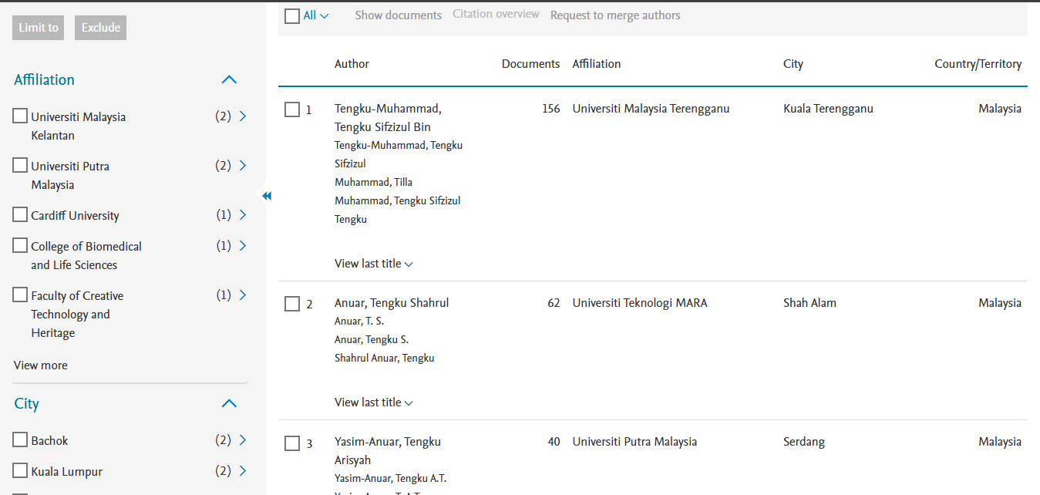

AUTHOR SEARCH > REFINE RESULTS
Refine Results > Anuar, Tengku Shahrul (UiTM)

Slide 12
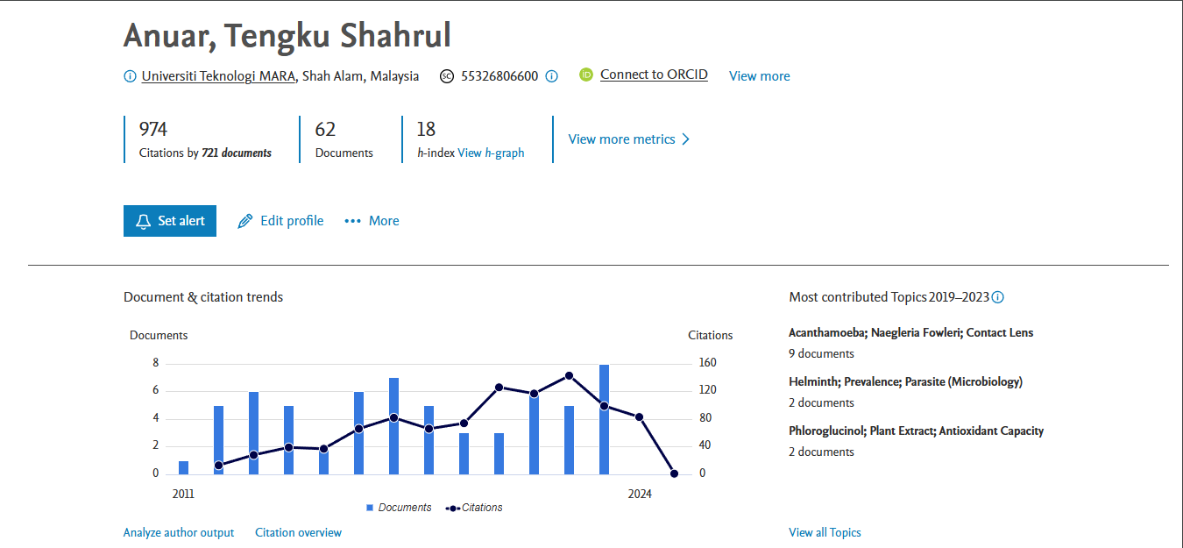
AUTHOR METRICS OVERVIEW

Slide 13
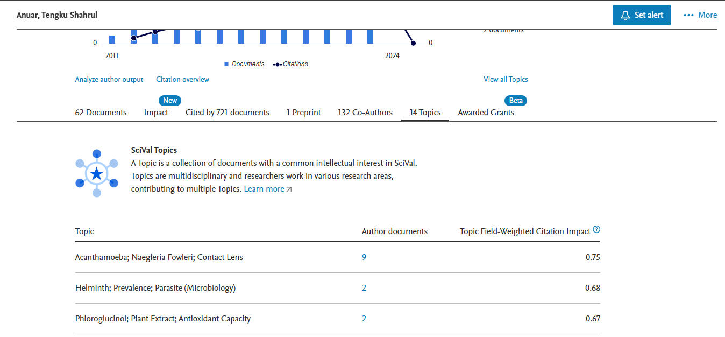
AUTHOR > TOPICS
Documents, Cited by, Topics

Slide 14
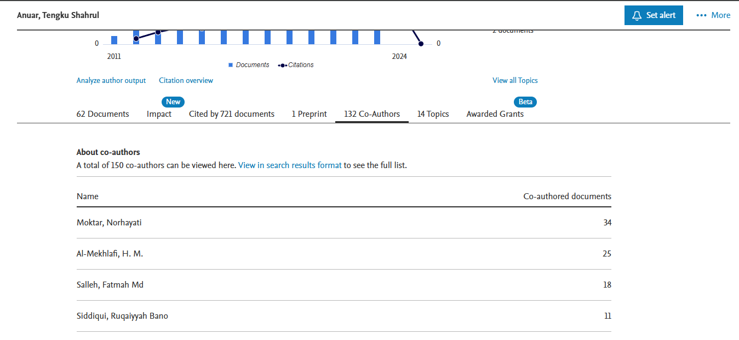
AUTHORS > CO-AUTHORS

Slide 15
ANALYZE AUTHOR OUTPUT

Slide 16
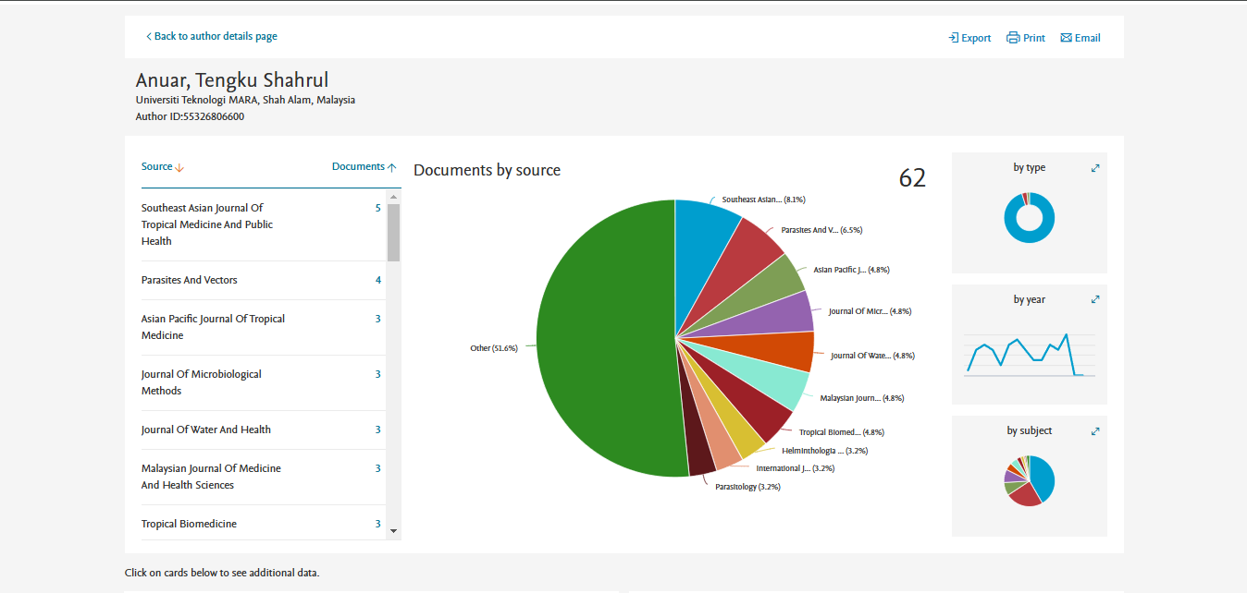
ANALYZE AUTHOR OUTPUT

Slide 17
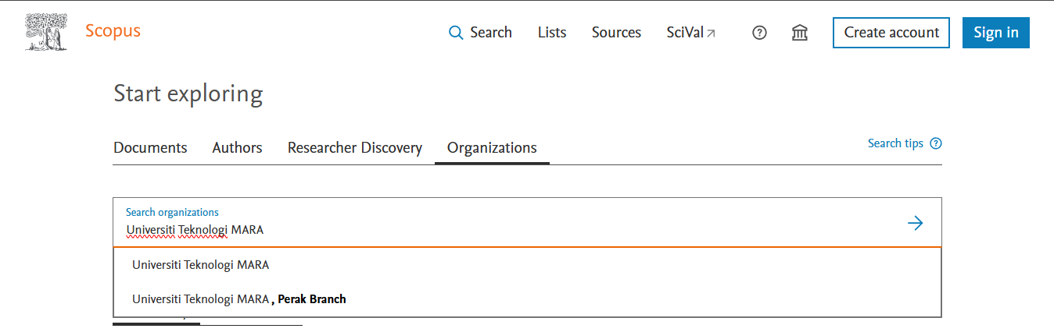
SEARCH AFFILIATION / ORGANIZATION
Search Organizations Universiti Teknologi MARA
*The organization (university, laboratory etc.) to which an author is affiliated

Slide 18
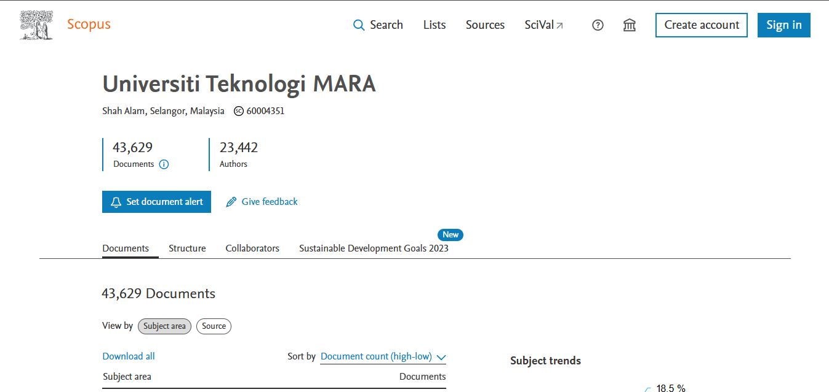
AFFILIATION / ORGANIZATION DETAILS

Slide 19
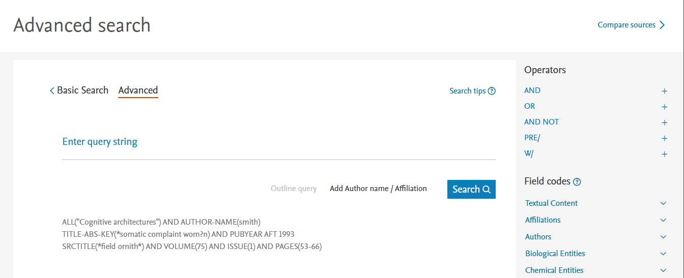


ADVANCED SEARCH
On the Advanced search form, you can create a search using field codes, proximity operators, or Boolean operators to narrow the scope of the search.
Advanced Search Tips: https://service.elsevier.com/app/answers/detail/a_id/11365/supporthub/scopus/#tips
Boolean operators to combine different search queries while Proximity operators find words near / within a specified distance of each other.
Boolean operators - OR, AND, AND NOT
Proximity operators - W/n, PRE/n

Slide 20
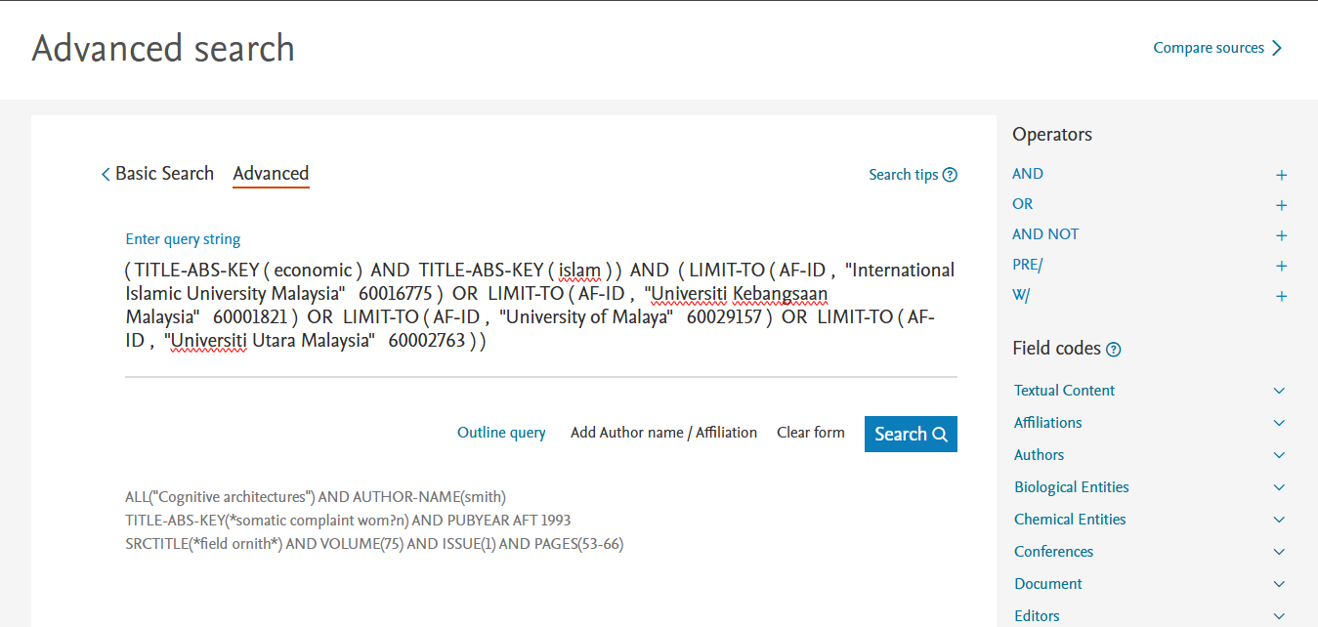
ADVANCED SEARCH
Combine / advance search - allows you to enter complex search queries using field codes, boolean and proximity operators to narrow the scope of your search. Example:
( TITLE-ABS-KEY ( economic ) AND TITLE-ABS-KEY ( islam ) ) AND ( LIMIT-TO ( AF-ID , "International Islamic University Malaysia" 60016775 ) OR LIMIT-TO ( AF-ID , "Universiti Kebangsaan Malaysia" 60001821 ) OR LIMIT-TO ( AF-ID , "University of Malaya" 60029157 ) OR LIMIT-TO ( AF-ID , "Universiti Utara Malaysia" 60002763 ) )

Slide 21
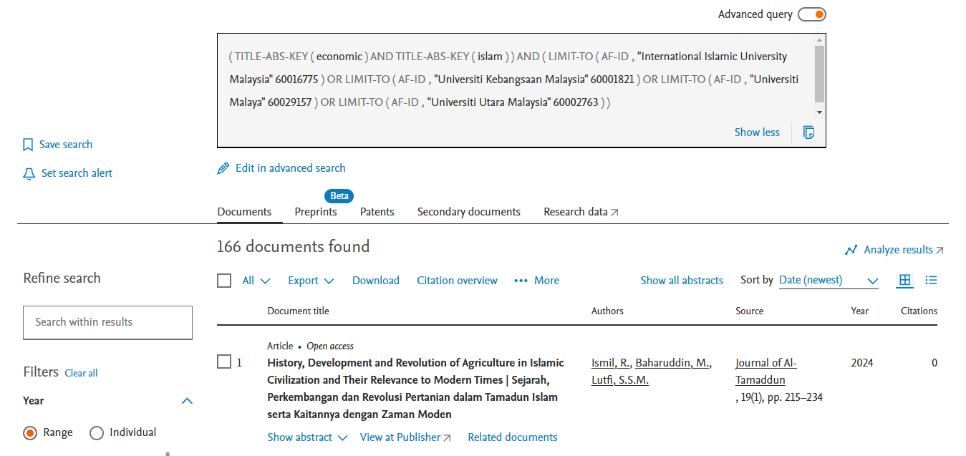
166 DOCUMENT RESULTS

Slide 22
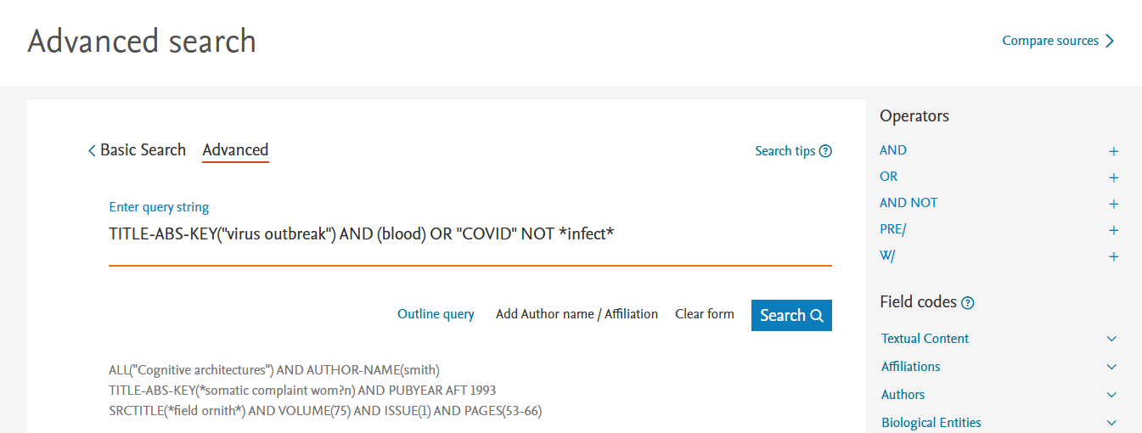
ADVANCED SEARCH
TITLE-ABS-KEY("virus outbreak") AND (blood) OR "COVID" NOT *infect*

Slide 23
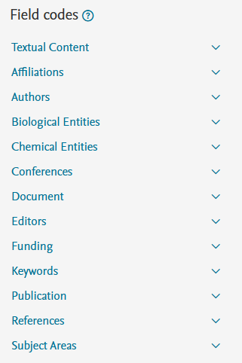
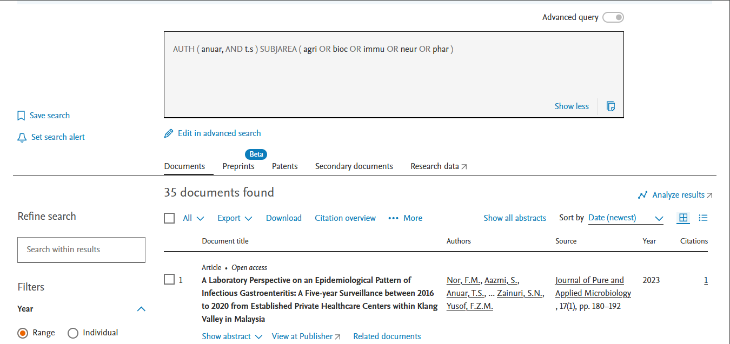
FIELD CODES SEARCH IN ADVANCED SEARCH
The examples for “operator” and “field codes” can be viewed by clicking on an operator or field code. A pop out box will appear with the respective example text.
AUTH(Anuar, T.S) SUBJAREA(AGRI OR BIOC OR IMMU OR NEUR OR PHAR)

Slide 24
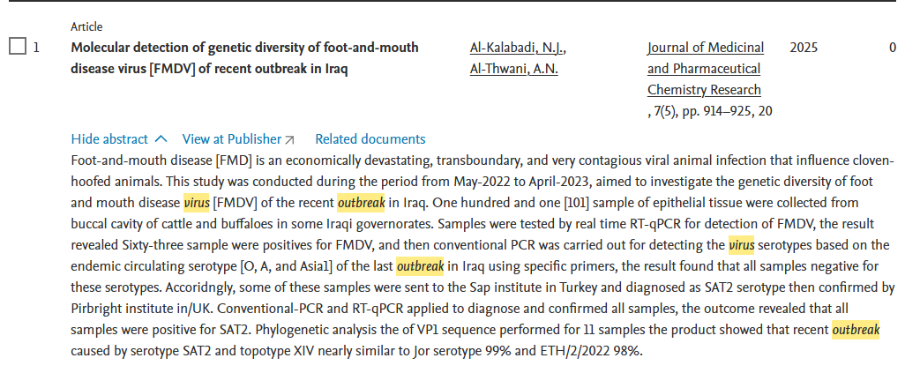
SCOPUS FIELD CODES
Field codes are used in an Advanced search for a term in a specific field.
https://service.elsevier.com/app/answers/detail/a_id/11236/supporthub/scopus/
Examples:
The search TITLE-ABS-KEY(virus outbreak) would return documents where the terms appear in the title, abstract or keywords.

Slide 25
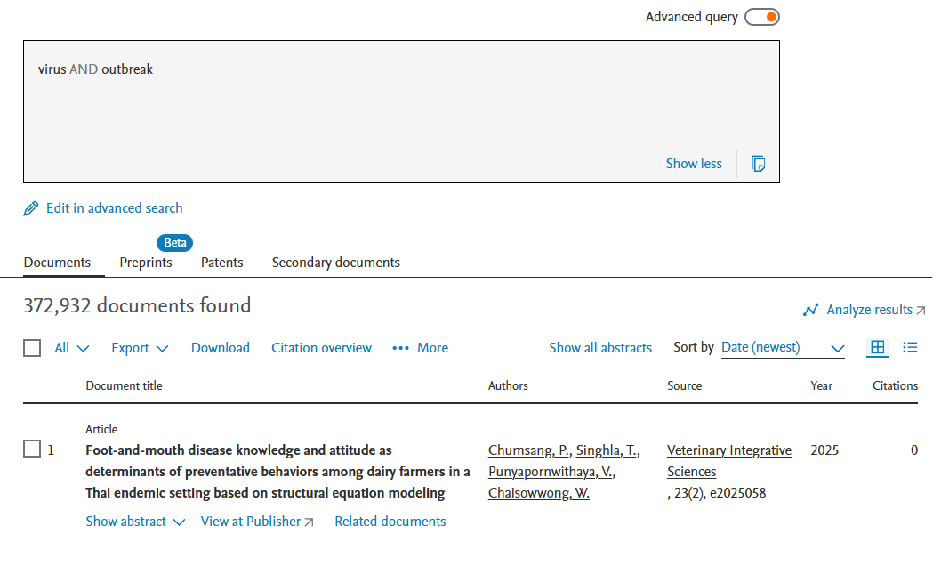
SCOPUS FIELD CODES
Examples:
Not using a field code, e.g. (virus outbreak), is the same as searching ALL ( virus AND outbreak )

Slide 26
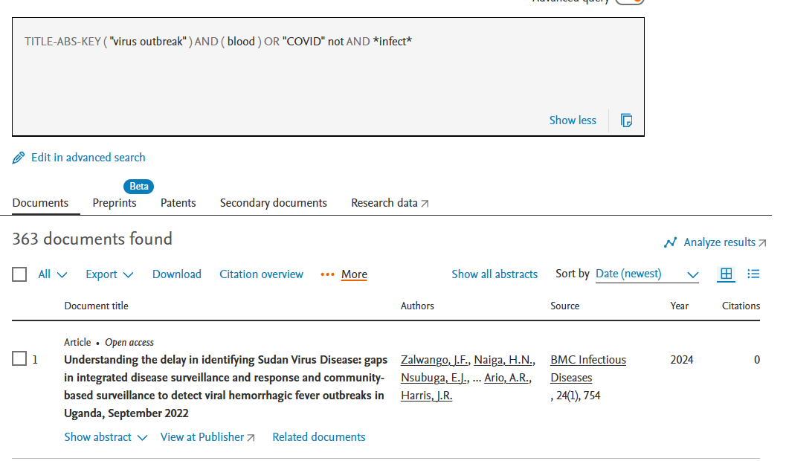
EXERCISE : TITLE-ABS-KEY("virus outbreak") AND (blood) OR "COVID" NOT *infect*

Slide 27
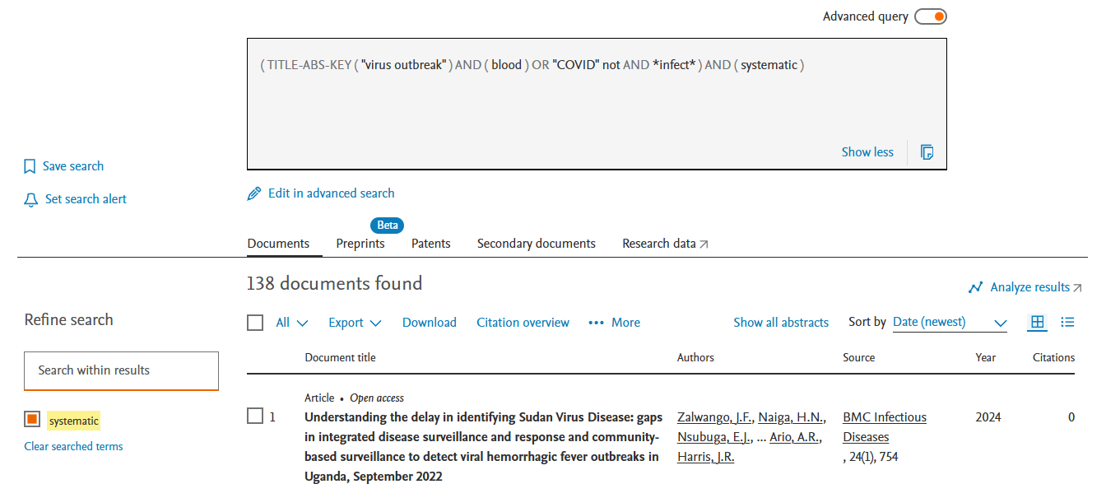

DOCUMENT SEARCH - SEARCH WITHIN RESULT
( TITLE-ABS-KEY ( "virus outbreak" ) AND ( blood )OR "COVID" AND NOT*infect* ) AND ( systematic )

Slide 28
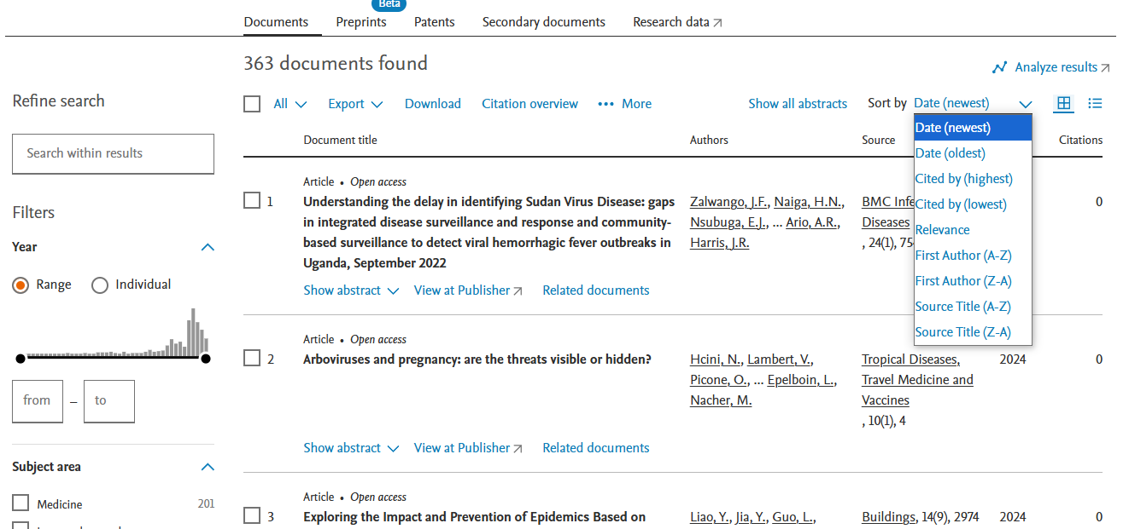
ANALYZE SEARCH RESULTS
Results are ordered by year of publication as default. You can create a new order with the sorting box (on the right): based on relevance, most cited or oldest articles. Or you could order the results alphabetically by first author or source title.

Slide 29
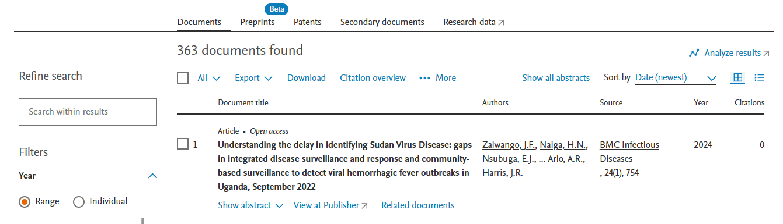
ANALYZE SEACH RESULTS
Click Analyze search results to view charts and graphs related to this result list

Slide 30
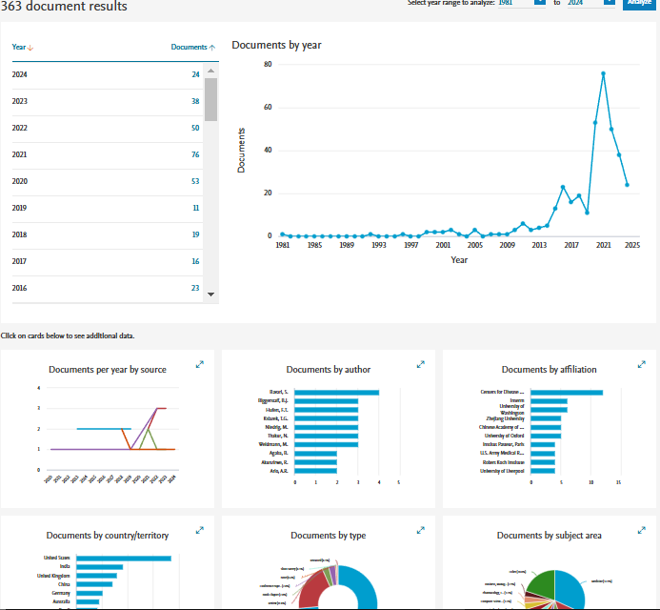
SOURCE DETAILS
The Analyze search results tool gives you an overview showing the number of documents broken down by various criteria, including year, source, author, affiliation, and so on.

Slide 31
ANALYZE SEACH RESULTS
Click Analyze search results to view charts and graphs related to this result list

Slide 32
SOURCE DETAILS
The Analyze search results tool gives you an overview showing the number of documents broken down by various criteria, including year, source, author, affiliation, and so on.

Slide 33
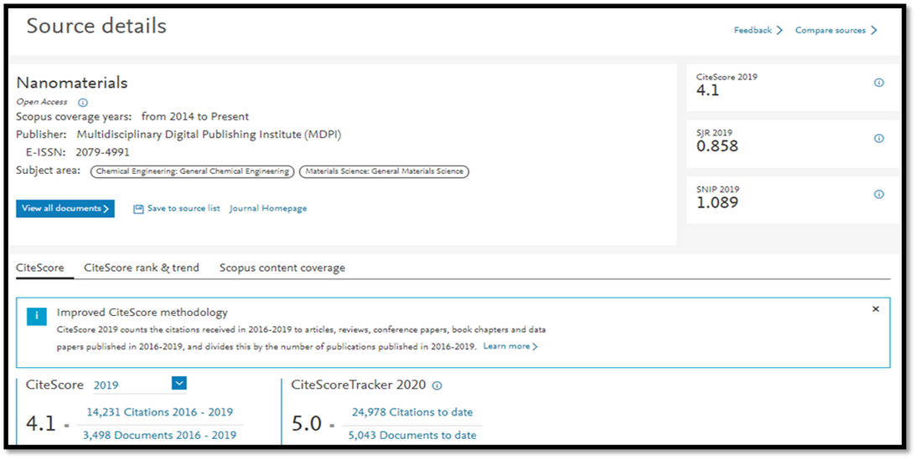

ANALYZE SEACH RESULTS
•CiteScore measures average citations received per document published in the journal. It is useful for comparing journals within the same field, ranking them in subject categories and indicating the percentile they fall into.
•SJR (SCImago Journal Rank) measures citations weighted by prestige. It is useful for comparing journals within the same field, and forms the basis of the subject category ranking. Q1 journals are cited more often and by more prestigious journals than those in the other quartiles.
•SNIP (Source Normalized Impact per Paper) measures citations weighted by the subject field. It is useful for comparing journals not just within the same field but also across disciplines. A SNIP of 1.0 means that a journal’s articles are cited at the average rate for all journals in the same subject area; anything over 1.0 indicates more citations than average in the field while a SNIP of less than 1.0 is below the average. A SNIP of more than 1.5 generally indicates a very well-cited journal.

Slide 34
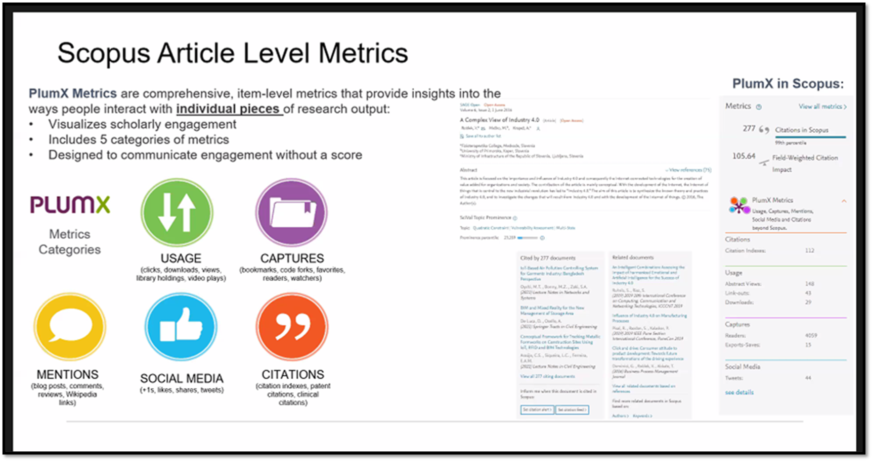
SCOPUS ARTICLE LEVEL METRICS

Slide 35
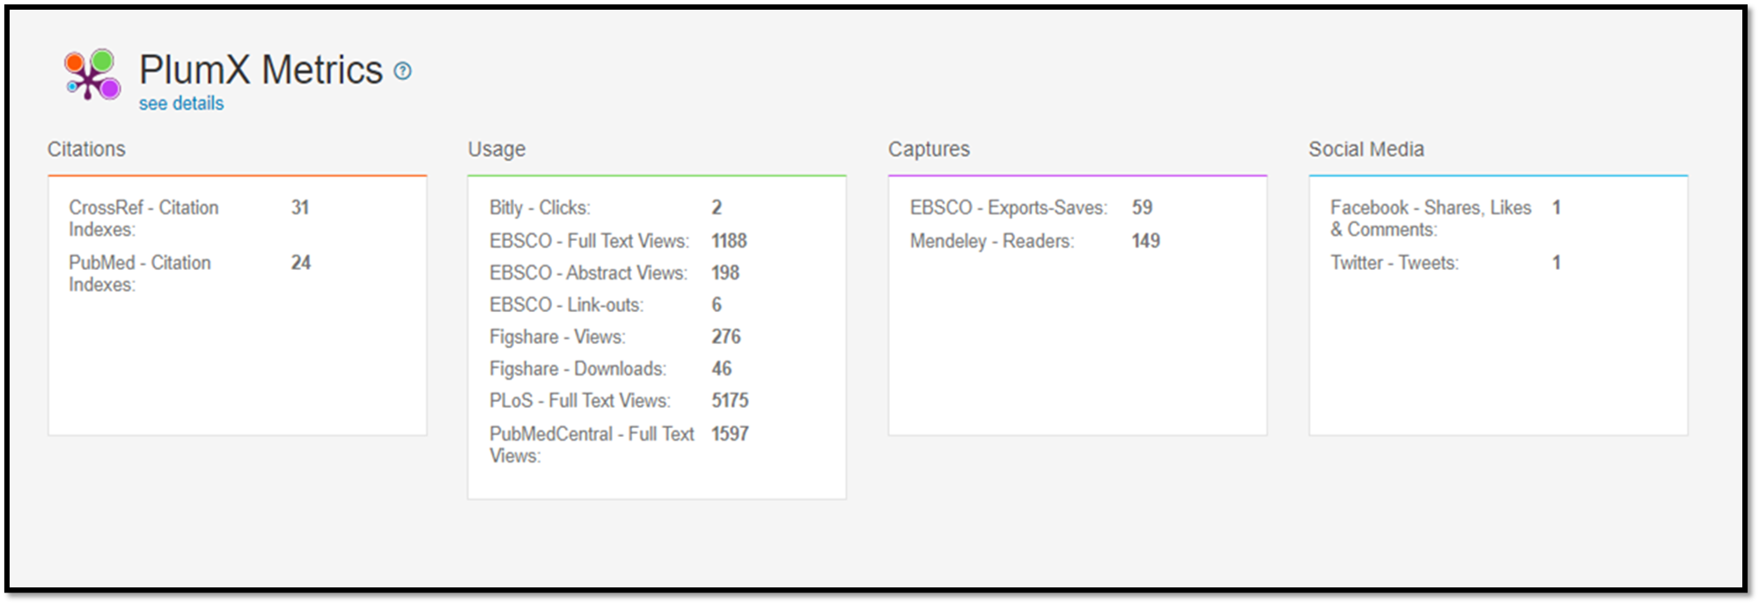
SCOPUS ARTICLE LEVEL METRICS

Slide 36
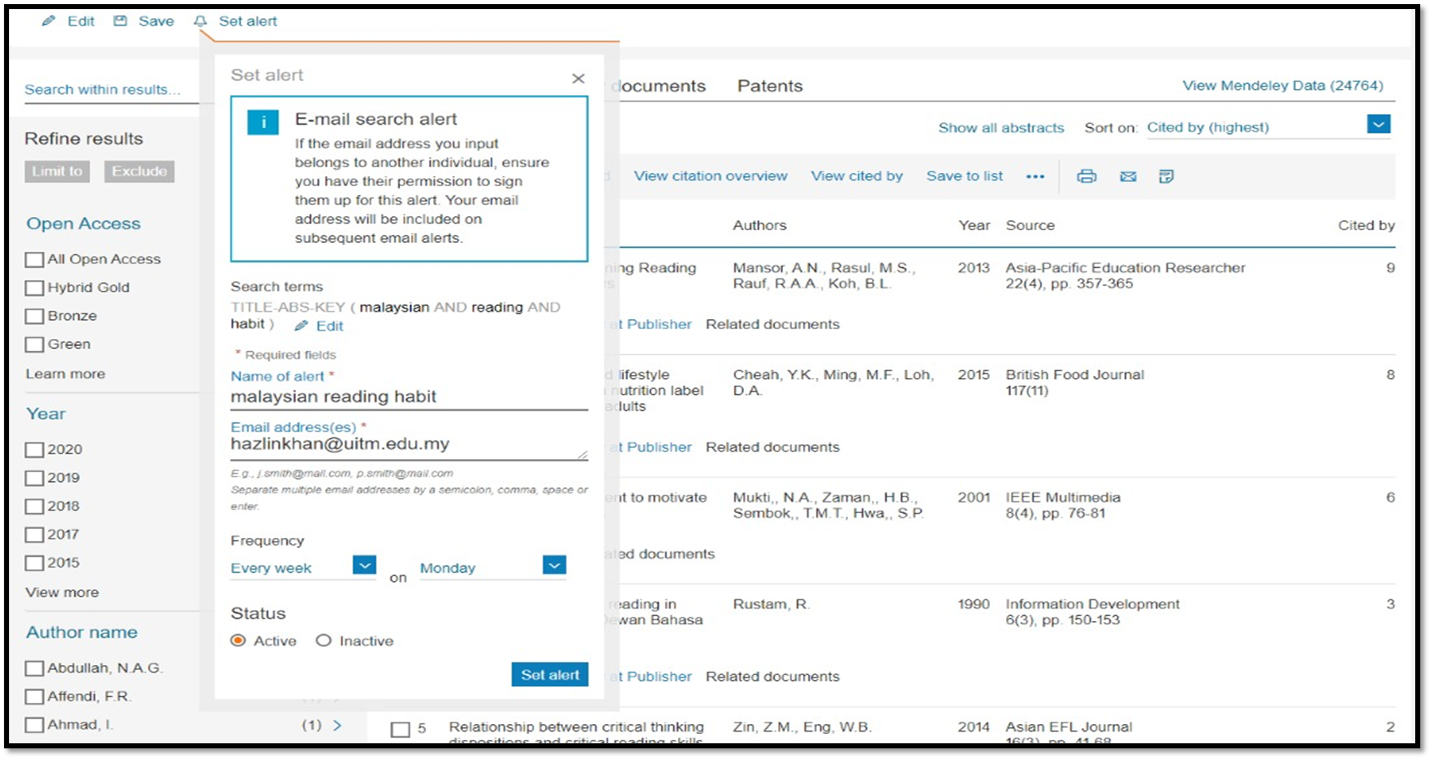
SCOPUS PERSONALIZATION - SET ALERT SETTING

Slide 37
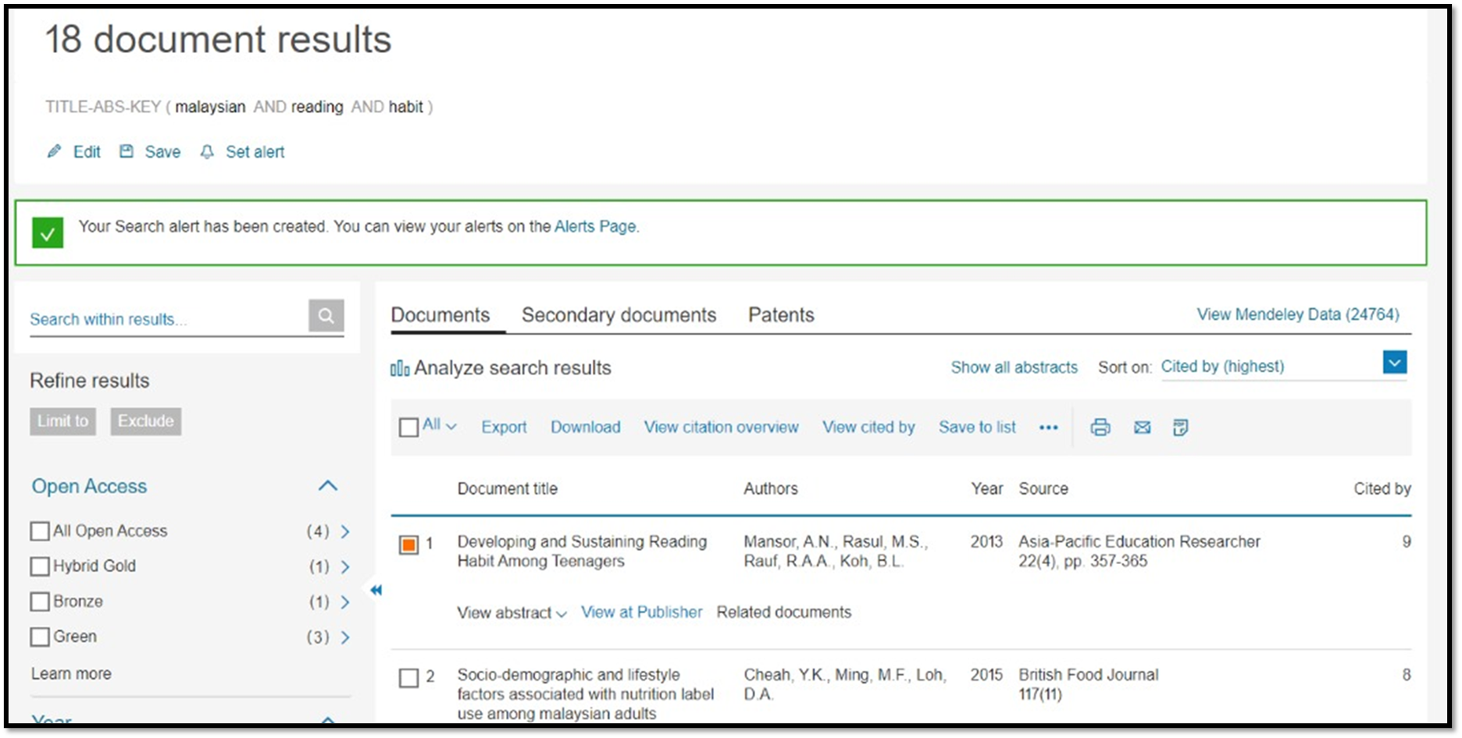
SCOPUS PERSONALIZATION - SET ALERT CREATED

Slide 38
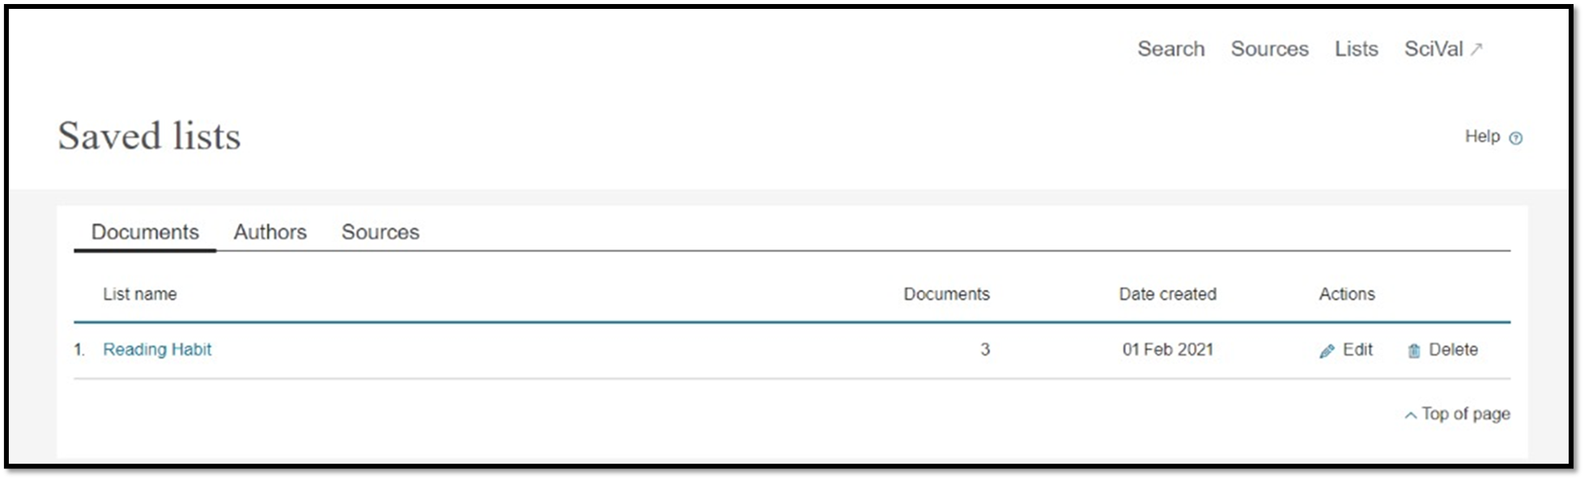
SCOPUS PERSONALIZATION - SAVE LIST

Slide 39
SciVal
•Subscription managed by Pusat Sitasi Malaysia (PSM) (Malaysia Citation Centre)
•SciVal offers quick, easy access to research performance of more than 19,500 research institutions and their associated researchers from 231 nations worldwide.

Slide 40

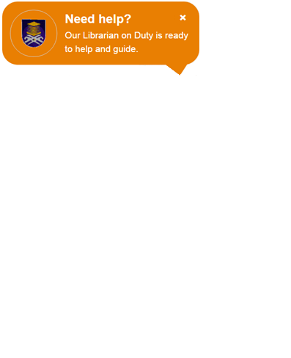
ENQUIRIES
Consultation Services:
Main Library : 03-5544 3793
Law Library : 03-5544 3733
Science & Technology Library : 03-5544 3820
Engineering Library : 03-5544 3812
Built Environment Library : 03-5544 4392
Chat with Librarian : https://ptar.uitm.edu.my/libchat
Like and follow us at social media:
https://twitter.com/uitmlibrary
https://www.instagram.com/libraryuitm/
https://perpustakaanuitm.blogspot.com/
https://www.facebook.com/libraryuitm/

Slide 41


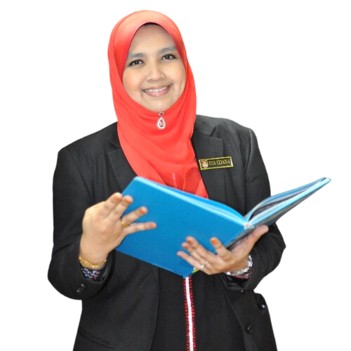


USER EDUCATION TEAM
EZA ELIANA HJ ABDUL WAHID
SENIOR LIBRARIAN
RESEARCH SUPPORT UNIT
TUN ABDUL RAZAK LIBRARY
03-5544 3742
eza080@uitm.edu.my
MUHAMMAD AZRUL NIZAM BIN ABDUL RAHMAN
LIBRARIAN
RESEARCH SUPPORT UNIT
TUN ABDUL RAZAK LIBRARY
03-5544 3736
azrulnizam@uitm.edu.my

Slide 42
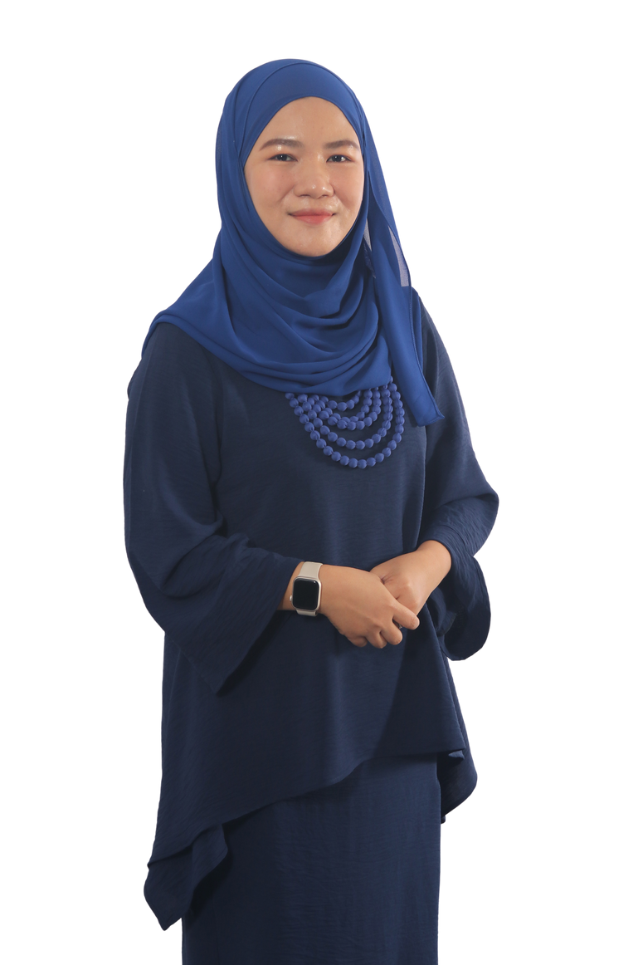
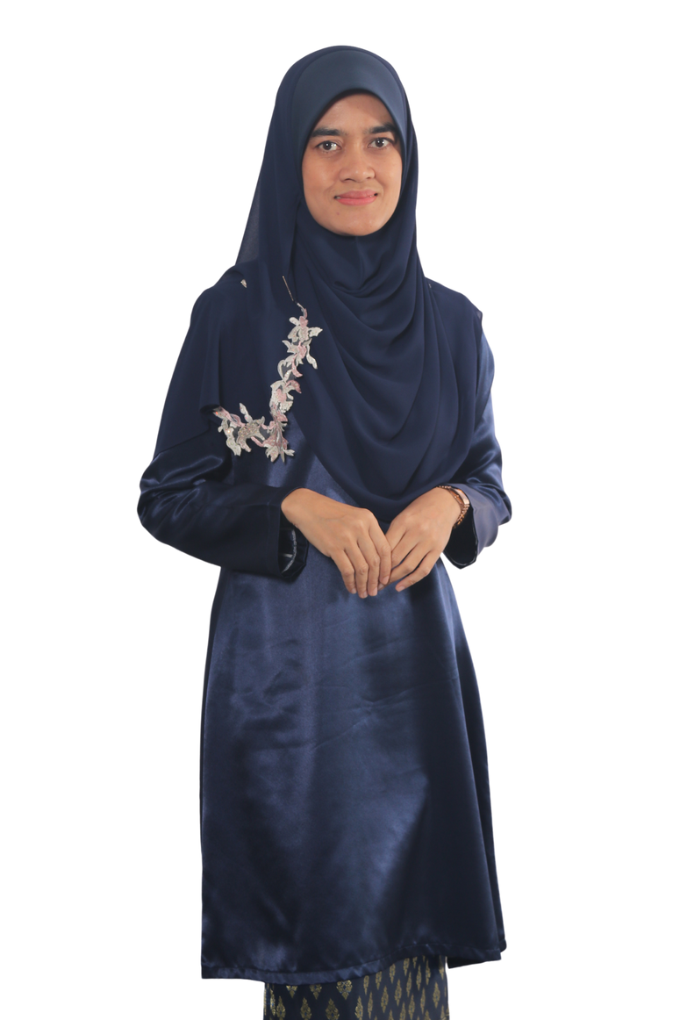

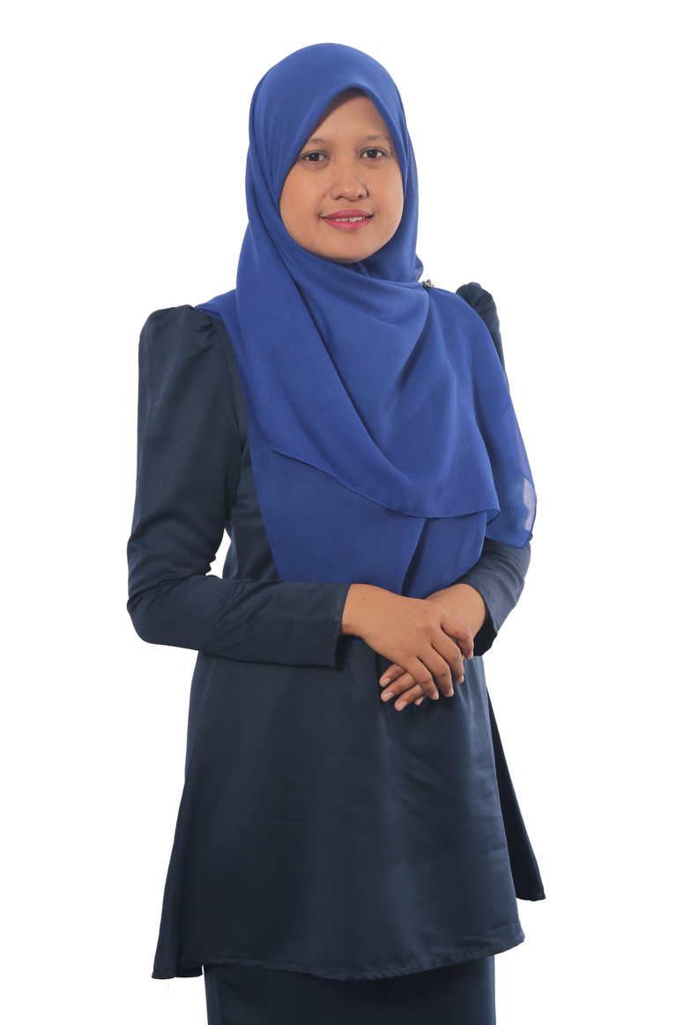
USER EDUCATION TEAM (FACULTY LIBRARIES)
SITI ROHAYU BINTI MOHAMAD YUSOF
SENIOR LIBRARIAN
TUN ABDUL RAZAK LIBRARY
(BUILT ENVIRONMENT)
03-5544 4392
sitirohayu@uitm.edu.my
MASNIDA HANIM BINTI ROJIKIN
SENIOR LIBRARIAN
TUN ABDUL RAZAK LIBRARY
(ENGINEERING)
03-5544 3812
idahanim@uitm.edu.my
MOHD HAZRUL BIN MOHD HUSSIN
SENIOR LIBRARIAN
TUN ABDUL RAZAK LIBRARY
(SCIENCE & TECHNOLOGY)
03-5544 3811
hazrul@uitm.edu.my
HANANI BINTI ROJIKIN
SENIOR LIBRARIAN
TUN ABDUL RAZAK LIBRARY
(LAW)
03-5544 3738
hanani_rojikin@uitm.edu.my

Slide 43

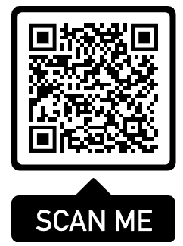
ATTENDANCE
SAMPLE

Slide 44
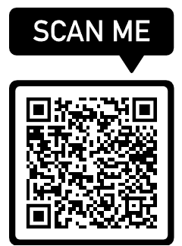
SURVEY
SAMPLE

Slide 45

THANK YOU
PERPUSTAKAAN TUN ABDUL RAZAK, UiTM

