Slide 1




MODUL LMS302 :
Easy Write with MS Word

Slide 2



MODULE OVERVIEW / INTRO
1
2
Module highlight :
What is LMS 302 Module?
Microsoft Word offers a set of tools and automated functions that can be of great help when writing a thesis. From this module, students and researchers will be able to produce draft templates systematically and efficiently in producing quality thesis.
Handling and demonstrate technique to:
1. Use important button in MS Word for formatting
4
Duration
3
Teaching Medium
1 to 2 Hour(s)
Online via Webex, Google Meet, Google Classroom
Face to Face : IT Centre

Slide 3
MICROSOFT WORD?
Used to make professional-quality documents, letters, reports, etc., MS Word is a word processor developed by Microsoft. It has advanced features which allow you to format and edit your files and documents in the best possible way.
MS Word enables users to do write-ups, create documents, resumes, contracts, etc. This is one of the most commonly used programs under the Office suite.
Microsoft Word is available for Microsoft Windows, Apple macOS, Android, and Apple iOS. It can also run on the Linux operating system using WINE.

Slide 4
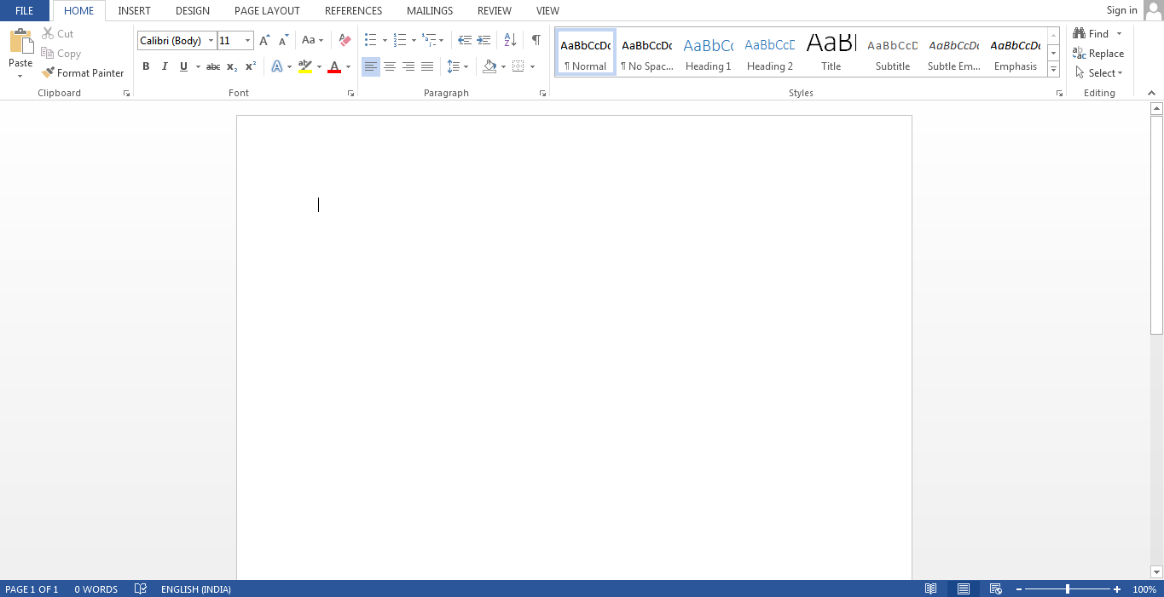
To create an MS Word doc, follow the steps mentioned above to open Microsoft Word. Then once the program is open, click on “File” followed by “New”. This opens a new doc where something new can be created.
Since it is used by people of all age groups, in schools, in colleges and for official purposes, having proper knowledge of Microsoft Word is a must. The preview of the MS Doc file once it is opened is given below:
https://byjus.com/govt-exams/microsoft-word/

Slide 5
Common issues using MS Word
Formatting
Lots of pages
Many Chapters
Correction from SV’s
TOC and LOF
Rotation of pages
Assignment page numbers
Margin
Line spacing

Slide 6


ONE STOP CENTER
Go to EMAIL UITM
https://mail.uitm.edu.my/

Slide 7
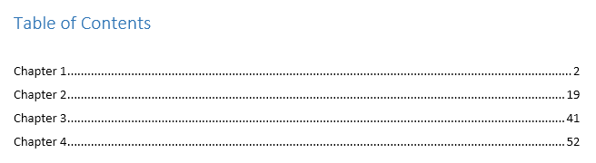
HOW TO CREATE A TABLE OF CONTENTS IN WORD
A table of contents is just like the list of chapters at the beginning of a book. It lists each section in the document and the page number where that section begins. A really basic table of contents might look like this:

Slide 8
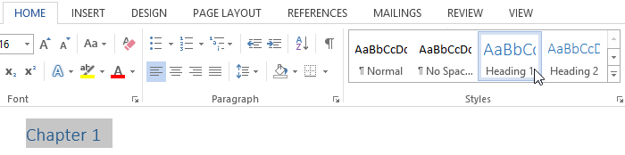
STEP 1: APPLY HEADING STYLES
If you apply a heading style, you're telling Word that you've started a new part of your document. When you insert the table of contents, it will create a section for each heading. In the table of contents above, each chapter uses a heading style, so there are four sections.
To apply a heading style, select the text you want to format, then choose the desired heading in the Styles group on the Home tab.

Slide 9
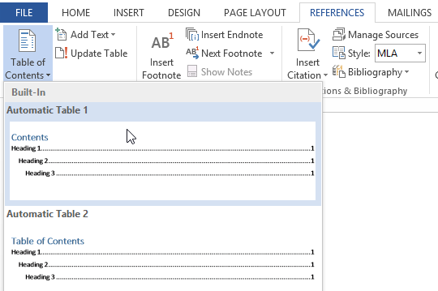
STEP 2: INSERT THE TABLE OF CONTENTS
Now for the easy part! Once you've applied heading styles, you can insert your table of contents in just a few clicks. Navigate to the References tab on the Ribbon, then click the Table of Contents command. Select a built-in table from the menu that appears, and the table of contents will appear in your document.

Slide 10
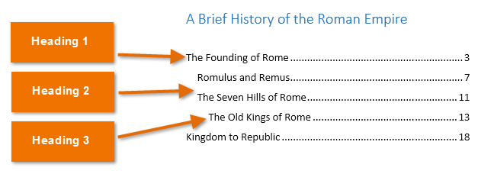
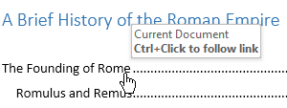
As you can see in the image below, the table of contents uses the heading styles in your document to determine where each section begins. Sections that begin with a Heading 2 or Heading 3 style will be nested within a Heading 1 style, much like a multilevel list.
A table of contents also creates links for each section, allowing you to navigate to different parts of your document. Just hold the Ctrl key on your keyboard and click to go to any section.

Slide 11
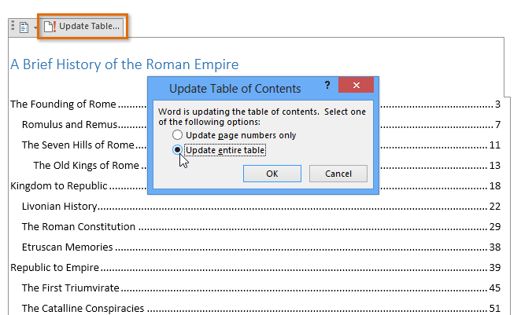
STEP 3: UPDATE AS NEEDED
If you edit or add to your document, it's easy to update the table of contents. Just select the table of contents, click Update Table, and choose Update Entire Table in the dialog box that appears. The table of contents will then update to reflect any changes.

Slide 12
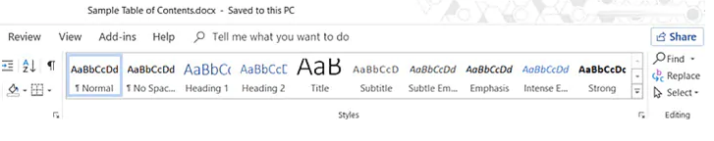
STEP 1: FORMAT YOUR DOCUMENT USING HEADING STYLES
Select each chapter in your document and apply Heading Styles to them. Here, you are marking up the section headers so that Word can recognize them.
Go to Ribbon > Home > Styles. Select the text and apply headings for all the text you want to include in the table of contents.

Slide 13
STEP 2: POSITION THE TABLE OF CONTENTS ON THE PAGE
Place the cursor on the specific position where you want the TOC to appear in your document. This is commonly somewhere at the beginning of the document.

Slide 14
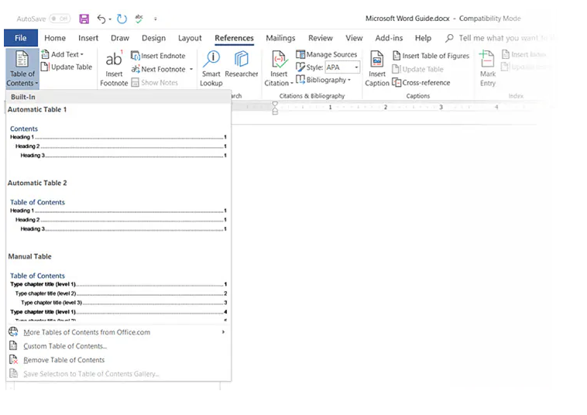
STEP 3: CLICK THE TABLE OF CONTENTS COMMAND
Go to Ribbon > References > Table of Contents. Choose from one of the two automatic types available. The only difference between the two is the heading of "Contents" or "Table of Contents" at the top.

Slide 15
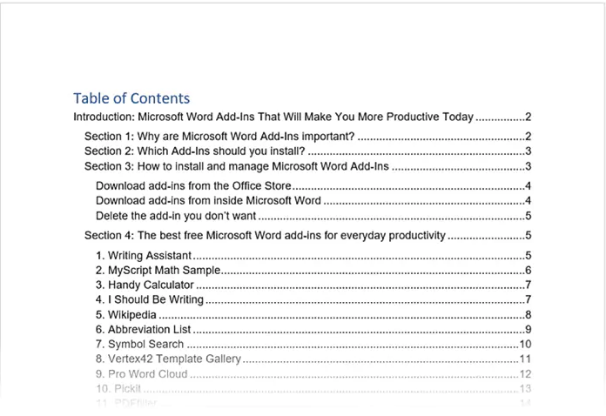
STEP 4: THE TABLE OF CONTENTS IS INSERTED AUTOMATICALLY
Word scans the document and uses the heading styles to construct the order of the sections and subsections and their page numbers. This is a barebones TOC and you can continue to work with this and make it more stylish.

Slide 16
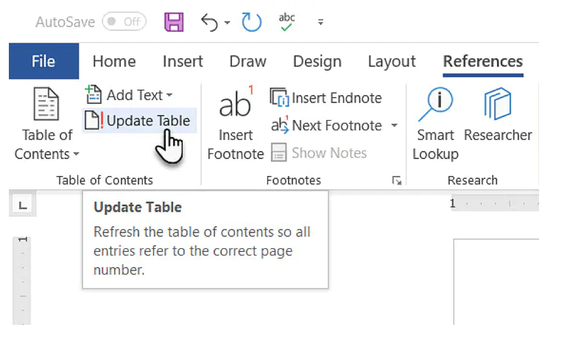
STEP 5: UPDATE THE TABLE OF CONTENTS ANYTIME
You can always update a Table of Contents that has been created automatically. Update the table if you change the heading styles, rearrange the contents, or change the text. Also, update it if you make any changes to the content that affects the page numbers.
To update a table of contents that was created automatically, click References > Update Table.

Slide 17
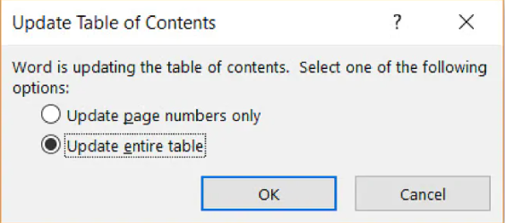
Choose to Update page numbers only or Update entire table if you want to update the page numbers and the text.

Slide 18
STEP 6: CREATE A TABLE OF CONTENTS MANUALLY
When the automatic method is so effortless, why would you feel the need to make one manually? There could be two reasons:
  The document is without any styles which Word can recognize.
  The document has too much of variety makes an automatic TOC difficult.
To create a manual table, go to References > Table of Contents > Click the dropdown to reveal the option for Manual Table.

Slide 19
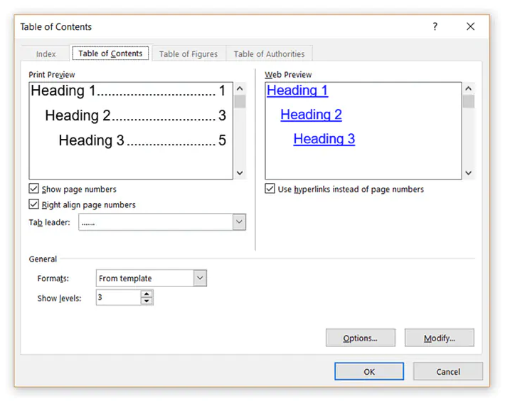
HOW TO CUSTOMIZE THE TABLE OF CONTENTS
You can easily customize a TOC with the Table of Contents dialog box. Go to References > Table of Contents > Custom Table of Contents to launch the dialog.

Slide 20
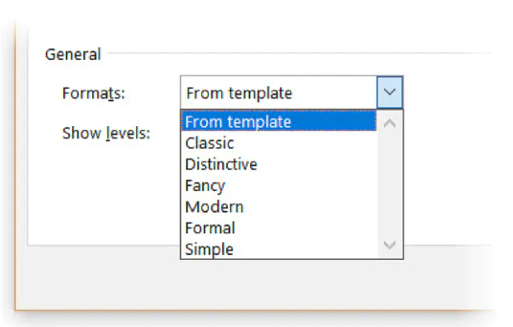
STEP 1: CHOOSE A DIFFERENT FORMAT FOR THE TOC
You can change an entire table by choosing a different format. In the General section, expand the dropdown for Formats and choose an appearance.

Slide 21
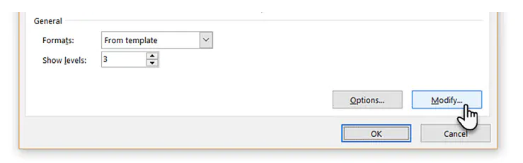
STEP 2: CHANGE THE APPEARANCE OF THE ITEMS IN THE TOC
Remember, the appearance of your TOC is ultimately controlled by style definitions. You may want to tweak the overall look of the TOC by creating your own styles for the headings. These modified styles can be saved alongside the in-built ones and applied across the document for a consistent look. Follow these steps.
  Click Modify. If the Modify button is grayed out, change Formats to From template.

Slide 22
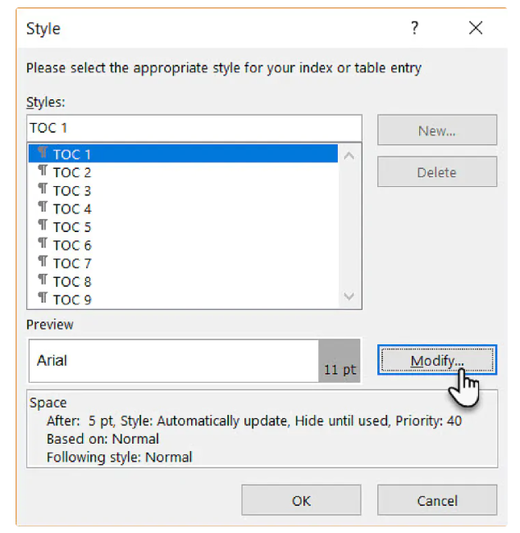
  In the Styles list, click the level that you want to change and then click Modify. Here, TOC 1 corresponds to heading level 1 in your document, TOC 2 to heading level 2, TOC 3 to heading 3 and so on.

Slide 23
  In the Modify Style dialog box, you can change the font or its color. Make any other formatting change like text indentation and then click OK.
  Before you click OK, you can choose whether the style change applies to the current document or to all future documents. To save it for future use, click the checkbox for Add to the Styles gallery.

Slide 24
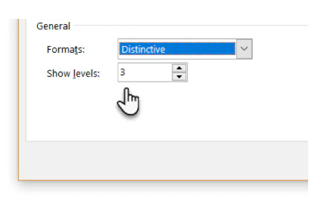
STEP 3: CHANGE THE LEVELS OF THE STYLE HEADINGS SHOWN
A TOC can be itemized, or you can just include the major sections. The Show levels number allows you to change the number of levels displayed in your table of contents. The “Levels” here refers to the style headings you have applied to your sections.
For instance: H1, H2, H3… etc. If you set it on 2, then all text with the Heading 1 style or the Heading 2 style is displayed.

Slide 25
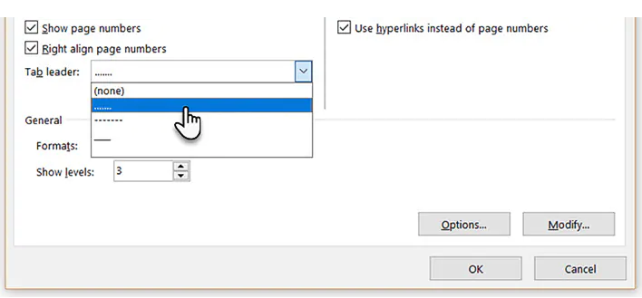
STEP 4: CHANGE OR ADD DOT LEADERS IN THE TOC
Dot leaders are the lines or dots that connect the items in the index to page numbers. These leader lines are mentioned in many style guides as a necessary part of thesis documents.
In the Table of Contents dialog box, click the dropdown for the Tab leader list and select the dotted line option. Alternatively, choose the leader line you want or select “none” to remove it from the TOC.

Slide 26
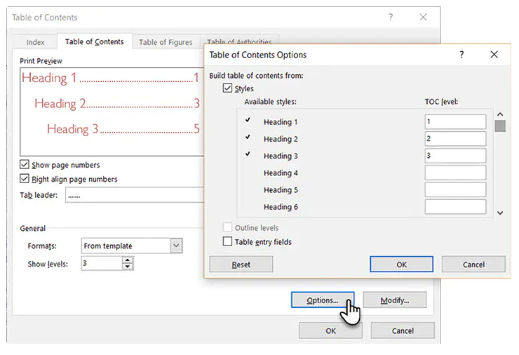
STEP 5: ADD A NON-HEADING STYLE
Word won’t include a non-heading style when it inserts an automatic TOC. By default, Word only includes headings 1 through 9. But it gives you a method to include any other style you create in the index. Let’s say you want to add another heading called “A Brief Guide” at the top of the content and the TOC.
In the Table of Contents dialog box, click the Options button to open this screen:

Slide 27
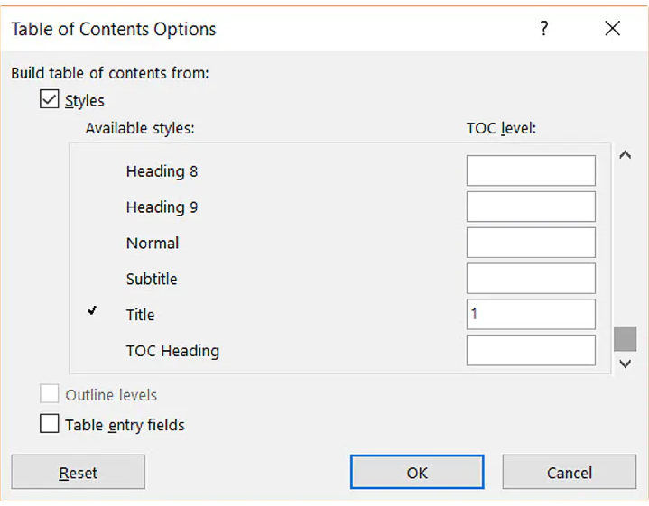
Right now, it maps the styles in use only to the TOC levels. As you can see, the three styles, Heading 1, Heading 2, and Heading 3 are mapped as levels 1. 2, and 3.
Go down the boxes until you find Title, which has no mapped TOC level. Enter 1 to map Title to the TOC top level.
Click OK twice to exit the dialogs. Word will prompt you to replace the contents. Click Yes to replace the TOC.

Slide 28
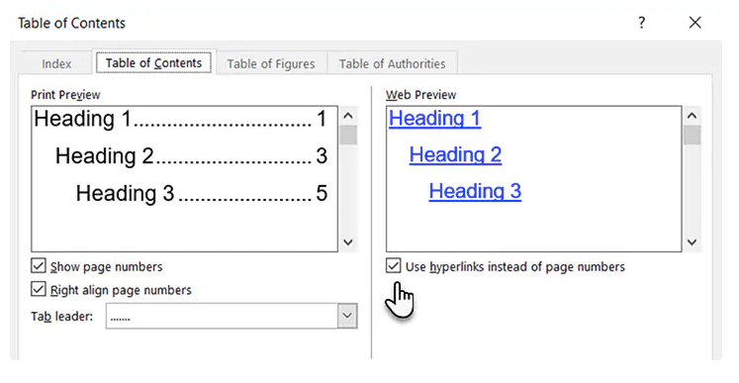
STEP 6: CREATE A CLICKABLE TABLE OF CONTENTS
Creating a hyperlinked Table of Contents is expected in the digital age. Navigation is faster. It is also another condition to submit a thesis or dissertation.
Click the Use hyperlinks instead of page numbers checkbox.
Also, uncheck the Show page numbers box if you just want to use the hyperlinks.

Slide 29
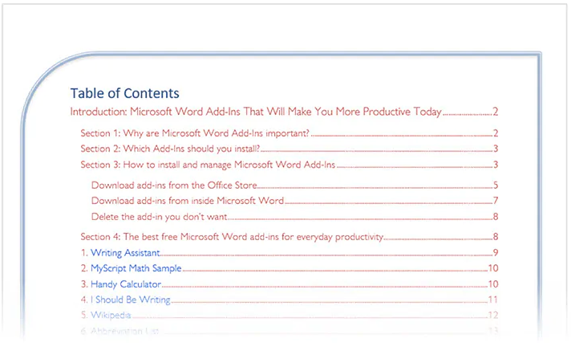
STEP 7: PLACE A SIMPLE BORDER AROUND THE TABLE OF CONTENTS
You can use Word’s Shapes feature to insert a border around the TOC. Set Shape Fill to “No Fill” and then add Shape Styles or use Format Shape to design the look of the pseudo-border around the table.
https://www.goskills.com/Microsoft-Office/Resources/Create-table-of-contents-Word

Slide 30
HOW TO CREATE AND CUSTOMIZE A TABLE OF FIGURES IN WORD
When you create a document with many pages and sections, you might use a Table of Contents to help your reader navigate. So if your document includes tables and figures, a Table of Figures serves the same purpose. This table allows your reader to jump directly to one of these objects.

Slide 31
STEP 1: ADD CAPTIONS TO YOUR TABLES AND FIGURES
Before you can insert a Table of Figures in Word, ensure that all of your items have captions. These are what allow the table to find and display them.
You can select, right-click the table or figure, and choose Insert Caption. This allows you to label the item as a table or figure and give it a number or letter. So you can use Table A, Figure 1, etc.

Slide 32
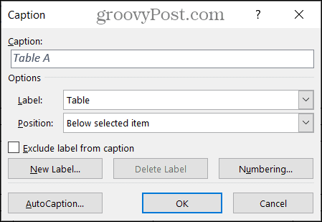

Slide 33
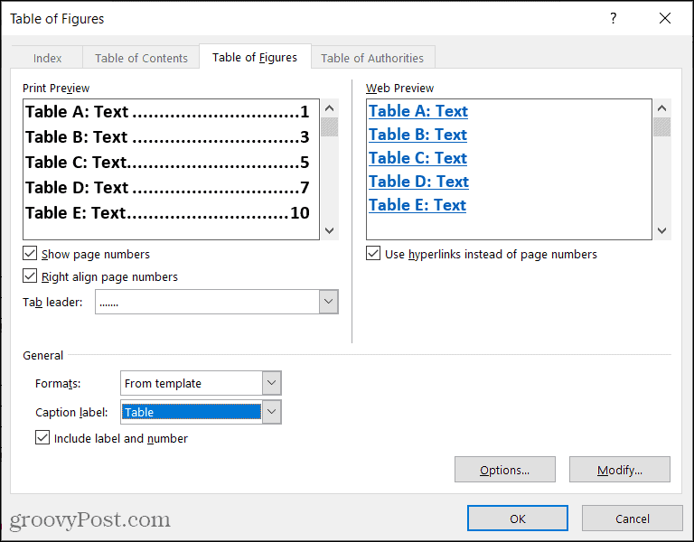
The Table of Figures window will display. This is where you customize the appearance of the table. First, confirm that the Table of Figures tab is selected at the top.
The top of the window is divided into two sections: Print Preview and Web Preview. Each of these offers customization or two of its own. Work with the one on your document view.

Slide 34
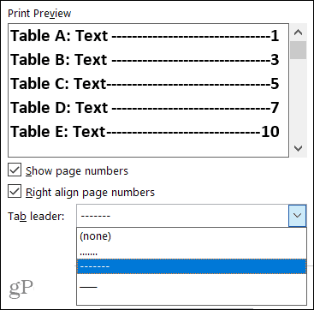
Print Preview: You can show the page number and/or right align to those page numbers by checking the corresponding boxes. If you use both, you have the option to select a Tab leader in that drop-down box. This lets you use dots, dashes, or lines between the label and the page number.

Slide 35
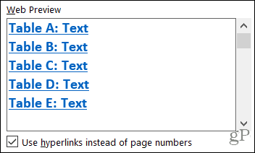
Web Preview: You can check the box to use hyperlinks instead of page numbers for this view. And it’s obviously a helpful way to navigate to the table or figure with a simple click.
Next, move down to the General section of the window for additional customization options.

Slide 36
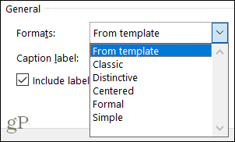
Formats: Various formats are available to pick from, each with a slightly different look and feel. You can select one to match your document or one that’s simple or formal.
If you prefer to create your own table formatting with specific fonts, you can modify the Table of Figures template. First, select From Template under Formats and then click the Modify button. Just note that you will be changing the default template for that object.

Slide 37
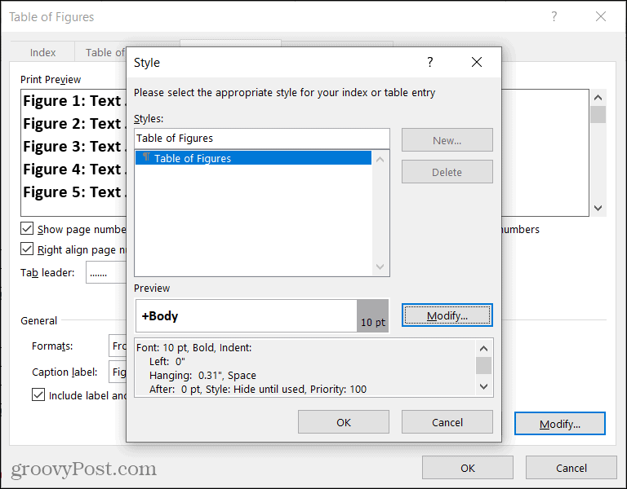
Label: This is a key element of the Table of Figures. Be sure to select the type that matches your items. For example, you can pick Equation, Figure, or Table.

Slide 38
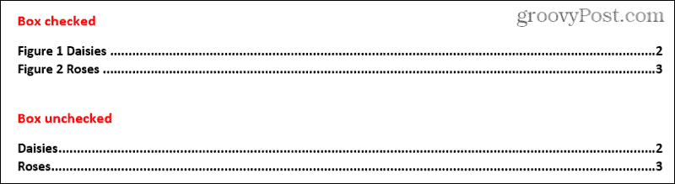
Include the label and number: This is an optional checkbox and depends on the text you include with your caption. For instance, if you only want the caption text to display rather than the label and its number, uncheck this box. Here’s an example to illustrate the difference.
We have two figures with the captions as “Figure 1 Daisies” and “Figure 2 Roses”. With the box checked, they display exactly like that in the Table of Figures because we include the label and number. With the box unchecked, you only see the text in the table, Daisies, and Roses.

Slide 39
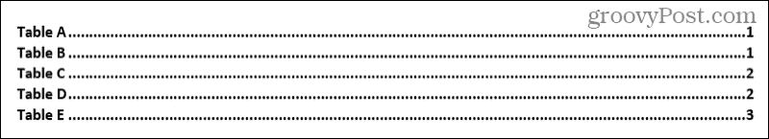
When you finish selecting all the options for your Table of Figures, click OK to insert it into your document.

Slide 40
HOW TO UPDATE A TABLE OF FIGURES
If you insert a Table of Figures and then add or remove figures or tables or edit the captions, you can update the table to reflect your changes.
  Select your Table of Figures.
  Go to the References tab and click Update Table in the Captions section of the ribbon.
  Choose to either Update the Page Numbers Only or Update the Entire Table.
  Click OK.

Slide 41
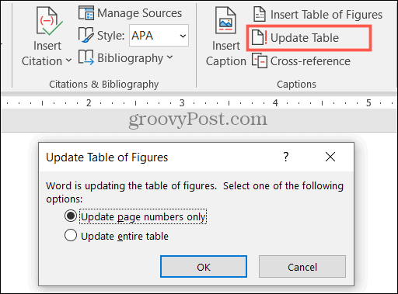
You should then see your table update with the new items you added and any other changes you made to the captions.
https://www.groovypost.com/howto/insert-and-format-the-current-date-and-time-in-google-sheets/

Slide 42
HOW TO ADD PAGE NUMBERS
Page numbers can be used to automatically number each page in your document. They come in a wide range of number formats and can be customized to suit your needs. Page numbers are usually placed in the header, footer, or side margin. When you need to number some pages differently, Word allows you to restart page numbering.
Word can automatically label each page with a page number and place it in a header, footer, or side margin. If you have an existing header or footer, it will be removed and replaced with the page number.

Slide 43
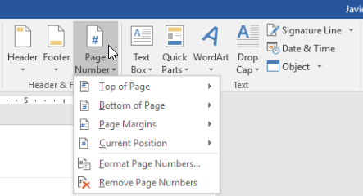
STEP 1
On the Insert tab, click the Page Number command.

Slide 44
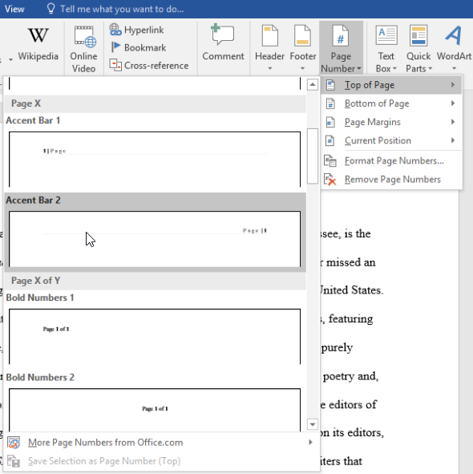
STEP 2
Open the Top of Page, Bottom of Page, or Page Margin menu, depending on where you want the page number to be positioned. Then select the desired style of header.

Slide 45
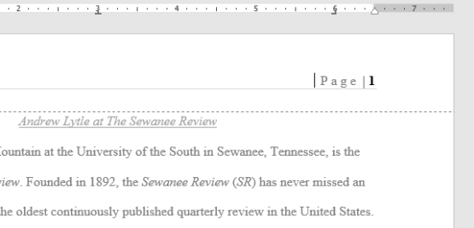
STEP 3
Page numbering will appear.

Slide 46
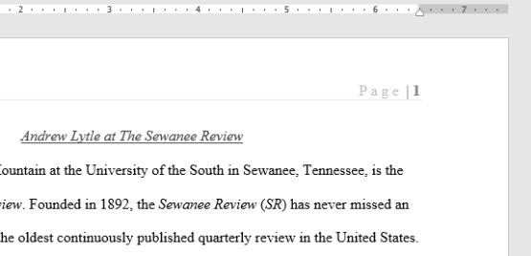
STEP 4
Press the Esc key to lock the header and footer.
If you need to make any changes to your page numbers, simply double-click the header or footer to unlock it.

Slide 47
HOW TO ADD PAGE NUMBERS TO AN EXISTING HEADER OR FOOTER
If you already have a header or footer and you want to add a page number to it, Word has an option to automatically insert the page number into the existing header or footer. In our example, we'll add page numbering to our document's header.

Slide 48
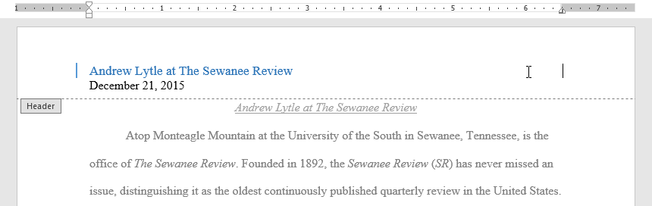
STEP 1:
Double-click anywhere on the header or footer to unlock it.

Slide 49
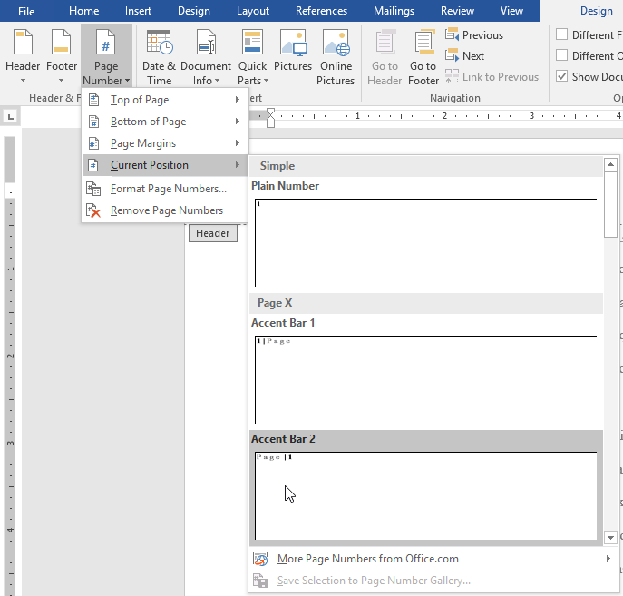
STEP 2:
On the Design tab, click the Page Number command. In the menu that appears, hover the mouse over Current Position and select the desired page numbering style.

Slide 50
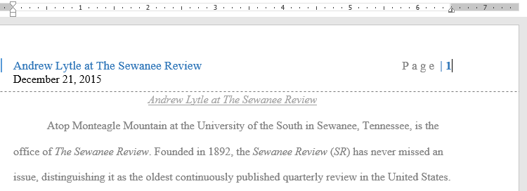
STEP 3:
Page numbering will appear.

Slide 51
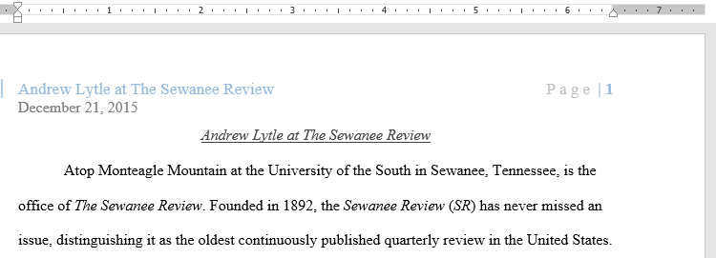
STEP 4:
When you're finished, press the Esc key.

Slide 52
HOW TO HIDE THE PAGE NUMBER ON THE FIRST PAGE
In some documents, you may not want the first page to show the page number. You can hide the first page number without affecting the rest of the pages.

Slide 53
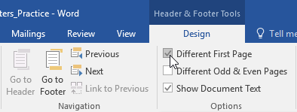
STEP
Double-click the header or footer to unlock it.
From the Design tab, place a check mark next to Different First Page. The header and footer will disappear from the first page. If you want, you can type something new in the header or footer, and it will only affect the first page.

Slide 54
HOW TO RESTART PAGE NUMBERING
Word allows you to restart page numbering on any page of your document. You can do this by inserting a section break and selecting the number you want to restart the numbering with. In our example, we'll restart the page numbering for our document's Works Cited section.

Slide 55
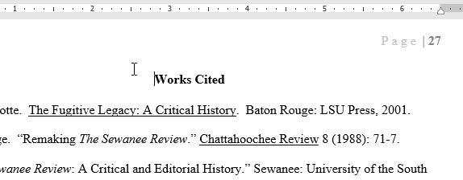
STEP 1:
Place the insertion point at the top of the page you want to restart page numbering for. If there is text on the page, place the insertion point at the beginning of the text.

Slide 56
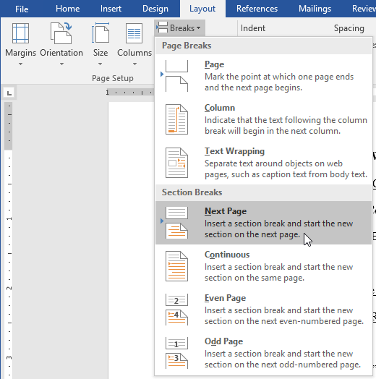
STEP 2:
Select the Layout tab, then click the Breaks command. Select Next Page from the drop-down menu that appears.

Slide 57
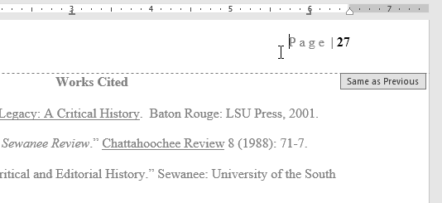
STEP 3:
A section break will be added to the document.
Double-click the header or footer containing the page number you want to restart.

Slide 58
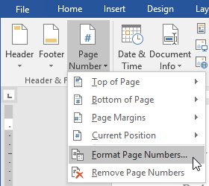
STEP 4:
Click the Page Number command. In the menu that appears, select Format Page Numbers.

Slide 59
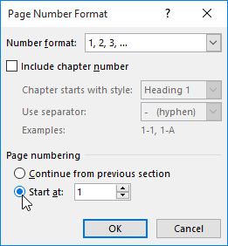
STEP 5:
A dialog box will appear. Click the Start at: button. By default, it will start at 1. If you want, you can change the number. When you're done, click OK.

Slide 60
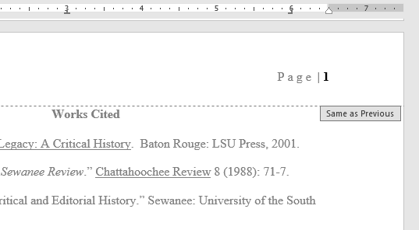
STEP 6:
The page numbering will restart.
https://edu.gcfglobal.org/en/word2016/page-numbers/1/#

Slide 61

HOW TO CREATE A BIBLIOGRAPHY OR WORKS CITED PAGE IN WORD
If you need to write a research paper, chances are you'll also be required to include a bibliography. Or you might be asked to include a works cited page or a list of references. These are all just different names for the same thing: a list of sources—such as books, articles, or even websites—that you used to research and write your paper. A bibliography makes it easy for someone else to see where you found your information. A short bibliography might look something like this:

Slide 62
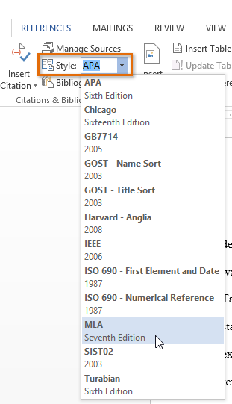
STEP 1: CHOOSE A REFERENCE STYLE
When you're creating a bibliography, you'll need to follow the guidelines of the required style guide. Different academic disciplines use their own styles guides, such as MLA, APA, and Chicago. Fortunately, Word comes with several built-in style guides; all you need to do is select the one you want to use, and Word will help you format your bibliography correctly.
To do this, click the References tab, then select the desired style in the Citations & Bibliography group.
You can use this same method to change the reference style at any time.

Slide 63
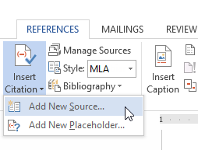
STEP 2: ADD CITATIONS AND SOURCES
Whenever you use information from one of your sources, you'll need to give credit—or cite them. This is known as making a citation. You'll include citations whenever you use information from a source or when you quote a source directly.
To add a citation, select the desired location for the citation in your document, click the Insert Citation command on the References tab, and select Add New Source.

Slide 64
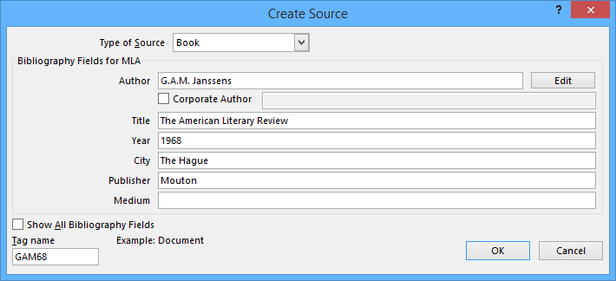

A dialog box will appear. Enter the requested information for the source—like the author name, title, and publication details—then click OK.
The citation will appear in the document, and the source will be saved. You can quickly add another citation for the source by clicking Insert Citation and selecting the source from the drop-down menu.

Slide 65
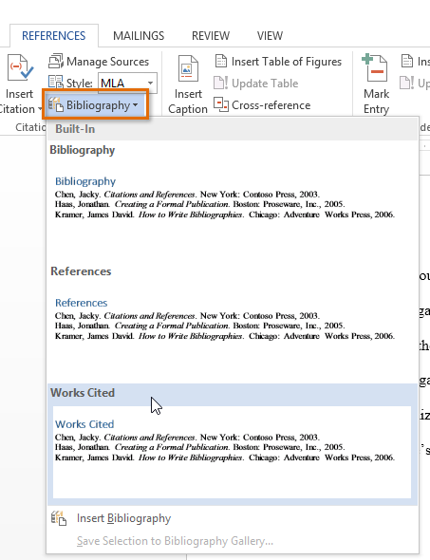

STEP 3: INSERT THE BIBLIOGRAPHY
Time for the easy part! Once you've added all of your sources, you can create your bibliography in just a few clicks! Just select the Bibliography command, then choose the desired style.
If you add more sources to your document, you can easily update your bibliography—just click it and select Update Citations and Bibliography
https://edu.gcfglobal.org/en/word-tips/how-to-create-a-bibliography-or-works-cited-page-in-word/1/

Slide 66


ENQUIRIES
Consultation Services:
Main Library : 03-5544 3793
Law Library : 03-5544 3733
Science & Technology Library : 03-5544 3820
Engineering Library : 03-5544 3812
Built Environment Library : 03-5544 4392
Chat with Librarian : https://ptar.uitm.edu.my/libchat
Like and follow us at social media:
https://twitter.com/uitmlibrary
https://www.instagram.com/libraryuitm/
https://perpustakaanuitm.blogspot.com/
https://www.facebook.com/libraryuitm/

Slide 67





USER EDUCATION TEAM
EZA ELIANA HJ ABDUL WAHID
SENIOR LIBRARIAN
RESEARCH SUPPORT UNIT
TUN ABDUL RAZAK LIBRARY
03-5544 3742
eza080@uitm.edu.my
MUHAMMAD AZRUL NIZAM BIN ABDUL RAHMAN
LIBRARIAN
RESEARCH SUPPORT UNIT
TUN ABDUL RAZAK LIBRARY
03-5544 3736
azrulnizam@uitm.edu.my

Slide 68




USER EDUCATION TEAM (FACULTY LIBRARIES)
SITI ROHAYU BINTI MOHAMAD YUSOF
SENIOR LIBRARIAN
TUN ABDUL RAZAK LIBRARY
(BUILT ENVIRONMENT)
03-5544 4392
sitirohayu@uitm.edu.my
MASNIDA HANIM BINTI ROJIKIN
SENIOR LIBRARIAN
TUN ABDUL RAZAK LIBRARY
(ENGINEERING)
03-5544 3812
idahanim@uitm.edu.my
MOHD HAZRUL BIN MOHD HUSSIN
SENIOR LIBRARIAN
TUN ABDUL RAZAK LIBRARY
(SCIENCE & TECHNOLOGY)
03-5544 3811
hazrul@uitm.edu.my
HANANI BINTI ROJIKIN
SENIOR LIBRARIAN
TUN ABDUL RAZAK LIBRARY
(LAW)
03-5544 3738
hanani_rojikin@uitm.edu.my

Slide 69


ATTENDANCE
SAMPLE

Slide 70

SURVEY
SAMPLE

Slide 71

THANK YOU
PERPUSTAKAAN TUN ABDUL RAZAK, UiTM

