Slide 1




Online Database For Literature
MODUL LSC102 :

Slide 2



Information Searching Strategy
Refer to the notes section below for guidelines on this topic.
Notes:
Once you find your sources, you will want to evaluate your sources using the following questions:
Author:
Who is the author?
Why should I believe what he or she has to say on the topic?
Is the author seen as an expert on the topic? How do you know?
Current:
How current is the information in the source?
When was the source published?
Is the information out-of-date?
Accuracy:
Is the content accurate?
Is the information presented objectively? Do they share the pros and cons?

Slide 3
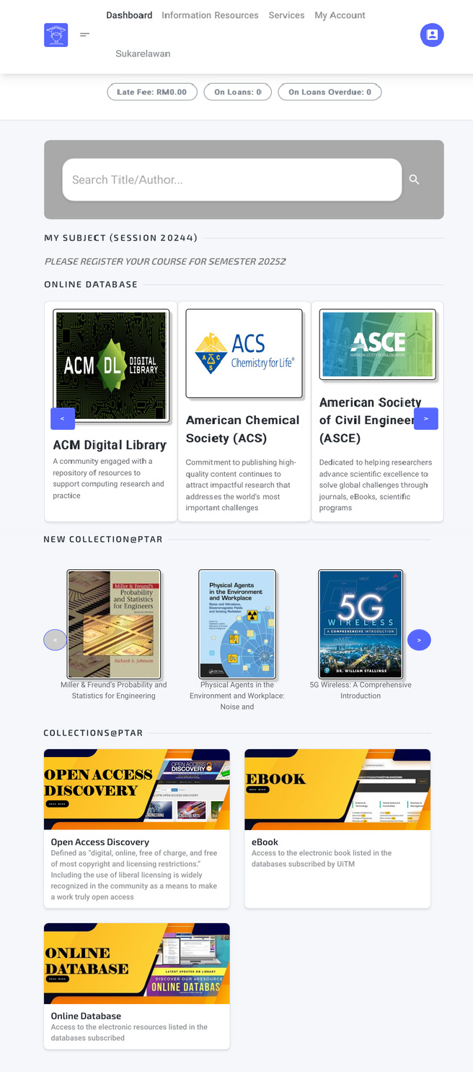

What is search strategy?
A search string is a combination of keywords, truncation symbols, and boolean operators you enter into the search box of an electronic library resource or an Internet search engine.

Slide 4
WHY?
To get relevant results
To save time going through irrelevant information
To go beyond Googling: retrieving anything and everything
HOW?
Enable you to quickly retrieve relevant information from the thousands of records in a database.
By using the following methods below you can make your search statement specific and increase the chance of retrieving relevant information
.

Slide 5
Type of Search Strategy
Use keyword and specific terms
Boolean operator
Quotation marks
Wildcard
Truncation
Notes:
Audio
In order to retrieve the most relevant results, you need to use some of type effective search strategy.
First is use keyword and specific terms
Second used Boolean operator
Third used quotation marks
Then user also can used wildcard or truncation

Slide 6
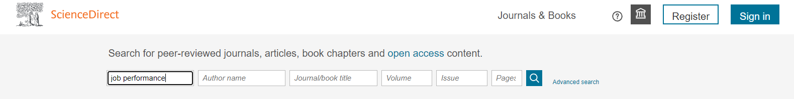
Use keyword and specific term
For example:
Job performance in the organization
Do not enter stop words in databases. Examples of stop words in databases are a, an, about, after, all, also, and, any, are, as, at, based, because, been, between, and so on.
Notes:
Audio
In order to retrieve the most relevant results, you need to use some of type effective search strategy.
First is use keyword and specific terms
Second used Boolean operator
Third used quotation marks
Then user also can used wildcard or truncation

Slide 7
Boolean operator
What is Boolean operator?
Boolean Operators are simple words (AND, OR, NOT) used as conjunctions to combine or exclude keywords in a search, resulting in more focused and productive results.
Source: http://library.alliant.edu
Notes:
Use Boolean Operator
What is Boolean operator?
Boolean Operators are simple words (AND, OR, NOT) used as conjunctions to combine or exclude keywords in a search, resulting in more focused and productive results.

Slide 8
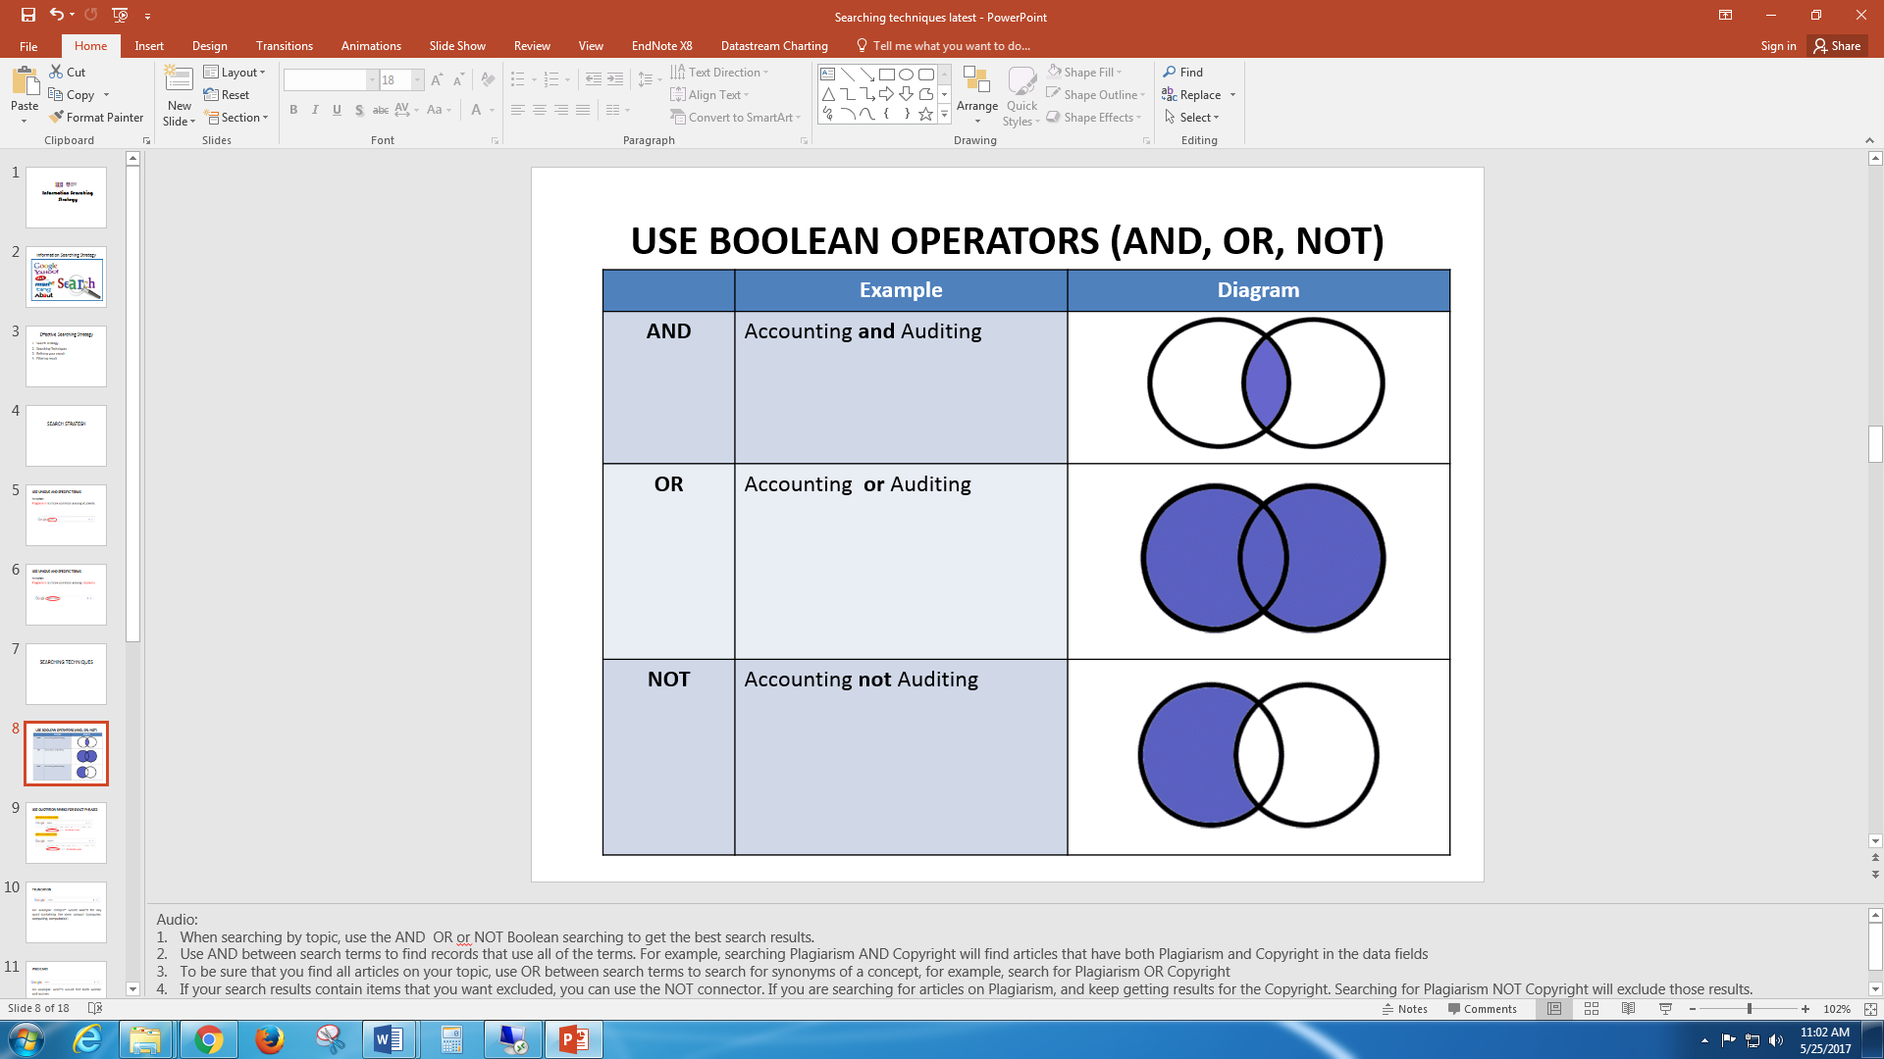
When searching by topic, use the AND OR or NOT Boolean searching to get the best search results.
Use AND between search terms to find records that use all of the terms. For example, searching Accounting AND Auditing will find articles that have both Accounting and Auditing in the data fields.
To be sure that you find all articles on your topic, use OR between search terms to search for synonyms of a concept, for example, search for Accounting OR Auditing
If your search results contain items that you want excluded, you can use the NOT connector. If you are searching for articles on Accounting, and keep getting results for the Auditing. Searching for Accounting NOT Auditing will exclude those results.
Notes:
1. When searching by topic, use the AND OR or NOT Boolean searching to get the best search results.
2. Use AND between search terms to find records that use all of the terms. For example, searching Accounting AND Auditing will find articles that have both Accounting AND Auditing in the data fields
3. To be sure that you find all articles on your topic, use OR between search terms to search for synonyms of a concept, for example, search for Accounting OR Auditing
4. If your search results contain items that you want excluded, you can use the NOT connector. If you are searching for articles on Accounting, and keep getting results for the Auditing. Searching for Accounting NOT Auditing will exclude those results.

Slide 9

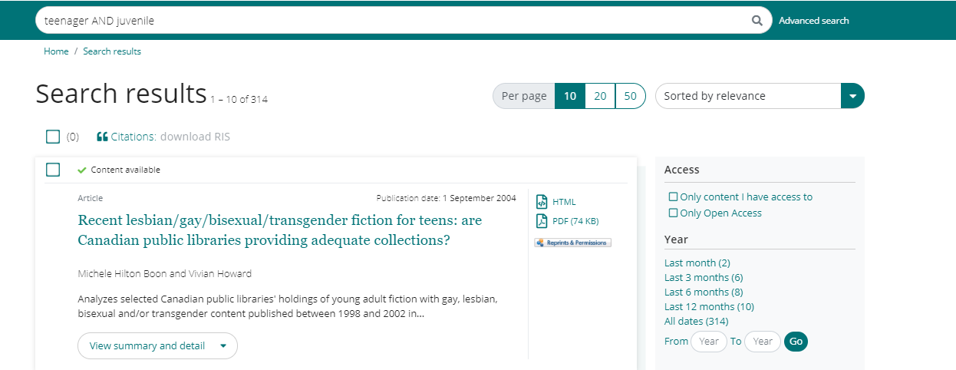
Example :
AND
Notes:
1. When searching by topic, use the AND OR or NOT Boolean searching to get the best search results.
2. Use AND between search terms to find records that use all of the terms. For example, searching Accounting AND Auditing will find articles that have both Plagiarism and Copyright in the data fields
3. To be sure that you find all articles on your topic, use OR between search terms to search for synonyms of a concept, for example, search for Accounting OR Auditing
4. If your search results contain items that you want excluded, you can use the NOT connector. If you are searching for articles on Accounting, and keep getting results for the Auditing. Searching for Accounting NOT Auditing will exclude those results.

Slide 10

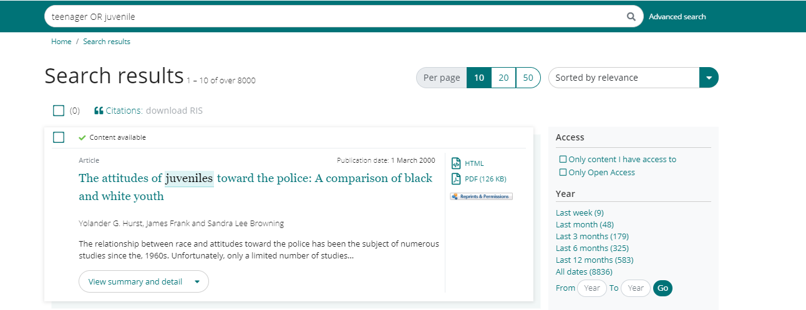
Example :
OR
Notes:
1. When searching by topic, use the AND OR or NOT Boolean searching to get the best search results.
2. Use AND between search terms to find records that use all of the terms. For example, searching Accounting AND Auditing will find articles that have both Plagiarism and Copyright in the data fields
3. To be sure that you find all articles on your topic, use OR between search terms to search for synonyms of a concept, for example, search for Accounting OR Auditing
4. If your search results contain items that you want excluded, you can use the NOT connector. If you are searching for articles on Accounting, and keep getting results for the Auditing. Searching for Accounting NOT Auditing will exclude those results.

Slide 11

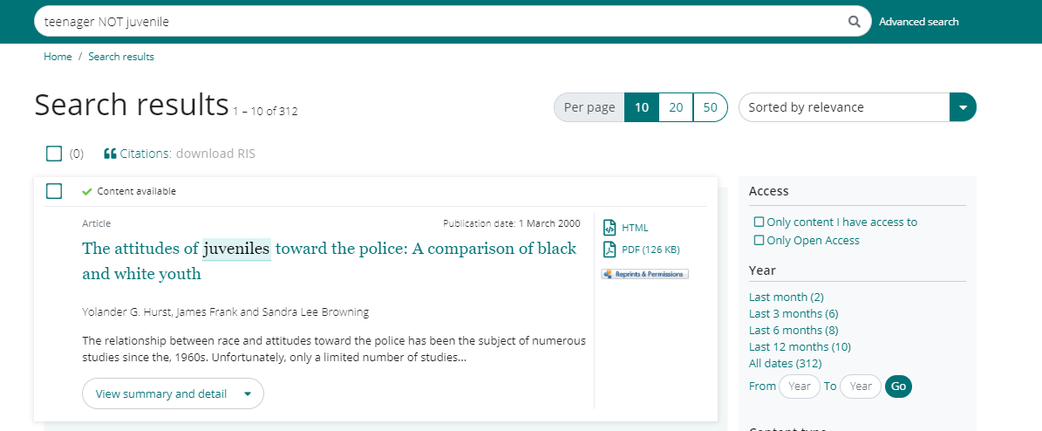
Example :
NOT
Notes:
1. When searching by topic, use the AND OR or NOT Boolean searching to get the best search results.
2. Use AND between search terms to find records that use all of the terms. For example, searching Accounting AND Auditing will find articles that have both Plagiarism and Copyright in the data fields
3. To be sure that you find all articles on your topic, use OR between search terms to search for synonyms of a concept, for example, search for Accounting OR Auditing
4. If your search results contain items that you want excluded, you can use the NOT connector. If you are searching for articles on Accounting, and keep getting results for the Auditing. Searching for Accounting NOT Auditing will exclude those results.

Slide 12
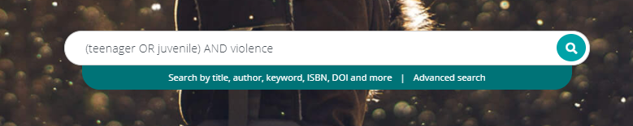
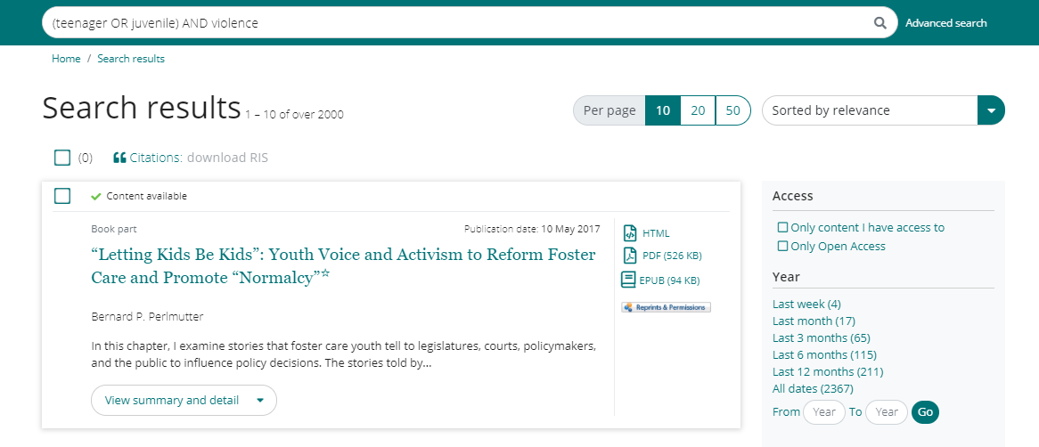
Example :
Combine BOOLEAN
Source : https://libguides.valdosta.edu/boolean-truncation-wildcards
Notes:
1. When searching by topic, use the AND OR or NOT Boolean searching to get the best search results.
2. Use AND between search terms to find records that use all of the terms. For example, searching Accounting AND Auditing will find articles that have both Plagiarism and Copyright in the data fields
3. To be sure that you find all articles on your topic, use OR between search terms to search for synonyms of a concept, for example, search for Accounting OR Auditing
4. If your search results contain items that you want excluded, you can use the NOT connector. If you are searching for articles on Accounting, and keep getting results for the Auditing. Searching for Accounting NOT Auditing will exclude those results.

Slide 13

Use Quotation Marks for exact phrases
If you are looking for a specific phrase, there's a simple way to make your searches more effective. Using quotation marks for exact phrases. When you use quotation marks around a phrase, you are telling the search engine to only bring back pages that include these search terms.
Notes:
If you are looking for a specific phrase, there's a simple way to make your searches more effective. Using quotation marks for exact phrases. When you use quotation marks around a phrase, you are telling the search engine to only bring back pages that include these search terms.

Slide 14
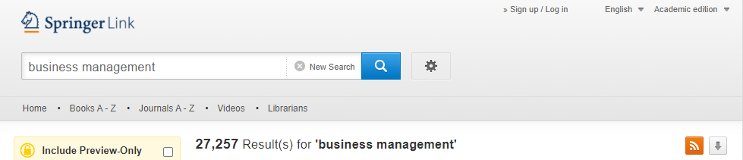
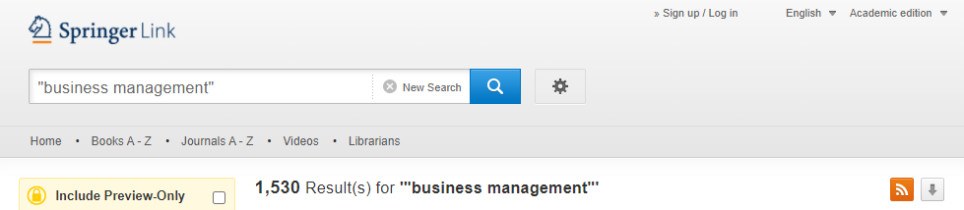
Use Quotation Marks for exact phrases
Before use quotation marks
27,257 results
After use quotation marks
1,530 results

Slide 15
Wildcard
A wildcard finds variant spellings of words. Use it to search for a single character or replace letters within a word.
Many databases use a question mark ? or hashtag # as their wildcard symbol.
Notes:
A wildcard finds variant spellings of words. Use it to search for a single character or replace letters within a word.
Many databases use a question mark ? or hashtag # as their wildcard symbol.

Slide 16
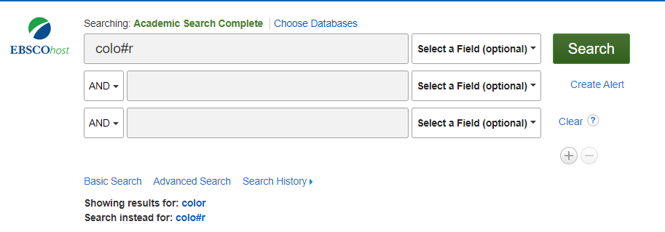
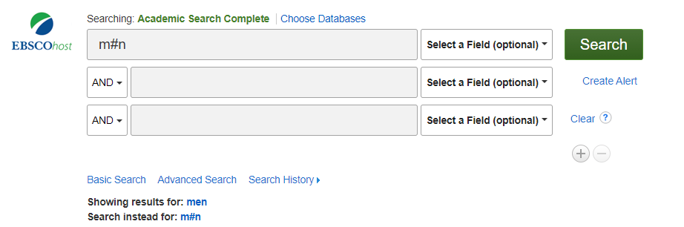
Wildcard
Notes:
For example:
Wildcards are useful for finding British and American spellings, for example, behavio?r will find behaviour and also behavior.
Or wom#n will find woman and also women.

Slide 17
Truncation
Truncation is useful for finding singular and plural forms of words and variant endings. Shorten your keyword to its 'stem' or 'trunk' and add the truncation symbol.
Many databases use an asterisk * as their truncation symbol.

Slide 18
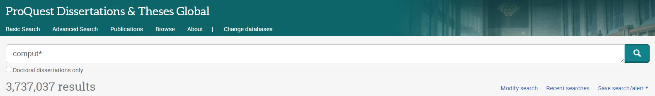
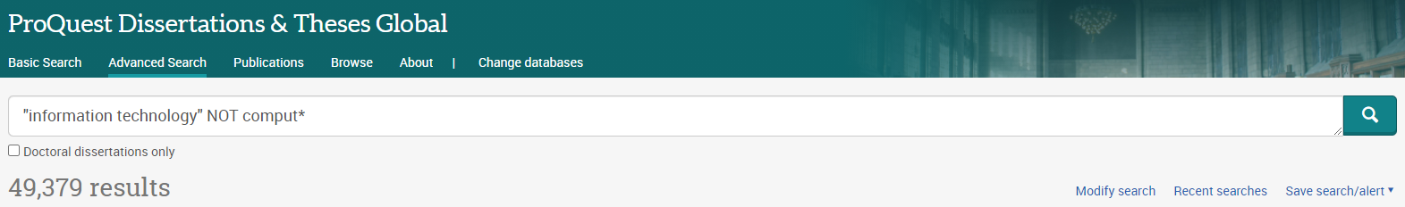
Truncation
Comput* will match all words that begin with:
1. Computer
2. Computing
3. Computational
Notes:
For example
Comput* would search for any word containing the stem comput (computer, computing and computation)

Slide 19

ONLINE DATABASE FOR LITERATURE
Refer to the notes section below for guidelines on this topic.
Notes:
When conducting research, it is easy to go to one source: Wikipedia. However, you need to include a variety of sources in your research. Consider the following sources:
Who can I interview to get more information on the topic?
Is the topic current and will it be relevant to my audience?
What articles, blogs, and magazines may have something related to my topic?
Is there a YouTube video on the topic? If so, what is it about?
What images can I find related to the topic?

Slide 20
What is online database?
Online databases is an electronic (online) catalog or index. Library databases contain information about published items.
Library databases are searchable.
The library subscribes to many databases for user access to these resources. When you're searching a database, you are not searching "the web."
Library databases also contain more reliable information than what people find on some websites, primarily because the information library databases contain is sourced from experts and professional.

Slide 21

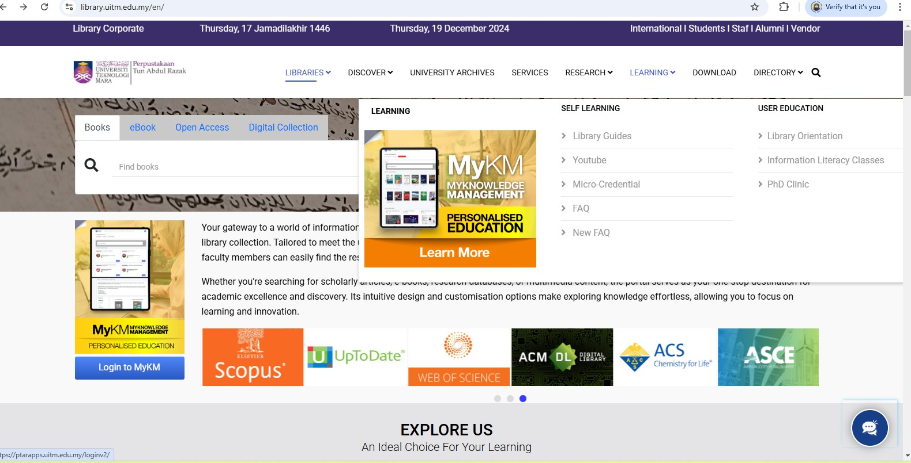


LIBRARY PORTAL
UiTM Library Portal
Start your search using Library Portal at
https://library.uitm.edu.my/en/
Visit the Library Portal and Click on Learning to access the MyKM Portal page.

Slide 22
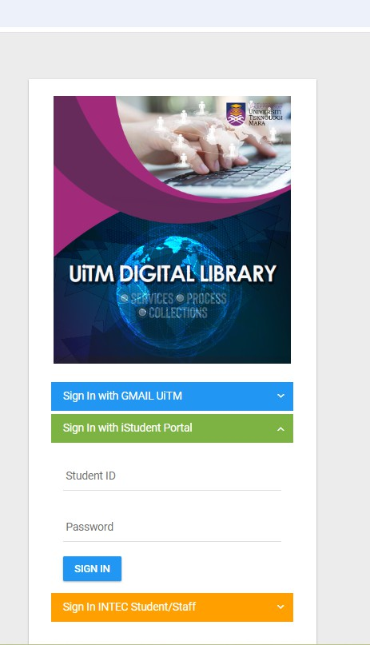



LOGIN TO MYKM
Scroll down and select Online Database.
Use your student ID and password to
202489****
log in to the MyKM portal.
***********

Slide 23
List of Databases Subscribed by UiTM

Slide 24
Online Databases
A list of all fields will be displayed here for selection based on your faculty.

Slide 25
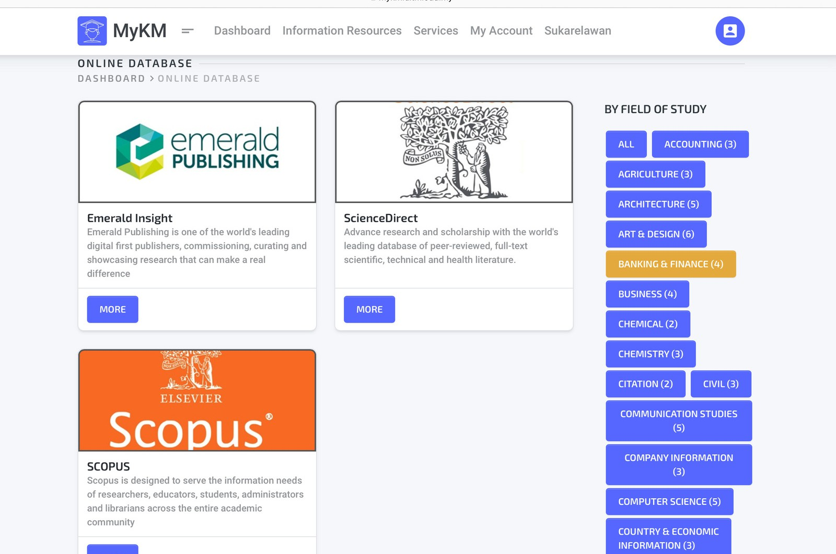


Select Field of Study
After selecting your field of study, recommended databases for use will be displayed.

Slide 26

Using Emerald Insight
for searching
Note : Different online database may have different search methods.
In the search bar on the Emerald Insight homepage, users can type keywords, the title of the article, ISBN, DOI and more.

Slide 27
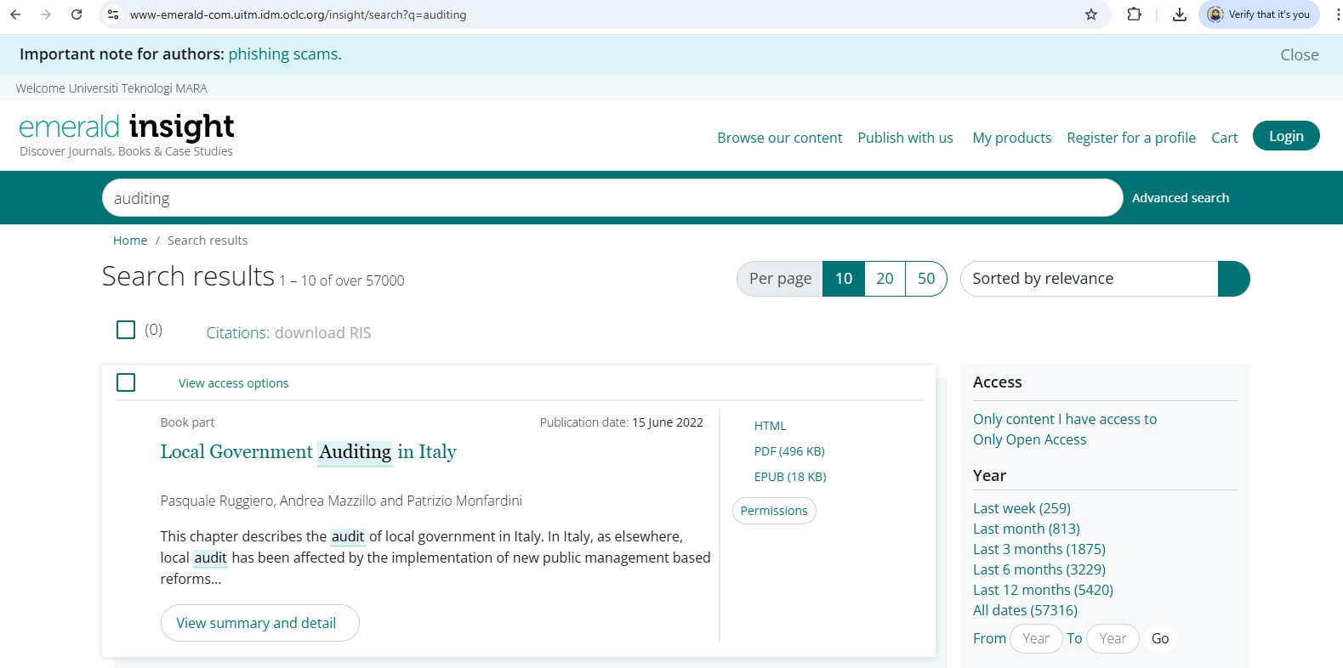

Basic search:
Keyword: Auditing
Users can find all search results for the title here.

Slide 28
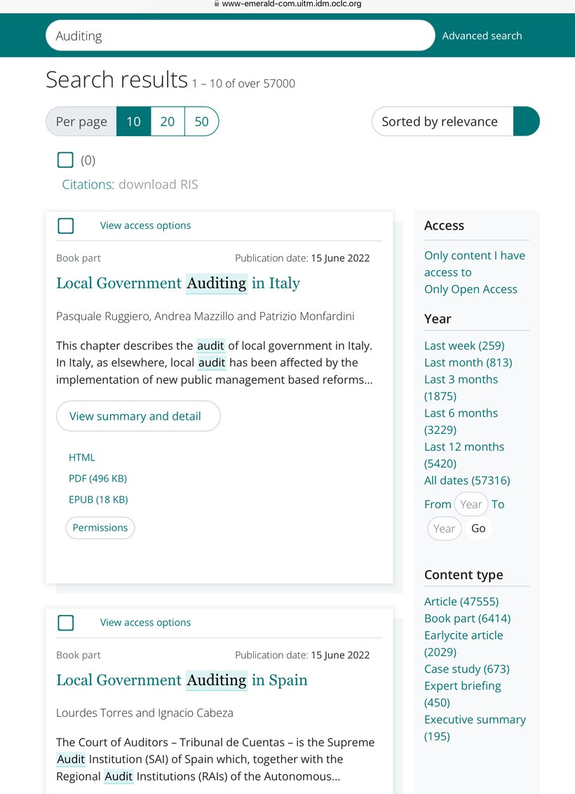

Basic search:
Keyword: Auditing
Users can choose the content type that they prefer either article, book part etc.

Slide 29
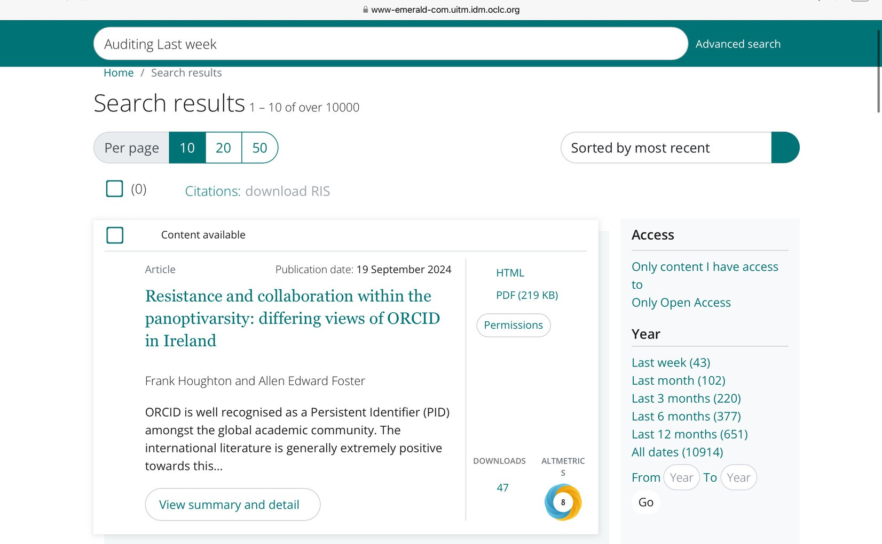

Advanced Search:
keyword: Auditing Last week
Users can search by selecting a specific year, month, or week in the past and sort the results by most recent or oldest first.

Slide 30
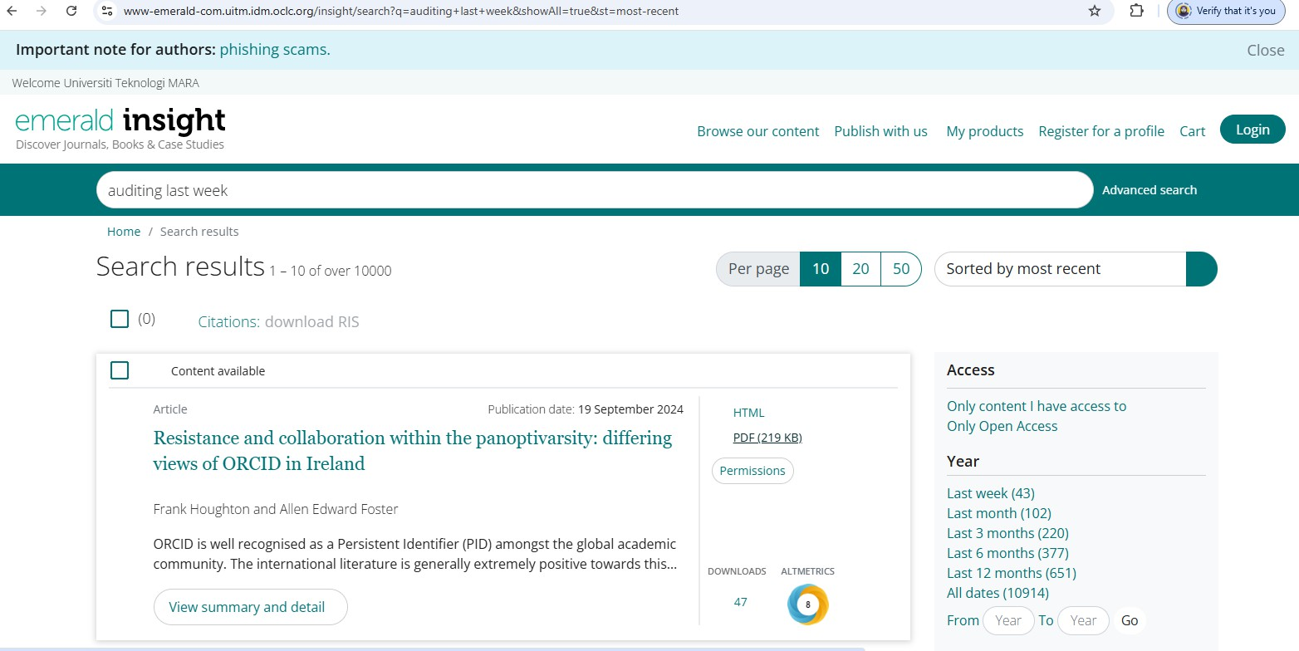

Download article from emerald insight
Once you find the article you want, click on its title to open the article page.
Look for a "Download PDF" button on the article page.

Slide 31
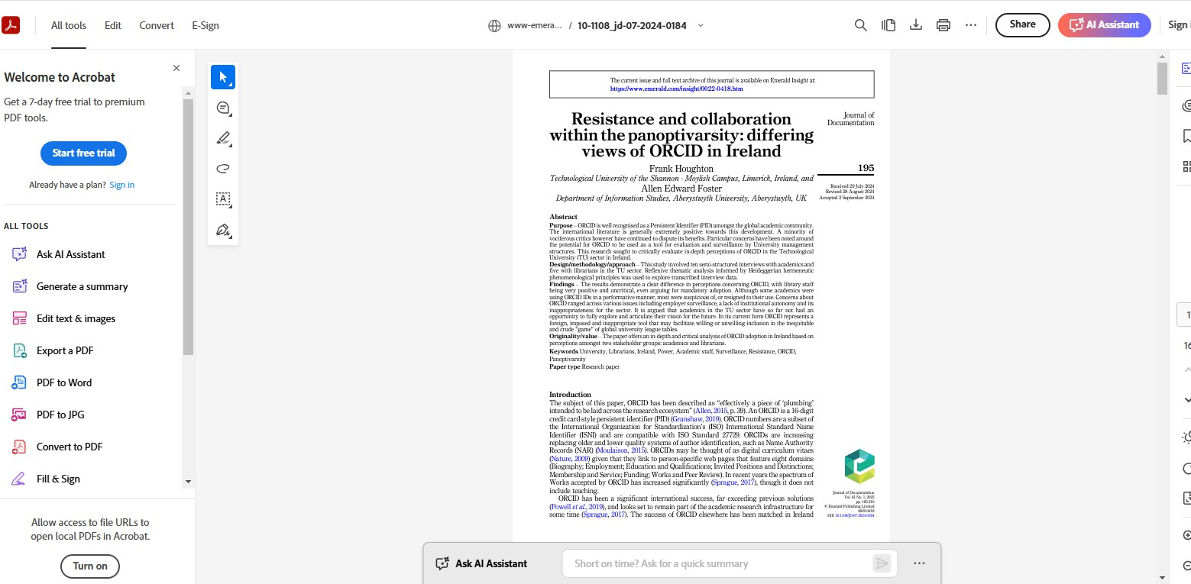
Download article from emerald insight
click the download icon to save it to your device.

Slide 32

ENQUIRIES
Consultation Services:
Telephone: Main Library : 03-5544 3793 / 3716
Law Library : 03-5544 3733
Science & Technology Library : 03-5544 3820
Engineering Library : 03-5544 3812
Built Environment Library : 03-5544 4392
Chat with Librarian : https://ptar.uitm.edu.my/libchat
Like and follow us at social media:
https://twitter.com/uitmlibrary
https://www.instagram.com/libraryuitm/
https://perpustakaanuitm.blogspot.com/
https://www.facebook.com/libraryuitm/

