Slide 1





Reference Management Software (Mendeley)
MODUL LMS 301 :

Slide 2

MODULE OVERVIEW / INTRO
1
2
Module highlight :
What is LMS 301 Module?
Mendeley is a free reference manager that can help students and researchers organize their research, collaborate with others online, and discover the latest research. This class would assist students and researchers at all levels to store, track and cite reference information about their research materials.
Access and searching technique to:
Introduction to Reference Management Software
Introduction to Mendeley
Installation Guide
Mendeley Use
In-Text Citation
Bibliography
4
Duration
3
Teaching Medium
1 to 2 Hour(s)
Online via Webex, Google Meet, Google Classroom
Face to Face : IT Centre

Slide 3
INTRODUCTION TO REFERENCE MANAGEMENT SOFTWARE

Slide 4

WHAT IS REFERENCING
Referencing means acknowledging someone else’s work or ideas.
It is sometimes called ‘citing’ or ‘documenting’ another person’s work.
Referencing is a basic university requirement.
Without appropriate referencing students are in effect “stealing” the work of others - this is lead to academic fraud @ Plagiarism

Slide 5
CITATION – REFERENCE - BIBLIOGRAPHY
CITATION | REFERENCE | BIBLIOGRAPHY
Appears within the text of your assignment and acknowledges that the words or ideas belongs to another. Author focus: According to Adams (2001), ….. Information focus: ……….(Adams, 2001). | Appears at the end of your assignment . This list contains ONLY the sources you cited in your assignment. | Appears at the end of your assignment . It is a list of ALL sources you used to formulate your assignment.

Slide 6
BIBLIOGRAPHY
A bibliography is a list contain of all the sources you have used, whether they are directly cited or not. In a Bibliography you list all of the material you have consulted in preparing your essay whether or not you have actually cited the work.
A bibliography will contain all research materials, including books, magazines, periodicals, websites and scientific papers, which you have used to generate ideas or ‘read around’ a topic, but have not referred to directly in the body of the document.
This means, in addition to listing the sources you cited in-text, you also list resources that you read or referred to generate your ideas about the topic.

Slide 7
When citing, you need:
WHO created the work
WHEN it was published, created, or performed
WHERE it was published, created, or performed
WHAT is the format (Book, Report, play, study, proceeding)
When using online resources, you need: The URL (Website) or Database Name, WHEN the URL (Website) or database was visited

Slide 8
WHEN SHOULD I DO CITATION/REFERENCE?
You reference whenever you have used a piece of information that comes from :
Text books
Journals
Published papers, (e.g. conference or working paper)
Newspapers
Reports
Websites
TV/Radio interviews/Film
Others, etc

Slide 9
WRITING STYLE
APA reference list
MLA list of works cited
Oxford bibliographies
Harvard reference lists
Chicago bibliographies
…. Many more ….

Slide 10
WRITING STYLE
APA (American Psychological Association) style is most frequently used within the social sciences, in order to cite various sources.
This style offers examples for the general format of APA research papers, in-text citations, endnotes/footnotes, and the reference page.

Slide 11
APA CITATION & REFERENCES
There are 2 parts:-
In-Text Citations (within the body of your paper).
  Each in-text citation gives just enough information on a particular source to “point” the reader to the corresponding, more detailed entry on the reference list.
  Example: Numerous studies in the field of total quality management (TQM) practices have indicated a positive effect of these practices on the performance of companies (Ahire et al., 1996; Adebanjo and Kehoe, 1999; Kaynak, 2003; Hanson and Eriksson, 2002; Sadikoglu and Zehir, 2010; Al-Dujaili, 2013).
Reference List (on the separate page at the end of your paper)
This is the list of sources you used and cited in your paper.
Example:-
Lepist, K., Saunila, M., & Ukko, J. (2020). The impact of certification on the elements of TQM exploring the influence of company size and industry. https://doi.org/10.1108/IJQRM-11-2020-0362
Zhu, M., Bonk, C. J., & Doo, M. Y. (2020). Self-directed learning in MOOCs: exploring the relationships among motivation, self-monitoring, and self-management. Educational Technology Research and Development, 0123456789. https://doi.org/10.1007/s11423-020-09747-8

Slide 12

APA STYLE COMMON “RULES”
It is important to remember that:-
APA follows the Author, Year format either Adam (2012) or (Adam, 2012)
Only “ Author’s last name or surname is used. For Malay name, full name/ first name can be used
In the reference list, the cited sources are listed in alphabetical order (From A to Z)

Slide 13
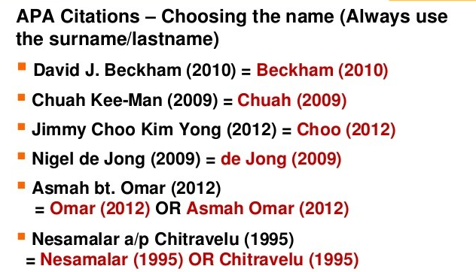
APA STYLE COMMON “RULES”

Slide 14
REFERENCE LIST APA STYLE
Book
Author | Date | Title | (SOURCE) Publisher Name | (SOURCE) URL
Author, A. A. | (2020). | Title of book. Title of book (3rd ed). Title of book [Audiobook]. | Publisher name. | https://doi.org/xxx https://xxx.xxxx
Examples:
References:
Stegenga, J. (2018). Care & cure: An introduction to philosophy of medicine. The University of Chicago Press. https://doi.org/10.7208/chicago/9780226595177.001.0001
In-text Citation (Paraphrase):
(Stegenga, 2018)
In-text Citation (Direct Quote):
(Stegenga, 2018, p. 52)
https://libguides.ecu.edu/c.php?g=982594&p=7105378

Slide 15
REFERENCE LIST APA STYLE
Journal Article-One Author & DOI (Electronic or Print)
Author | Date | Title | (SOURCE) Periodical Information | (SOURCE) URL
Author, A. A. | (2020). (2020, August). (2020, September 28). | Title of article. | Title of Periodical, 23(5), 35-39. Title of Periodical, 44(3), e34876. | https://doi.org/xxxx
Examples:
References:
Milligan, C. K. (2006). Yoga for stress management program as a complementary alternative counseling resource in a university counseling center. Journal of College Counseling, 9(2), 181-187. https://doi.org/10.1002/j.2161-1882.2006.tb00105.x
In-text Citation (Paraphrase):
(Milligan, 2006)
In-text Citation (Direct Quote):
(Milligan, 2006, p. 185)
https://libguides.ecu.edu/c.php?g=982594&p=7105378

Slide 16
REFERENCE LIST APA STYLE
Citing Webpages
Author | Date | Title | (SOURCE) Website Name | (SOURCE) URL
Author, A. A. & Author, B. B. | (2020). (2020, August). (2020, September 28). (n.d.). | Title of work. | Site Name. | https://xxx.xxxx Retrieved December 22, 2020 from https://xxx.xxxx
Examples:
Reference
Tucker, M. E. (2018, May). An occupational therapist may benefit your care. Diabetes Forecast. http://www.diabetesforecast.org/2018/03-may-jun/an-occupational-therapist-may.html
In-text Citation (Paraphrase):
(Tucker, 2018)
In-text Citation (Direct Quote):
(Tucker, 2018, para. 1)
https://libguides.ecu.edu/c.php?g=982594&p=7105378

Slide 17
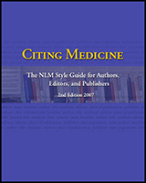
CITING MEDICINE - NLM STYLE
View this eBook by NLM with guidelines and examples for citing all material types.
https://www.ncbi.nlm.nih.gov/books/NBK7256/
Resources and samples for creating the reference page of your research paper with NLM, APA, or AMA Style, plus books, articles, and websites for improving writing skills.
https://libguides.logan.edu/citation_styles/nlm

Slide 18
ETHICS & PLAGIARISM
Plagiarism :
The copying of words, sentences and paragraphs directly from the work of another without paraphrase
The copying of illustrations, figures, photographs, drawings, models, or other visual and nonverbal materials, including recordings, of another without proper credit
The presentation of work prepared by another in final or draft form as one's own without citing the source
Sources: Brian James Baer, Kent State University
29 August 2014

Slide 19
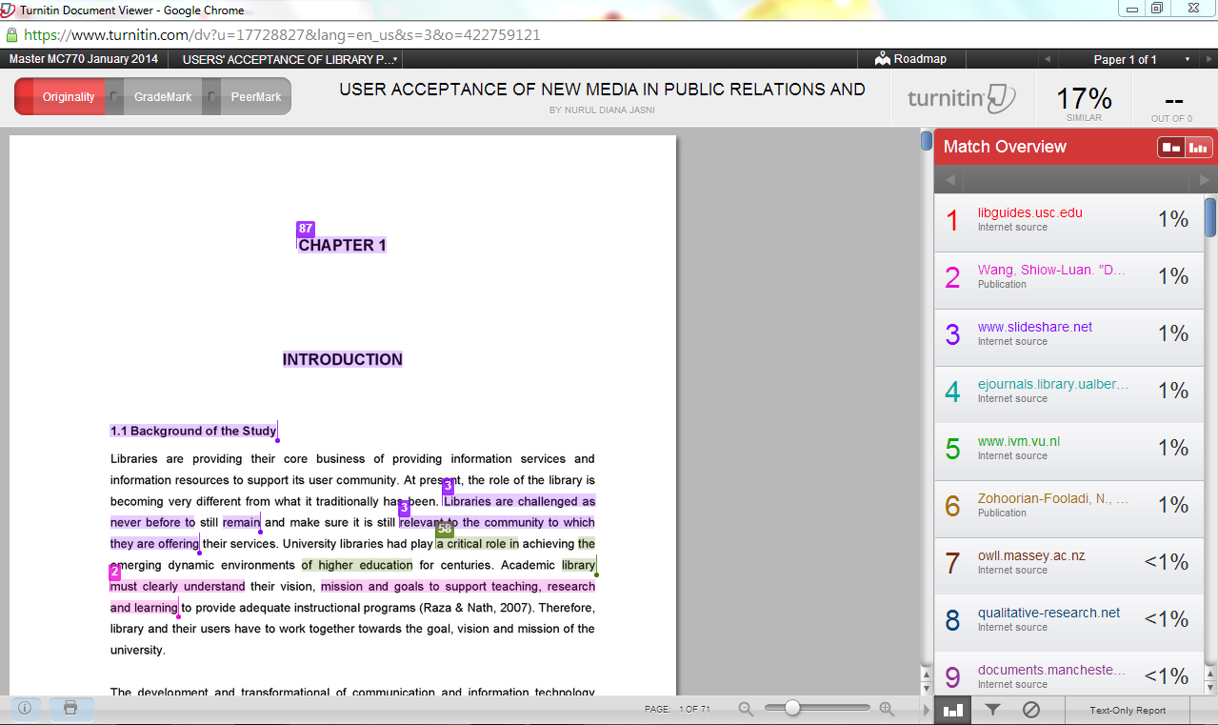
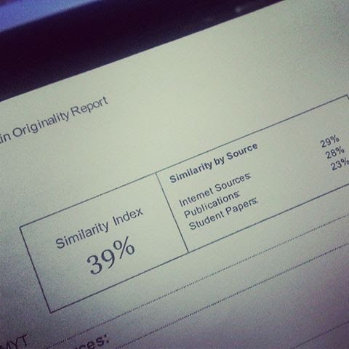

ETHICS & PLAGIARISM
Turnitin is a leading academic plagiarism checker technology for teachers and students. Online plagiarism detection, grammar check, grading tools.
UiTM: (30% ) ONLY
Sumber: Maklumat terperinci, sila rujuk dokumen Understanding, Plagiarism a Guide for Lecturers and Avoiding Pagiarism a Guide for student yang diperolehi dari laman web https://hea.uitm.edu.my

Slide 20
REFERENCE MANAGEMENT SOFTWARE
Reference management software that available in UiTM Libraries:
Mendeley
*Endnote
(*This software is intended to UiTM registered users only)

Slide 21
MENDELEY VS ENDNOTE
Feature | Benefits | Mendeley | EndNote
Secure, sync across multiple platforms | Anytime, anywhere access | Desktop Web Mobile (iOS and soon Android) | Desktop Web Mobile (iOS) Does not sync
Full text search | Be able to find the right information quickly | Yes | Yes
Annotations, highlights | Share comments with others | Yes | No – free version Yes – paid version
Group, follow capability | Ability to share information/ full text as well as ‘follow’ group trends | Yes | Only private groups
Personalized recommendation | Proactive recommendation | Related papers – free Mendeley suggest – paid | No
Citation style | More styles = flexibility | 7000 styles | 6500 styles
Auto-extract of metadata from PDF | Saves time and accuracy to create citation | Extracts full citation metadata, DOI, PubMed, and Arxiv ID | Only DOI and embeded PDFs
Library system integration | Enable one-click download | No (TBC in 2015) | Yes
Support non-English documents and UI | More user adoption | No | Yes
Freemium version | Low-cost to entry | Yes – 2 GB of storage | Yes – 2 GB of storage
Alumni policy | Benefits for alumni | Yes – 12 months grace period then free account | None

Slide 22
REFERENCE MANAGEMENT SOFTWARE: MENDELEY

Slide 23
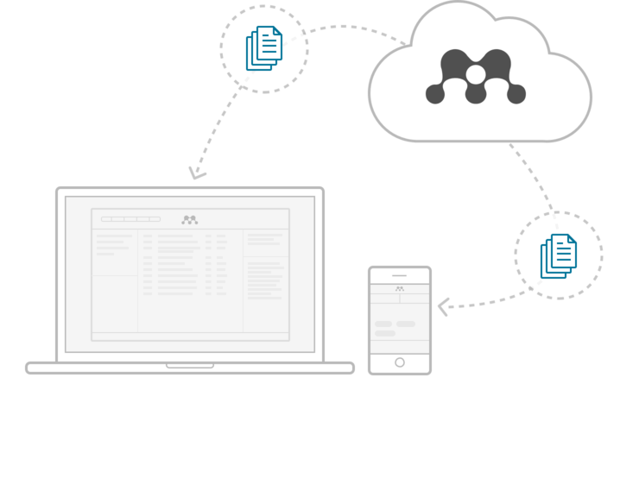
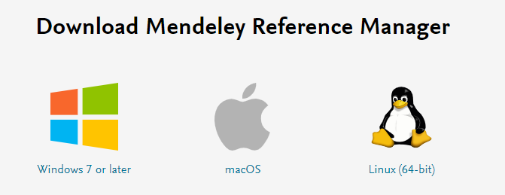
WHAT IS MENDELEY
Free Academic Software
Web: Mendeley Reference Manager
Desktop
Ms Word: Mendeley Cite-O-Matic
Mendeley Web Importer
Note: The Mendeley mobile app is discontinued. You can use the Mendeley Reference Manager web application instead. The Mendeley app this is no longer available to users. The app has been removed from the Google Play Store and the App Store.

Slide 24
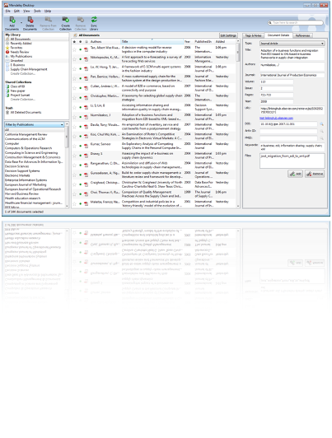
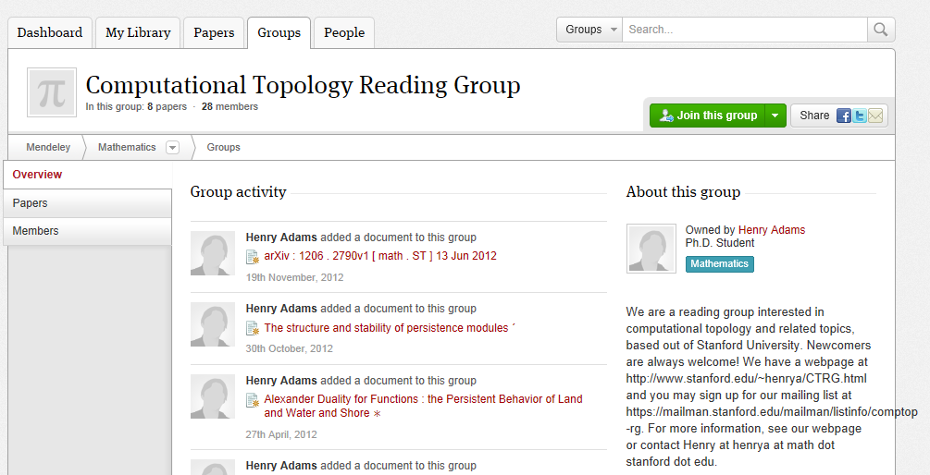
WHAT IS MENDELEY
Mendeley is a reference manager allowing you to manage, read, share, annotate and cite your research papers...
...and an academic collaboration network with 4 Million users to connect like-minded researchers & discover research trends and statistics.

Slide 25
Mendeley Term
• Mendeley Desktop: Mendeley Desktop is the downloaded part of the software installed onto your computer. Download Mendeley Desktop if you haven’t already.
• Mendeley Web: This is the Mendeley website where you can access the web version of your library, edit your profile and search for papers, groups or people.
• Sync: The process of synchronizing your Mendeley data across devices.
• Web Importer: The browser bookmarklet that lets you quickly import documents from anywhere on the web.
• Citation Plugin: A plugin you can install that allows you to create and format your citations and bibliography according to your chosen style.

Slide 26
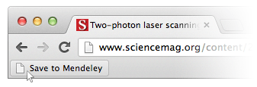
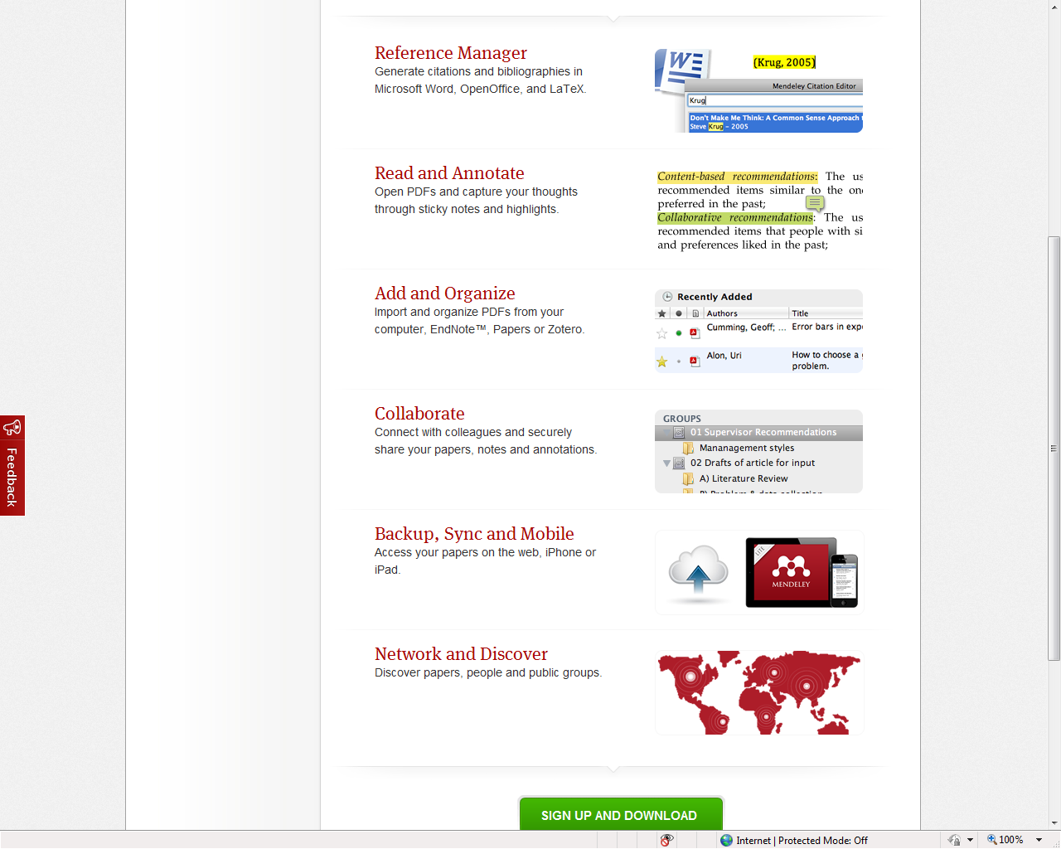
HOW MENDELEY DRIVES RESEARCHER PRODUCTIVITY
Add and organize PDFs
Import and organize PDFs from your computer, EndNote™, RefWorks, Papers, Zotero, Mendeley importer, ScienceDirect, and Scopus
Read and annotate
Open PDFs and capture your thoughts through sticky notes and highlights.
Reference Manager
Generate citations and bibliographies in Microsoft Word, OpenOffice, and LaTeX. 7000 citation styles!

Slide 27
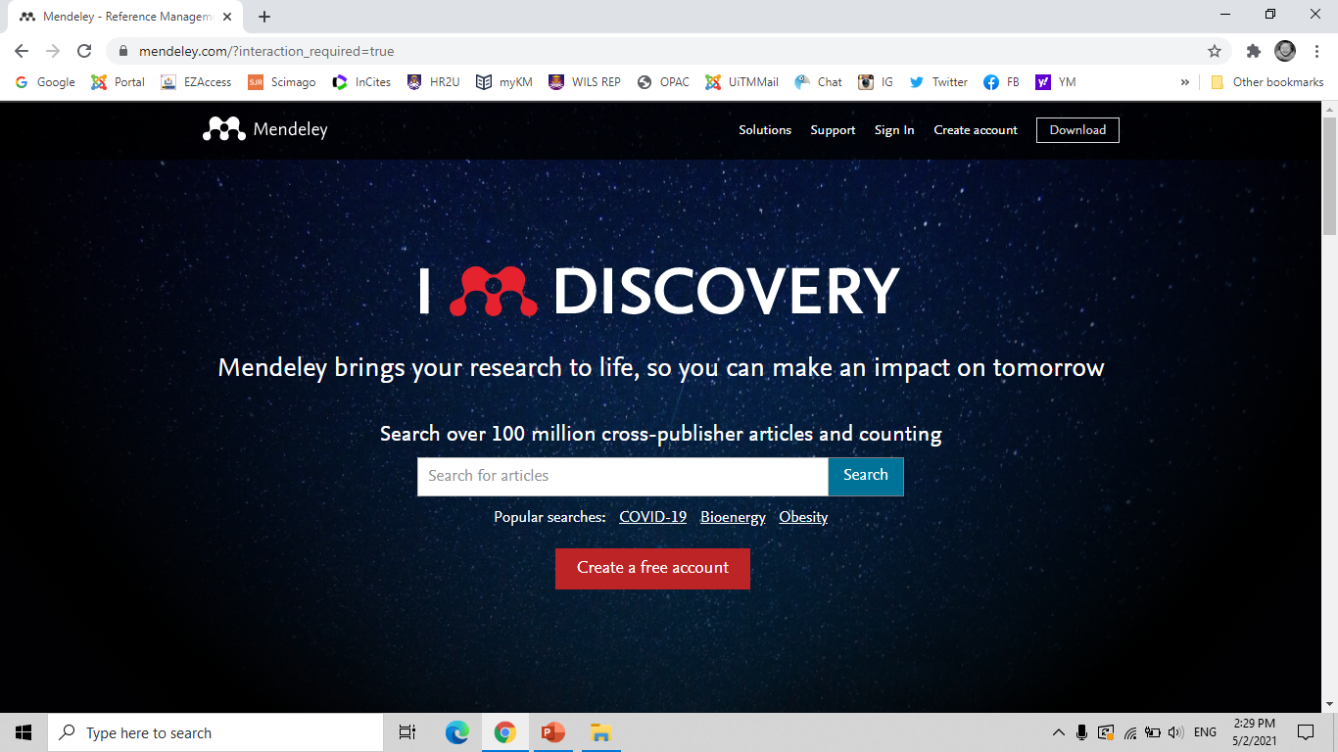
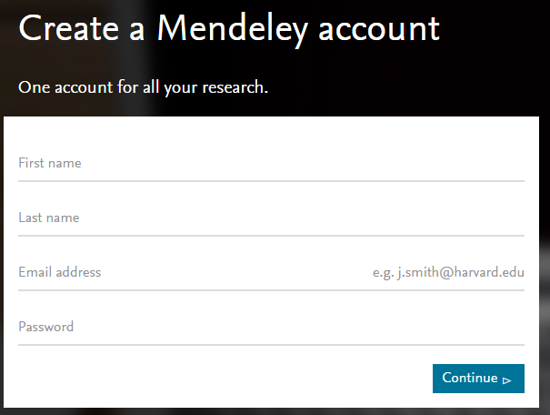
Getting started www.mendeley.com
You are recommended to use personal email to ensure no time limitation usage.

Slide 28

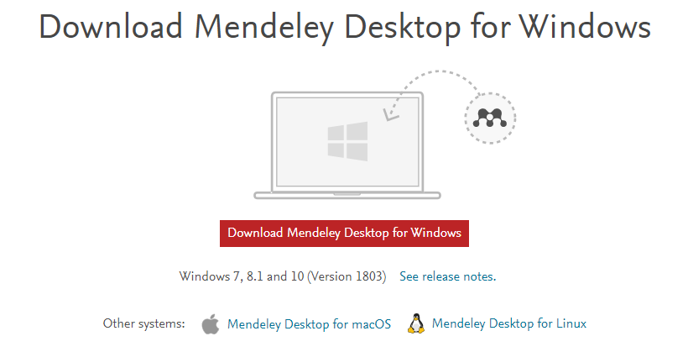


Download - Installation Guide & Resources
https://www.mendeley.com/
Choose (Linux / Mac / Windows) and download Mendeley Desktop.
Login Mendeley Desktop > Tools > Install Web Importer.
Login to Mendeley Desktop > Tools > Install MS Word Plugin. (Microsoft Word)
For MAC users, Install the free plugin for LibreOffice or MS Word to cite a document and generate a bibliography:

Slide 29
MENDELEY DESKTOP
Free to download
Easy to install
Frequently updated automatically
User friendly interface
Intergrate with any word processing software (Microsoft Words,Open Office, iNotes, etc..)
Compatible with all type of operating software (Windows, Linux,etc...)

Slide 30
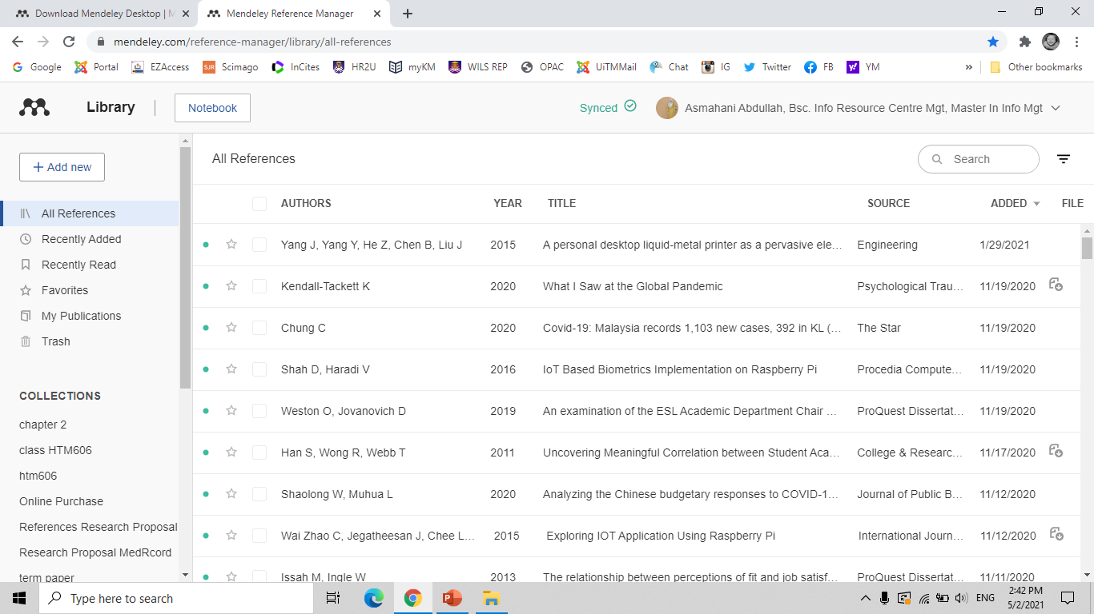
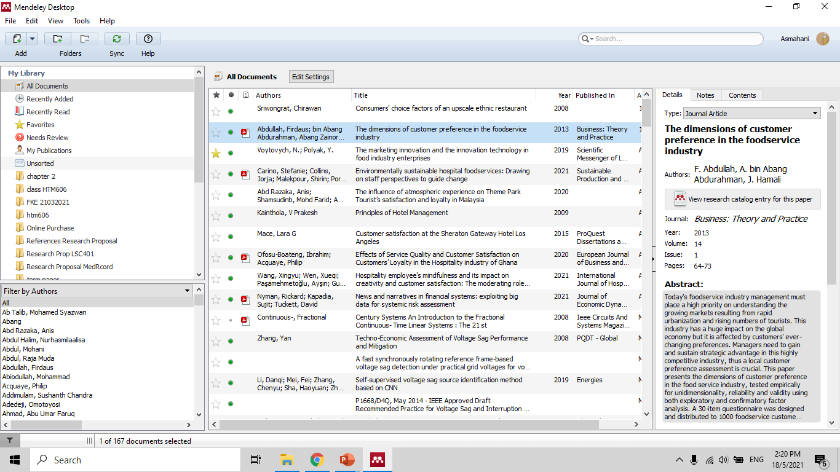
WEB VERSION
DESKTOP VERSION
BOTH REQUIRE ONE SAME ACCOUNT

Slide 31
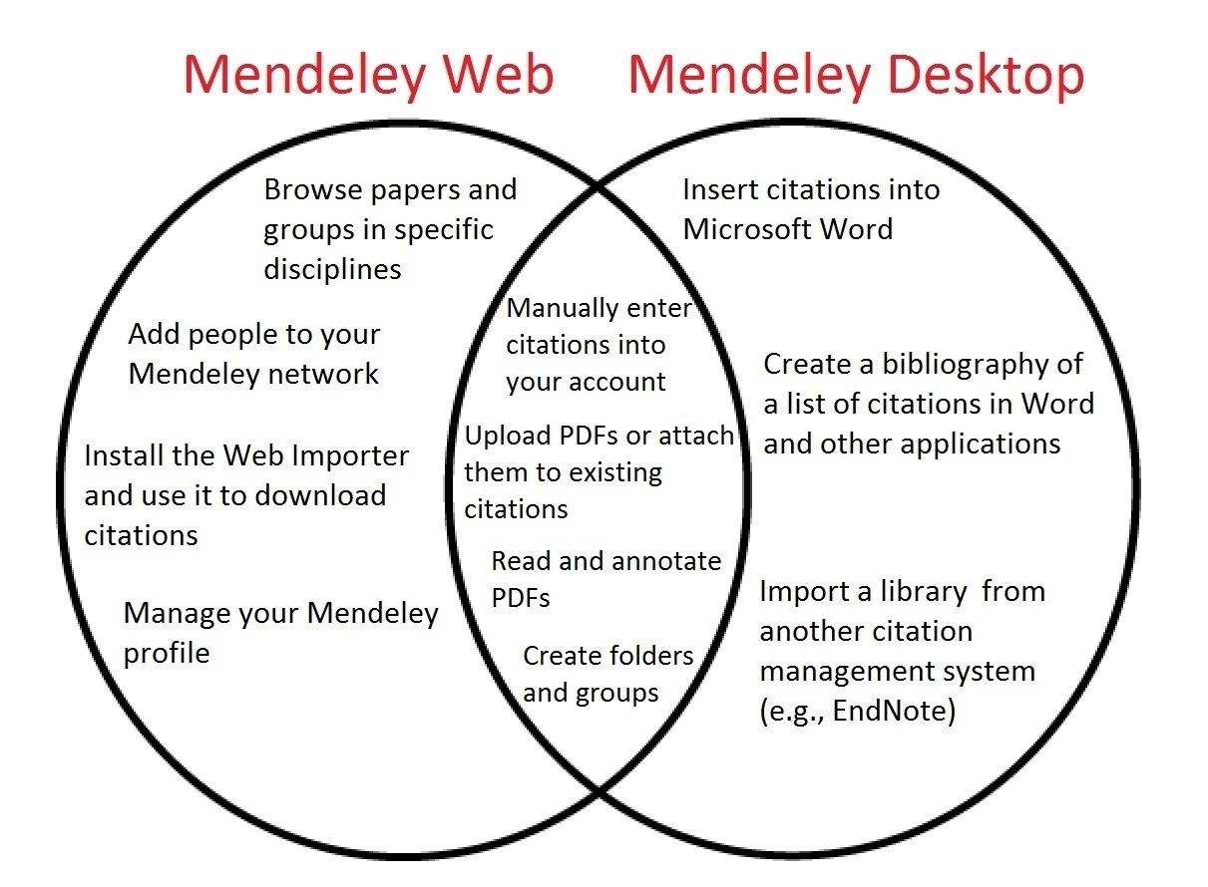

Slide 32
CREATING YOUR LIBRARY (MENDELEY WEB)

Slide 33
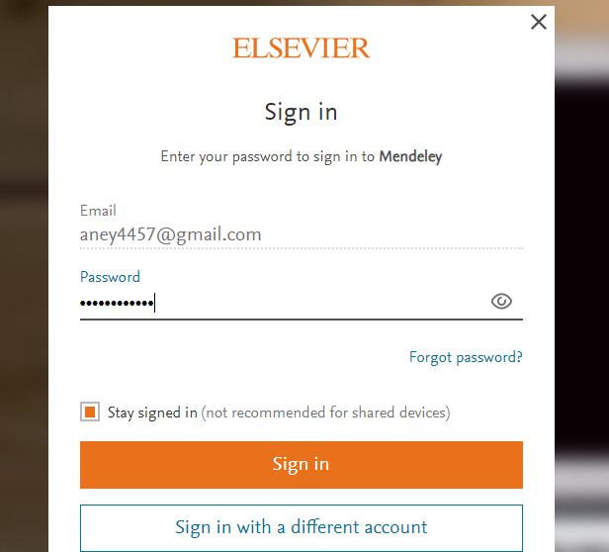
MENDELEY WEB – SIGN IN

Slide 34
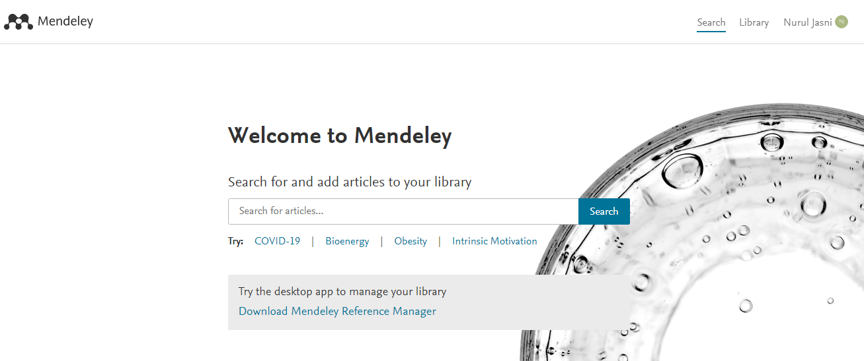
MENDELEY WEB – LITERATURE SEARCH
https://www.mendeley.com/search

Slide 35
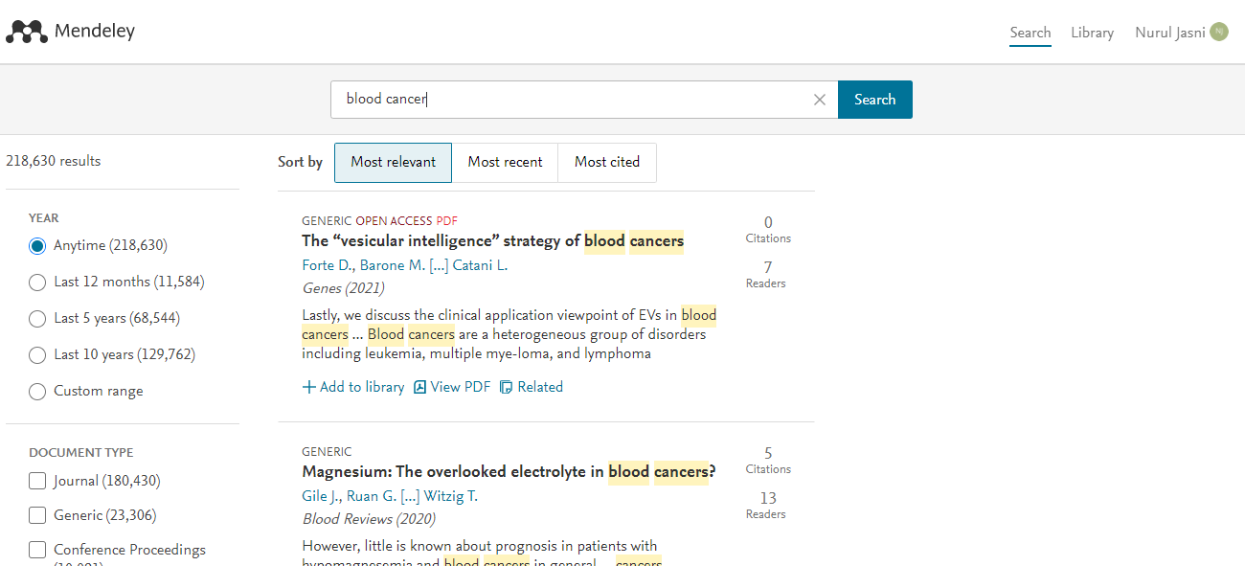
MENDELEY WEB – ADD FILES FROM LITERATURE SEARCH
Get full text at publisher’s page.

Slide 36
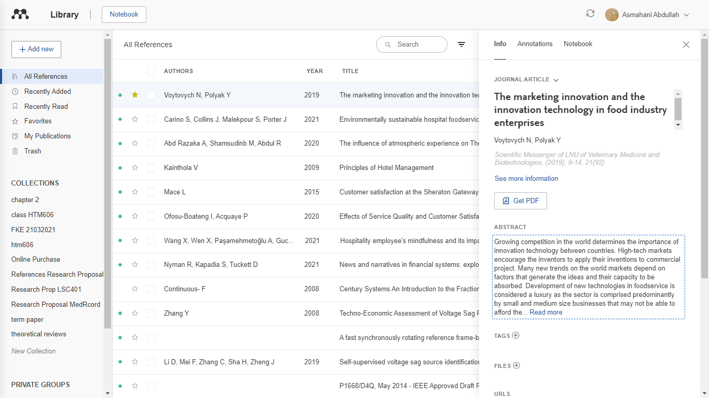
MENDELEY WEB - LIBRARY
MAIN LIBRARY
DISPLAY SELECTED REFERENCE

Slide 37
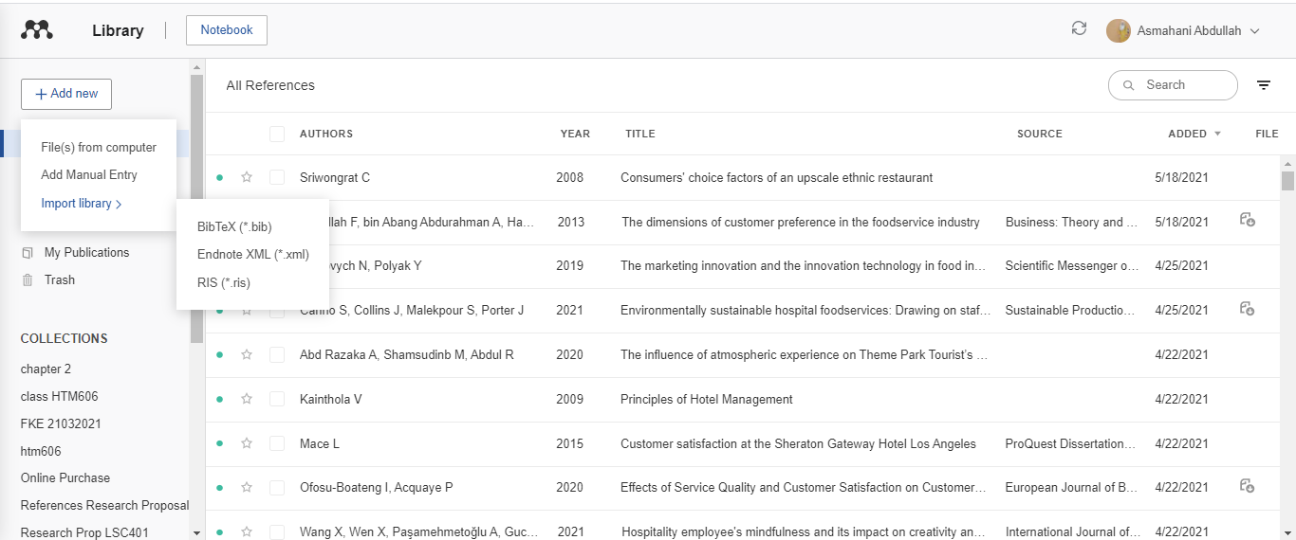
MENDELEY WEB – ADD & CREATE FILES
All uploaded files will be automatically updated (sync) in the main library. Can be viewed in Mendeley Desktop Version too.

Slide 38
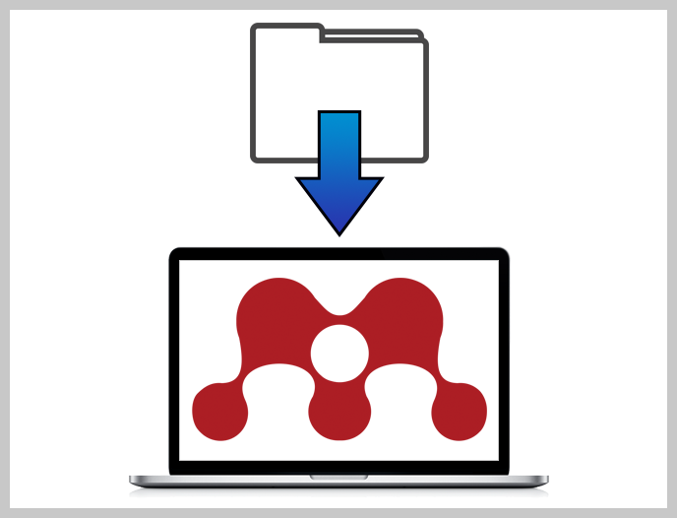
Import from other software
You can transfer your library from online databases, EndNote, Papers, Zotero, Refworks, Jabref and more.
Use the Export option within the other software to extract your references to RIS, BibTeX, or EndNote XML file format.
In Mendeley Desktop/Web, click File > ‘Import’ and select the exported file to add its contents to your Mendeley library.

Slide 39
CREATING YOUR LIBRARY (MENDELEY DESKTOP)

Slide 40
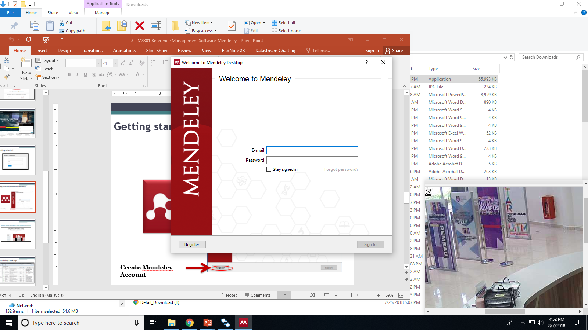
Create Mendeley Account

Slide 41
Enter registered email and password

Slide 42

DISPLAY SELECTED REFERENCE
MAIN LIBRARY
FILTERING OPTION

Slide 43
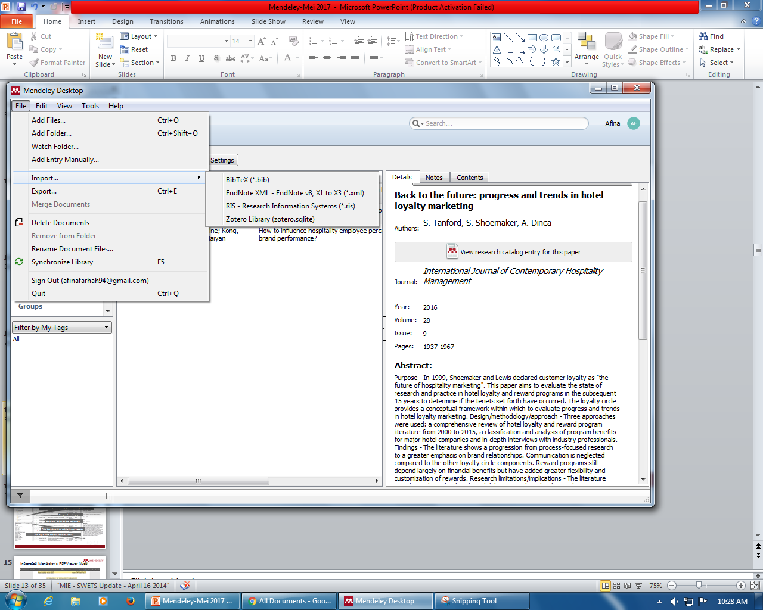
CREATING YOUR LIBRARY (MENDELEY DESKTOP)
You have different options to set up your library:
Add single files or an entire folder
“Watch a folder” to automatically import PDF files
Drag and drop PDFs into Mendeley Desktop
You can also:
Add existing EndNote/BibTeX/RIS databases
Use Mendeley Web Importer to add from online databases
Add from the Mendeley Research Catalog
… and Mendeley will try to extract the document details automatically

Slide 44
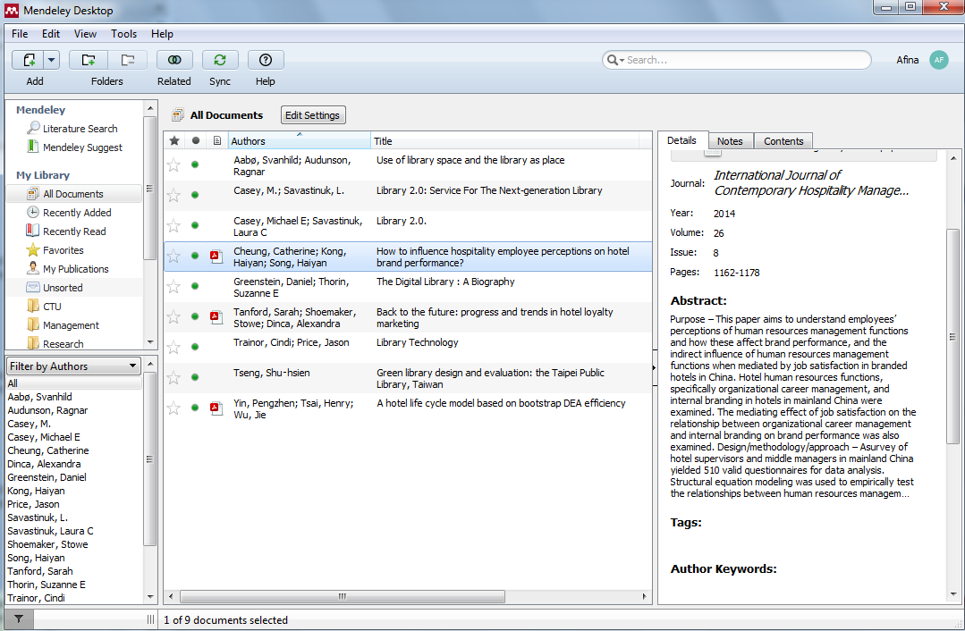
CREATING YOUR LIBRARY
(MENDELEY DESKTOP)
Star your favorite papers
Open attached PDF files in integrated viewer
Set up and manage your reference groups
Documents can be marked read/unread
Filter by authors, tags, publications or keywords
Add tags & notes and edit document details

Slide 45
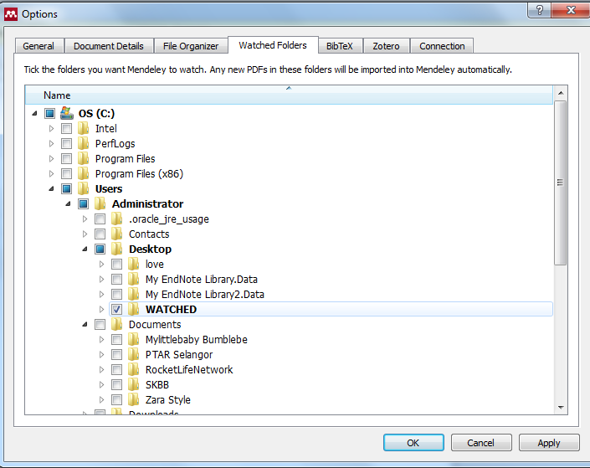

MENDELEY: WATCHED FOLDERS
Open Mendeley Desktop
Click Tools > Options >Watched Folders in Windows or Linux machines, or Mendeley Desktop >Preferences >Watched Folders in Macs
Check the boxes for the folders you wish to watch
Save PDF files to these folders as normal
When you run Mendeley Desktop, any new PDFs added to these folders will be automatically imported to your All Documents folder in your personal library in Mendeley Desktop.

Slide 46
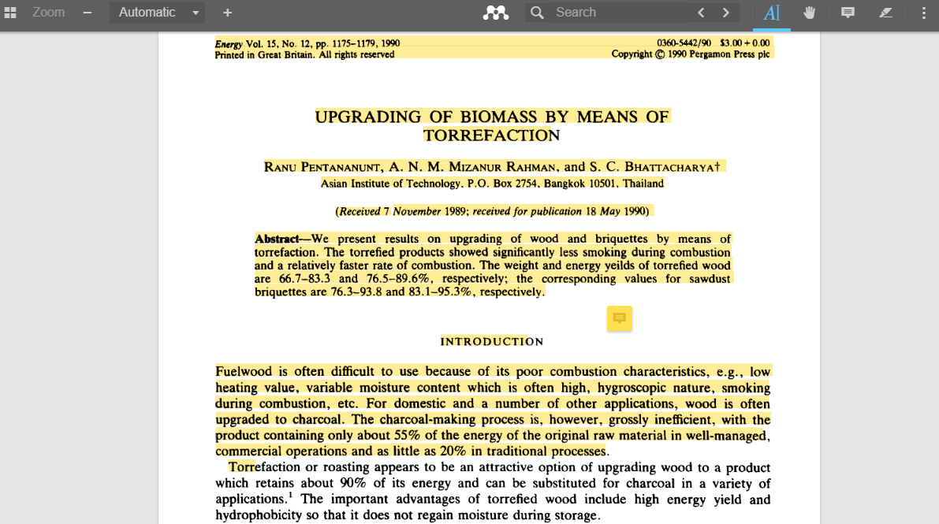
INTEGRATED MENDELEY’S PDF VIEWER (WEB)

Slide 47
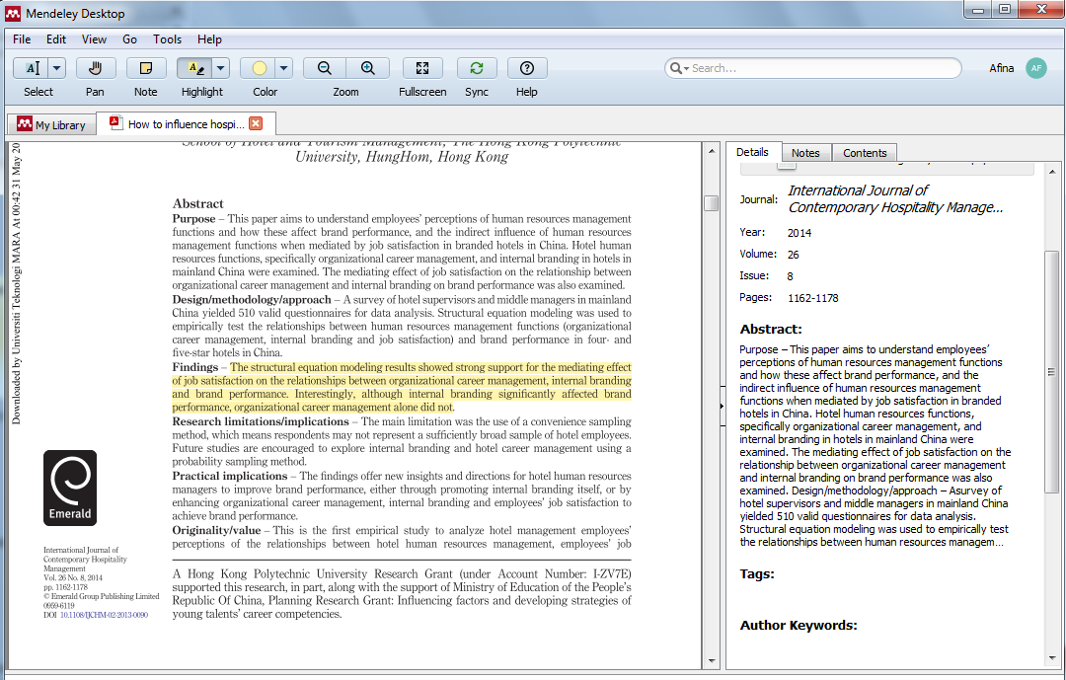
INTEGRATED MENDELEY’S PDF VIEWER (DESKTOP)

Slide 48
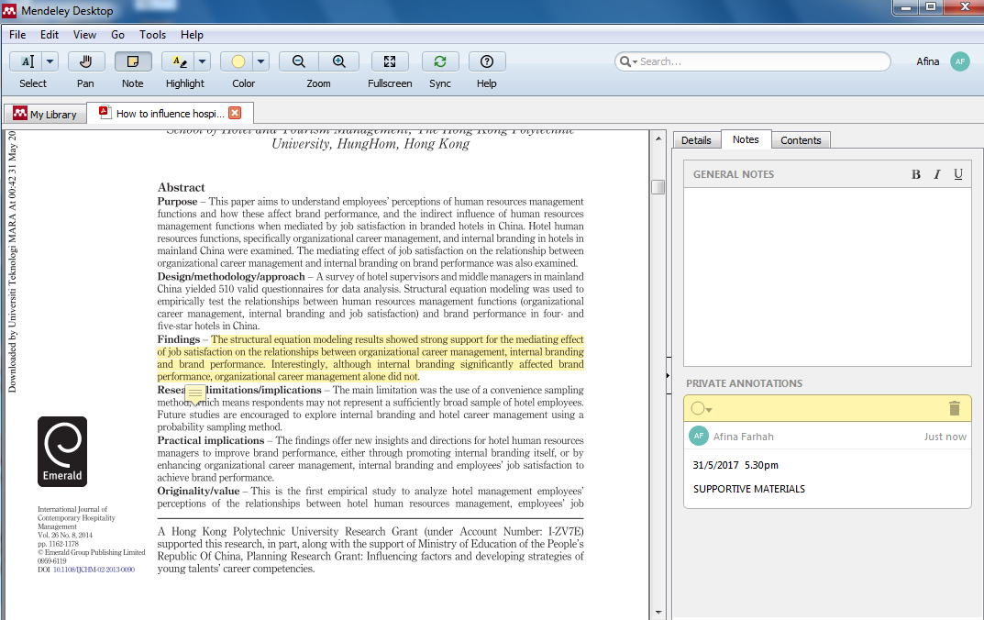
ANNOTATE AND HIGHLIGHT

Slide 49
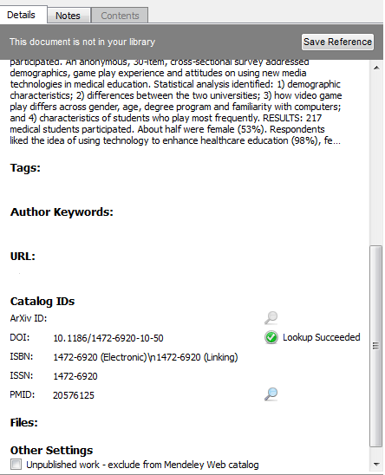
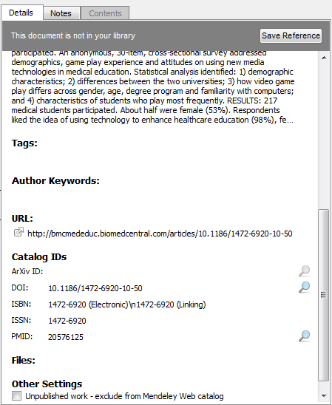
DOCUMENT DETAILS LOOKUP
Missing info will automatically appear at URL & Open at Web Browser
Enter the DOI, PubMed, or ArXiv ID and click on the magnifier glass to start lookup [Lookup Succceeded]

Slide 50
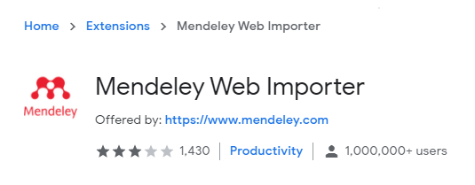
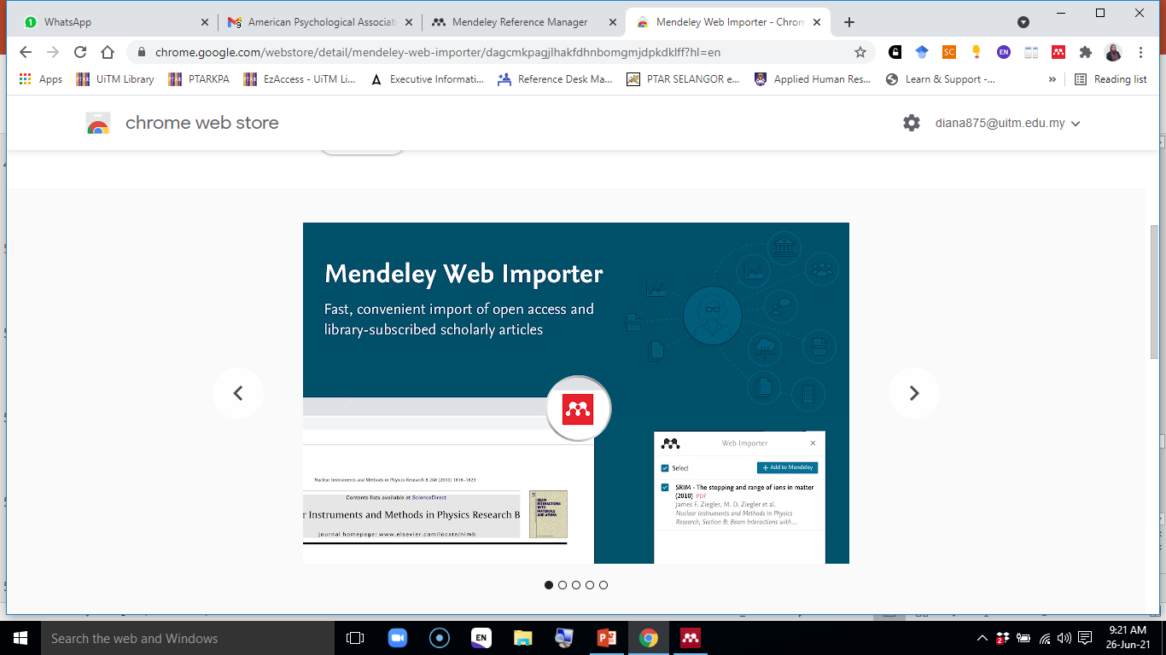
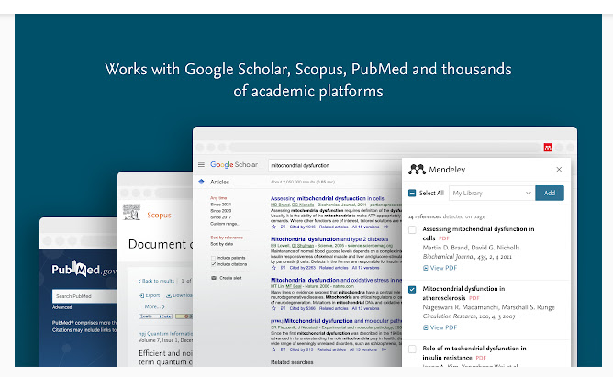
WEB IMPORTER – CHROME EXTENSION
https://chrome.google.com/webstore/detail/mendeley-web-importer/dagcmkpagjlhakfdhnbomgmjdpkdklff?hl=en

Slide 51
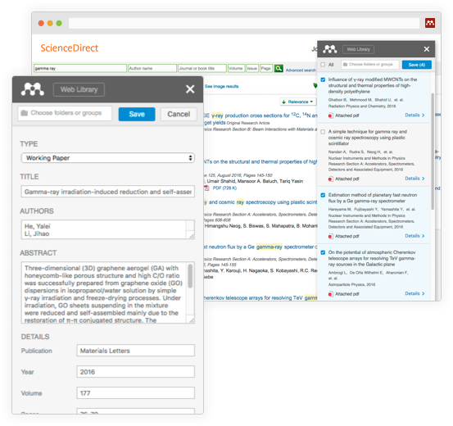
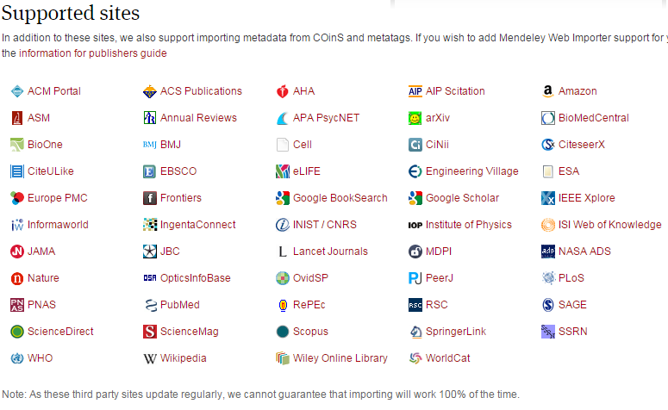
Step 1: Install Web Importer & www.java.com Updates
www.mendeley.com/import
To install the Web Importer, drag & drop the bookmarklet to your Favorites/Bookmarks
in your internet browser
The Web Importer helps you grab citations off the web

Slide 52
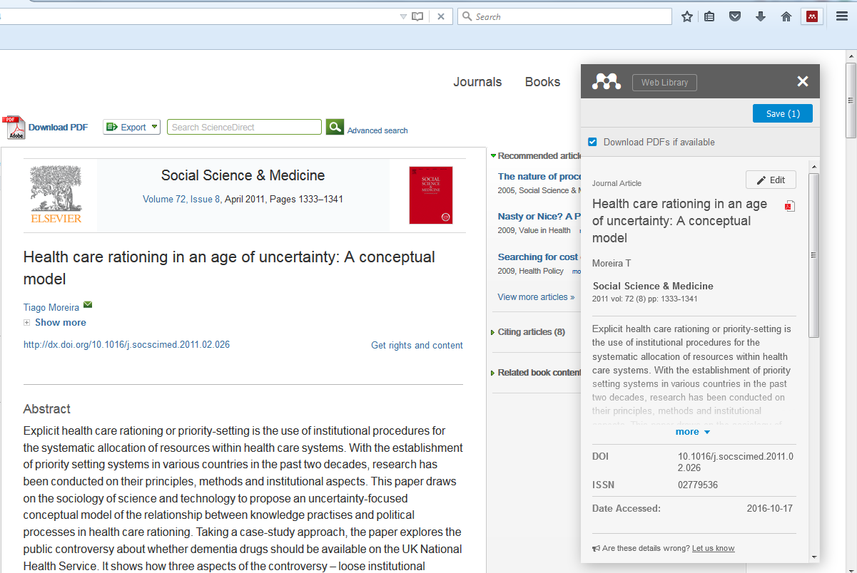
Step 2 : Click Web Importer & Save
On the web page with the reference(s) you want to capture: click on the bookmarklet…
…then click on “Save” to import the reference/paper to your Mendeley library. If possible/available, also the associated PDF will be imported.

Slide 53
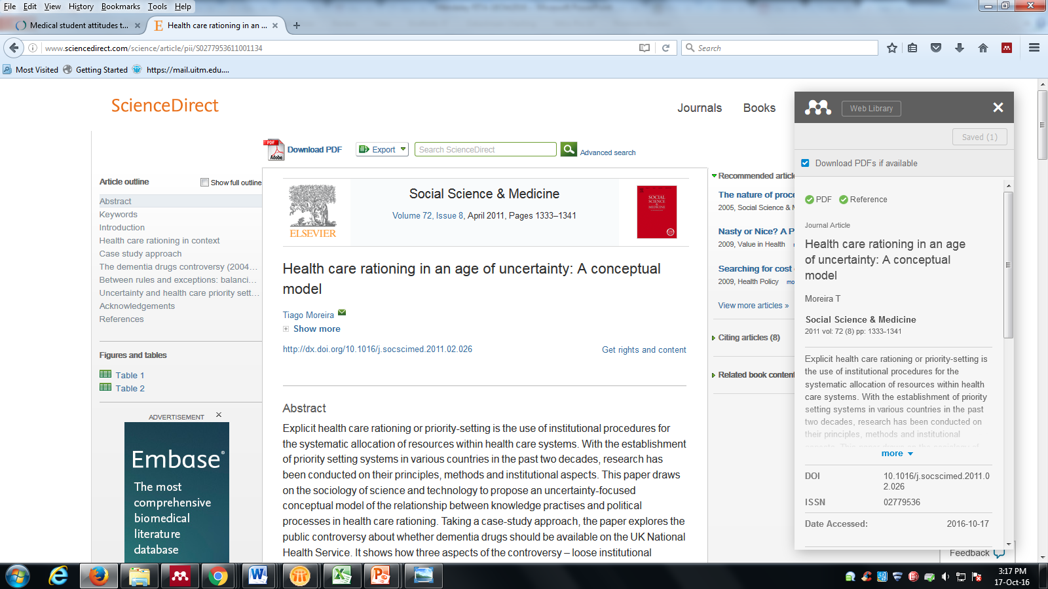
Step 3 : Check PDF & Reference Available
PDF
Reference
Please make sure “PDF” and “REFERENCE” is available

Slide 54
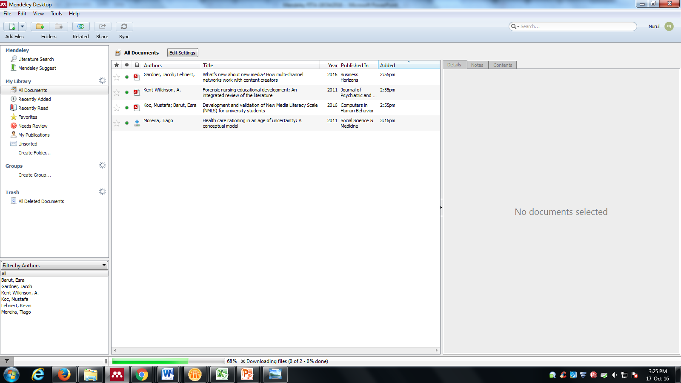
Step 4 : Open Mendeley Desktop > Click SYNC
…After Sync completed > Mendeley will automatically imported PDF file to your library.

Slide 55
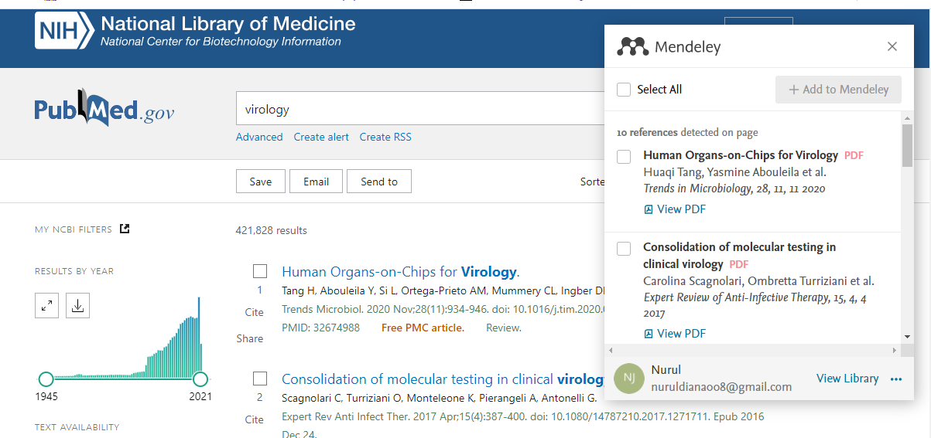
Using Web Importer – NLM @ Pubmed
https://pubmed.ncbi.nlm.nih.gov

Slide 56
Using Web Importer – NLM @ Pubmed
https://pubmed.ncbi.nlm.nih.gov

Slide 57
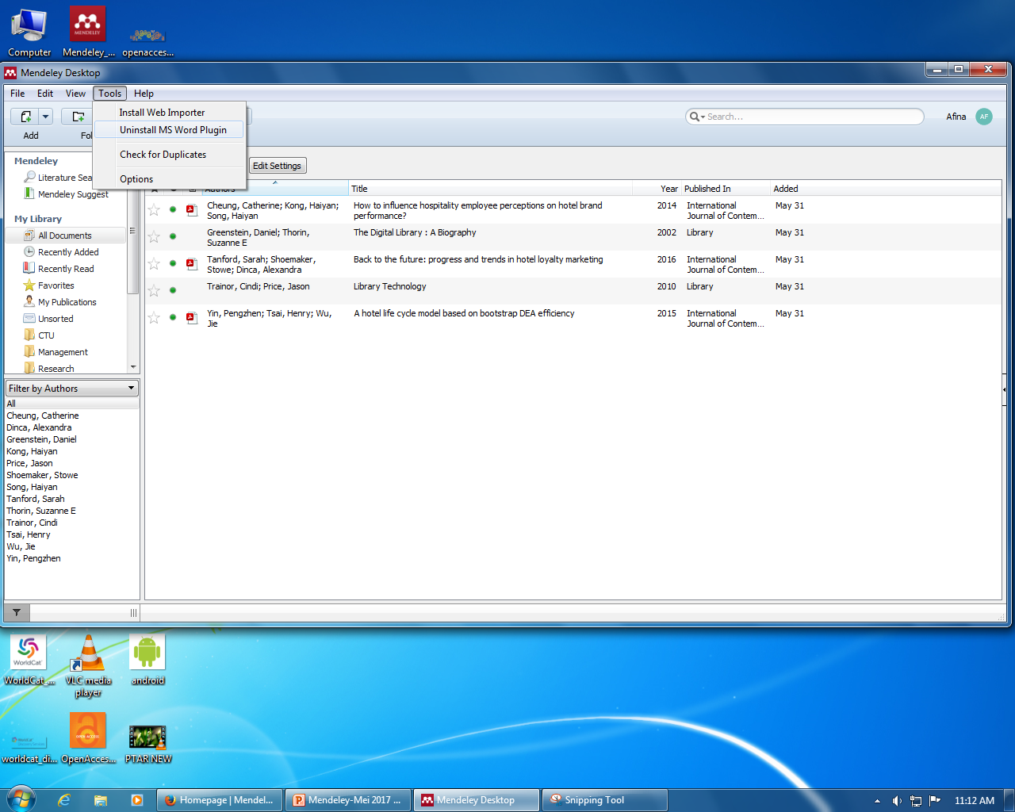

Citing in MS Word
Open Mendeley Desktop > Install MS Word plugin
Choose style.
Open Word > References > Click on “Insert Citation” in Word

Slide 58
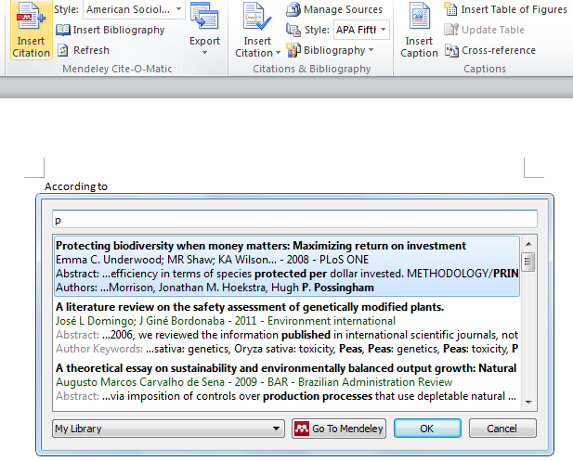

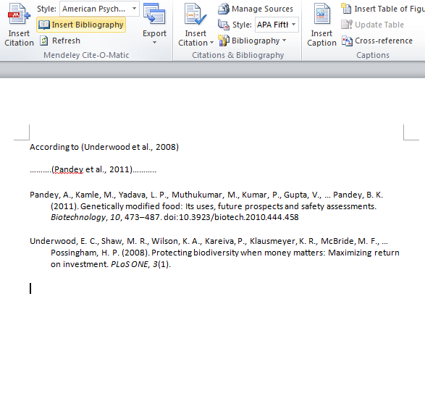

Generate a bibliography in one click!
Key in either author’s name or title of the reference
Citation will show up based on selected style

Slide 59
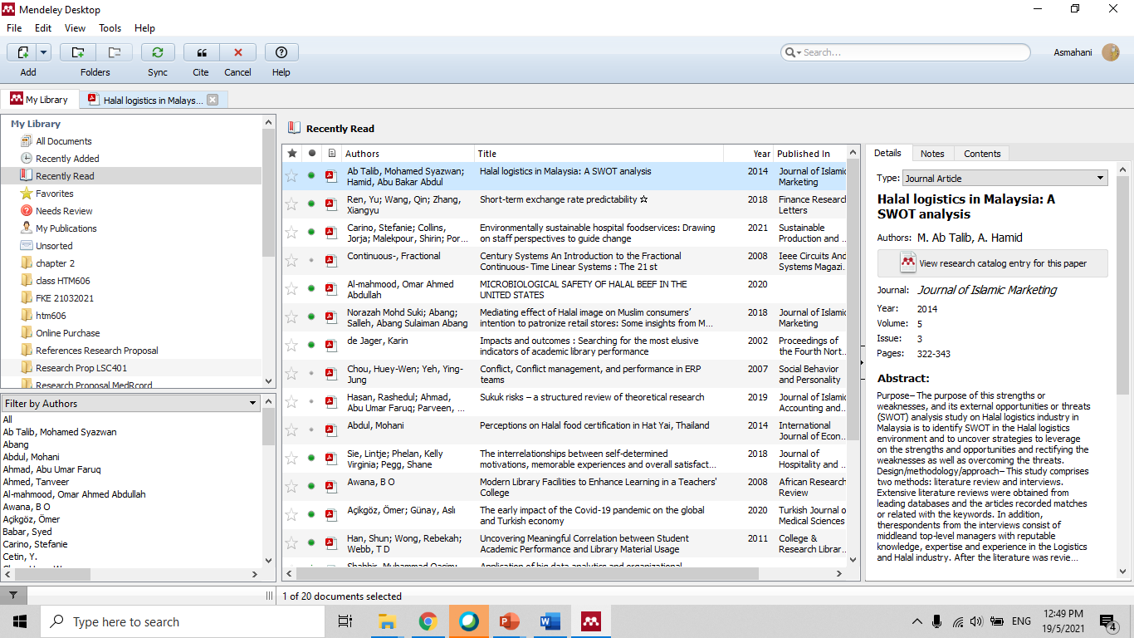
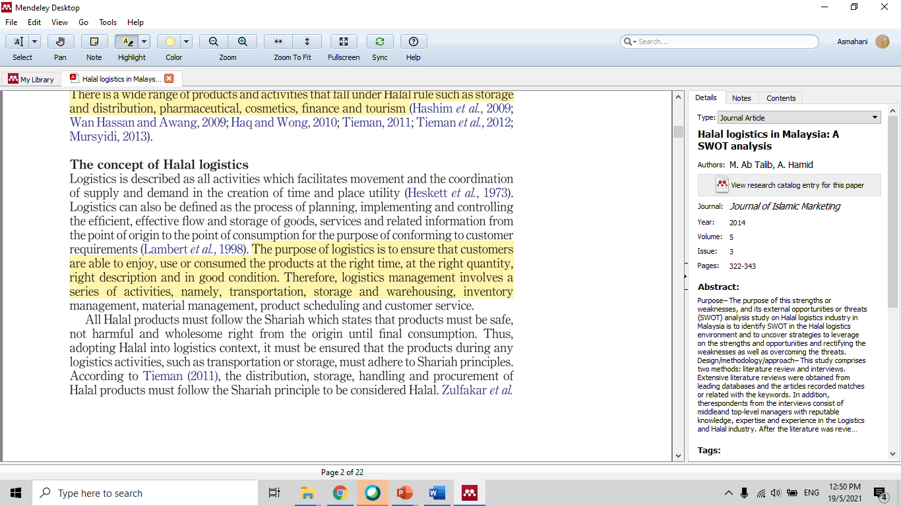
Choosing article title from list at library.
Current reading article at Mendeley.

Slide 60
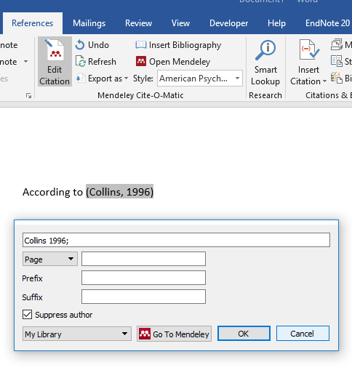
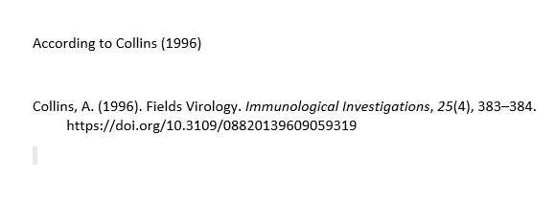
Excluding an author in-text
Place your cursor anywhere within the highlighted section of your reference in your document.
2. Click the 'Edit Citation' button in the Mendeley toolbar. When the pop-up opens, click on the reference you would like to edit.
3. In the dropdown menu that appears, click the box next to 'Suppress author’.
4. Keep Citation edit ? > Click Keep Manual Edit
5. The author field will now be removed from your in-text citation.
Collins (1996)

Slide 61
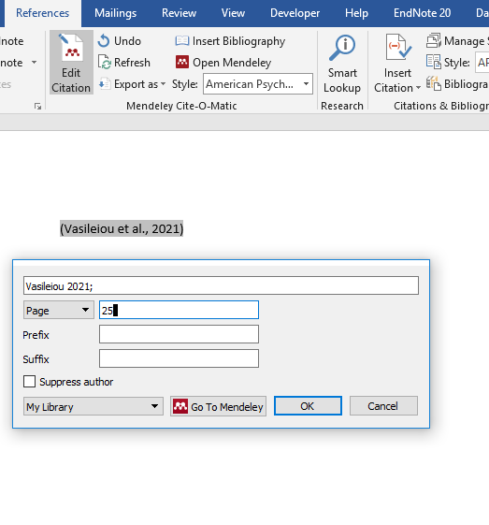
Adding page numbers
1. Place your cursor anywhere within the highlighted section of your reference in the Word document.
2. Click the 'Edit Citation' button in the Mendeley toolbar. When the pop-up opens, click on the reference you would like to add page numbers to.
3. In the dropdown menu that appears, enter your page number(s) in the field that says 'Page’ eg
4. The page number will be added to your in-text citation in the correct style eg
(Vasileiou et al., 2021, p. 25)
Note: You can also use this dropdown list to add other information if required eg paragraph or part number. Simply select the type of information you are providing from the dropdown list and fill out the adjacent field.

Slide 62
Secondary referencing
Secondary referencing involves referring to a document which you have not seen, but which has been used and cited by someone else. This is not generally good academic practice. You should make an effort to track down the original work and reference that.
Citation of an article implies that you have personally read the cited work. If you quote from a work that has been mentioned in something else you have read, but you have not read the original source, then you must make it a secondary reference. It is important to make it clear that you have not read the original work.
Complete reference to the original journal article, book or other item.
Cited in: Complete reference to the item you have read: Page number where the original source was quoted
Examples of a secondary references:
Meijer. J.H. and Robbers, Y. (2014) Wheel running in the wild. Proceedings of the Royal Society B281(1786):20140210. Cited in: Something About Science (2017) A picture is worth a thousand words. Something About Science http://www.somethingaboutscience.com/index.php/nggallery/slideshow?page_id=1165 Accessed 12 February 2017.
Senogles, H. (1938) The standing stones of Anglesey. Anglesey antiquarian society and field club transactions. 38, 24 – 29. Cited in: Dyer, J. (1990) Ancient Britain. University of Philadelphia Press: 58.
Examples of citing in the text of your work: (Senogles 1938, cited in Dyer 1990: 58) says that… or Senogles (1938) cited in Dyer (1990: 58) says that….
Source: https://www.bradford.ac.uk/library/find-out-about/referencing/referencing/citing-within-the-text-of-written-work/#d.en.35107

Slide 63

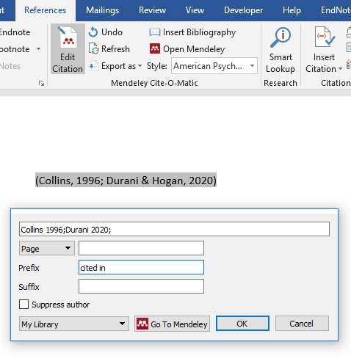
Using the 'Prefix' and 'Suffix' fields
1. Place your cursor anywhere within the highlighted section of your reference in your document.
2. Click the 'Edit Citation' button in the Mendeley toolbar. When the pop-up opens, click on the reference you would like to add a prefix or suffix to.
3. Type the information you would like to display in the Prefix or Suffix field, including the punctuation required.
4. Select OK to save and update your citation.
For example, if you are citing a secondary reference in APA style, you can add 'as cited in ' to the Prefix field, and your reference will look like this:
(cited in Collins, 1996; Durani & Hogan, 2020) says that .......

Slide 64





USER EDUCATION TEAM
EZA ELIANA HJ ABDUL WAHID
SENIOR LIBRARIAN
RESEARCH SUPPORT UNIT
TUN ABDUL RAZAK LIBRARY
03-5544 3742
eza080@uitm.edu.my
MUHAMMAD AZRUL NIZAM BIN ABDUL RAHMAN
LIBRARIAN
RESEARCH SUPPORT UNIT
TUN ABDUL RAZAK LIBRARY
03-5544 3736
azrulnizam@uitm.edu.my

Slide 65




USER EDUCATION TEAM (FACULTY LIBRARIES)
SITI ROHAYU BINTI MOHAMAD YUSOF
SENIOR LIBRARIAN
TUN ABDUL RAZAK LIBRARY
(BUILT ENVIRONMENT)
03-5544 4392
sitirohayu@uitm.edu.my
MASNIDA HANIM BINTI ROJIKIN
SENIOR LIBRARIAN
TUN ABDUL RAZAK LIBRARY
(ENGINEERING)
03-5544 3812
idahanim@uitm.edu.my
MOHD HAZRUL BIN MOHD HUSSIN
SENIOR LIBRARIAN
TUN ABDUL RAZAK LIBRARY
(SCIENCE & TECHNOLOGY)
03-5544 3811
hazrul@uitm.edu.my
HANANI BINTI ROJIKIN
SENIOR LIBRARIAN
TUN ABDUL RAZAK LIBRARY
(LAW)
03-5544 3738
hanani_rojikin@uitm.edu.my

Slide 66

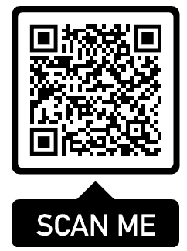
ATTENDANCE
SAMPLE

Slide 67

SURVEY
SAMPLE

Slide 68

THANK YOU
PERPUSTAKAAN TUN ABDUL RAZAK, UiTM

